Slide 1
Trust in Formal Methods Toolchains
Arie Gurfinkel
Software Engineering Institute
Carnegie Mellon University
July 14, 2013
VeriSure

Slide 2
Copyright 2013 Carnegie Mellon University
This material is based upon work funded and supported by the Department of Defense under Contract No. FA8721-05-C-0003 with Carnegie Mellon University for the operation of the Software Engineering Institute, a federally funded research and development center.
Any opinions, findings and conclusions or recommendations expressed in this material are those of the author(s) and do not necessarily reflect the views of the United States Department of Defense.
NO WARRANTY. THIS CARNEGIE MELLON UNIVERSITY AND SOFTWARE ENGINEERING INSTITUTE MATERIAL IS FURNISHED ON AN “AS-IS” BASIS. CARNEGIE MELLON UNIVERSITY MAKES NO WARRANTIES OF ANY KIND, EITHER EXPRESSED OR IMPLIED, AS TO ANY MATTER INCLUDING, BUT NOT LIMITED TO, WARRANTY OF FITNESS FOR PURPOSE OR MERCHANTABILITY, EXCLUSIVITY, OR RESULTS OBTAINED FROM USE OF THE MATERIAL. CARNEGIE MELLON UNIVERSITY DOES NOT MAKE ANY WARRANTY OF ANY KIND WITH RESPECT TO FREEDOM FROM PATENT, TRADEMARK, OR COPYRIGHT INFRINGEMENT.
This material has been approved for public release and unlimited distribution.
This material may be reproduced in its entirety, without modification, and freely distributed in written or electronic form without requesting formal permission. Permission is required for any other use. Requests for permission should be directed to the Software Engineering Institute at permission@sei.cmu.edu.
DM-0000507

Slide 3



About Me
Researcher at Carnegie Mellon Software Engineering Institute
Working on Software Model Checking and Static Analysis
Developer of many verification tools and libraries
  Xchek
  TLQSolver
  Yasm
  Linear Decision Diagrams
  Whale
  UFO
  Vinta
  REK
UFO/Vinta won the 2nd Software Verification Competition (SVCOMP)

Slide 4
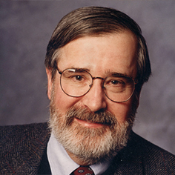
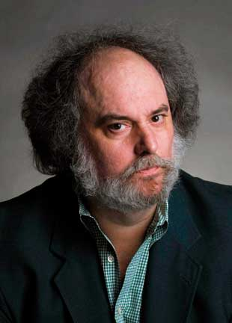
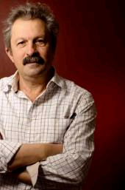
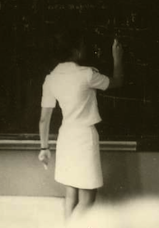
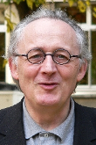
Automated Software Analysis
Program
Automated
Analysis
Correct + Proof
Property
Incorrect + Counterexample
Software Model Checking with Predicate Abstraction
e.g., Microsoft’s SDV
Abstract Interpretation with Numeric Abstraction
e.g., ASTREE, Polyspace

Slide 5
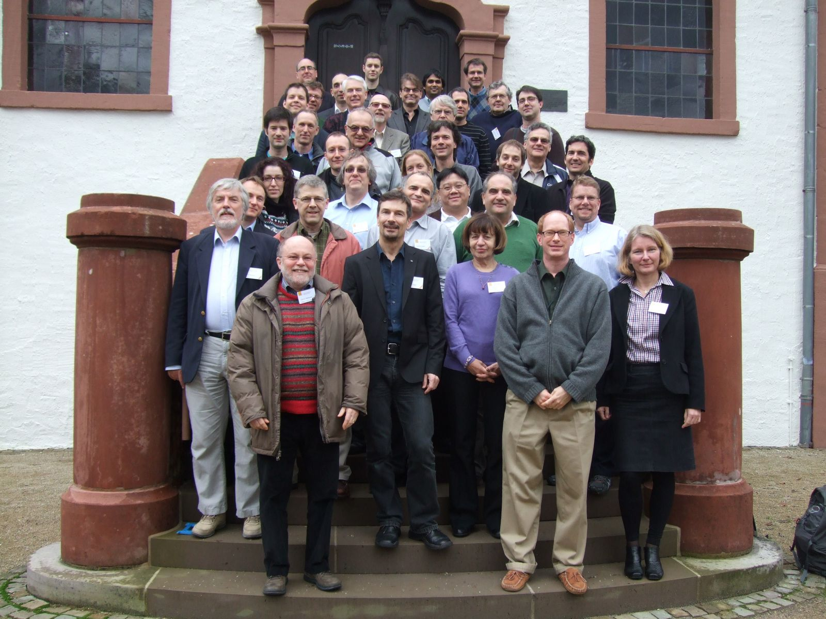
Software Certification: Methods and Tools
Dagstuhl Seminar 13051: http://www.dagstuhl.de/13051

Slide 6
Idealized Development w/ Formal Methods
Design
Develop
Verify (with FM)
Certify
Deploy
No expensive testing!
  Verification is exhaustive
Simpler certification!
  Just check formal arguments
Can we trust formal methods tools? What can go wrong?

Slide 7
Trusting Automated Verification Tools
How should automatic verifiers be qualified for certification?
What is the basis for automatic program analysis (or other automatic formal methods) to replace testing?
Verify the verifier
  (too) expensive
  verifiers are often very complex tools
  difficult to continuously adapt tools to project-specific needs
Proof-producing (or certifying) verifier
  Only the proof is important – not the tool that produced it
  Only the proof-checker needs to be verified/qualified
  Single proof-checker can be re-used in many projects

Slide 8

Evidence Producing Analysis
do not trust
“easy” to verify
Active research area
  proof carrying code, certifying model checking, model carrying code etc.
  Few tools available. Some preliminary commercial application in the telecom domain.
  Static context. Good for ensuring absence of problems.
  Low automation. Applies to source or binary. High confidence.
EPA
Program P
Proof X
Property Q
X witnesses that P satisfies Q. X can be objectively and independently verified. Therefore, EPA is outside the Trusted Computing Base (TCB).
Not that simple in practice !!!

Slide 9
An In-Depth Look…
Hard to get right
Hard to get right
No + Counterexample
Hard to verify
Environment model
Low level property
Program = (Text, Semantics)
Front-End
VC
Verifier
Diff sem used by diff tools
Compiler
Yes + Proof
Proof Checker
Executable
Bad
Real Env
Hardware
?=?
Good
Bad
Good
Notes:
Many things can go wrong even when a complete, consistent, and sound proof was produced:
semantics used by FE and Compiler can differ
Environment model and Real Environment can differ
Low-level property may not capture high-level one
Question: is there an assurance case for qualifying and using automated verification tools?

Slide 10
Five Hazards (Gaps) of Automated Verification
Soundness Gap
  Intentional and unintentional unsoundness in the verification engine
  e.g., rational instead of bitvector arithmetic, simplified memory model, etc.
Semantic Gap
  Compiler and verifier use different interpretation of the programming language
Specification Gap
  Expressing high-level specifications by low-level verifiable properties
Property Gap
  Formalizing low-level properties in temporal logic and/or assertions
Environment Gap
  Too coarse / unsound / unfaithful model of the environment

Slide 11
Mitigating The Soundness Gap

Slide 12
Mitigating The Soundness Gap
Proof-producing verifier makes the soundness gap explicit
  the soundness of the proof can be established by a “simple” checker
  all assumptions are stated explicitly
Open questions:
  how to generate proofs for explicit Model Checking
    e.g., SPIN, Java PathFinder
  how to generate partial proofs for non-exhaustive methods
    e.g., KLEE, Sage
  how to deal with “intentional” unsoundness
    e.g., rational arithmetic instead of bitvectors, memory models, …

Slide 13
Mitigating the Property Gap:
Vacuity in Model Checking
Joint work with Marsha Chechik

Slide 14
Vacuity: Mitigating Property Gap
Model Checking Perspective: Never trust a True answer from a Model Checker
When a property is violated, a counterexample is a certificate that can be examined by the user for validity
When a property is satisfied, there is no feedback!
It is very easy to formally state something very trivial in a very complex way

Slide 15
MODULE main
VAR
send : {s0,s1,s2};
recv : {r0,r1,r2};
ack : boolean;
req : boolean;
ASSIGN
init(ack):=FALSE;
init(req):=FALSE;
init(send):= s0;
init(recv):= r0;
next (send) :=
case
send=s0:{s0,s1};
send=s1:s2;
send=s2&ack:s0;
TRUE:send;
esac;
next (recv) :=
case
recv=r0&req:r1;
recv=r1:r2;
recv=r2:r0;
TRUE: recv;
esac;
next (ack) :=
case
recv=r2:TRUE;
TRUE: ack;
esac;
next (req) :=
case
send=s1:FALSE;
TRUE: req;
esac;
SPEC AG (req -> AF ack)
Notes:
Do a demo with NuSMV

Slide 16
Can A TRUE Result of Model Checker be Trusted
Antecedent Failure [Beatty & Bryant 1994]
  A temporal formula AG (p ⇒ q) suffers an antecedent failure in model M iff M ⊧ AG (p ⇒ q) AND M ⊧ AG (¬p)
Vacuity [Beer et al. 1997]
  A temporal formula ϕ is satisfied vacuously by M iff there exists a sub-formula p of ϕ such that M ⊧ ϕ[p←q] for every other formula q
  e.g., M ⊧ AG (r ⇒ AF a) and M ⊧ AG (r ⇒ AF ¬a) and AG (r ⇒ AF ¬r) and AG (r ⇒ AF FALSE), …

Slide 17
Vacuity Detection: Single Occurrence
ϕ is vacuous in M iff there exists an occurrence of a subformula p such that
  M ⊧ ϕ[p ← TRUE] and M ⊧ ϕ[p ← FALSE]
M ⊧ AG (req ⇒ AF TRUE)
M ⊧ AG TRUE
M ⊧ AG (req ⇒ AF FALSE)
M ⊧ AG ¬req
M ⊧ AG (TRUE ⇒ AF ack)
M ⊧ AG AF ack
M ⊧ AG (FALSE ⇒ AF ack)
M ⊧ AG TRUE

Slide 18
Detecting Vacuity in Multiple Occurrences
Is AG (req ⇒ AF req) vacuous? Should it be?
Is AG (req ⇒ AX req) vacuous? Should it be?
M ⊧ AG (TRUE ⇒ AF TRUE)
M ⊧ AG TRUE
M ⊧ AG (FALSE ⇒ AF FALSE)
M ⊧ AG TRUE
M ⊧ AG (TRUE ⇒ AX TRUE)
M ⊧ AG TRUE
M ⊧ AG (FALSE ⇒ AX FALSE)
M ⊧ AG TRUE

Slide 19
Detecting Vacuity in Multiple Occurrences: ACTL
An ACTL ϕ is vacuous in M iff there exists an a subformula p such that
  M ⊧ ϕ[p ← x] , where x is a non-deterministic variable
Is AG (req ⇒ AF req) vacuous? Should it be?
Is AG (req ⇒ AX req) vacuous? Should it be?
Always vacuous!!!
M ⊧ AG (x ⇒ AF x)
M ⊧ AG TRUE
Not vacuous!!!
M ⊧ AG (x ⇒ AX x)
can’t reduce

Slide 20
Mitigating the Environment Gap:
Environment Guarantee
Joint work with Marsha Chechik and Mihaela Gheorghiu

Slide 21
Validity of Vacuity Results
Properties may hold for wrong reasons
vacuity detection [Beer’97] – are all parts of property relevant?
  Example: “every time there is a request for a resource, it is fulfilled”
  ... holds if there are no requests!
Pros
  May help identify errors
Cons
  General definition yields many false positives
    Vacuous but not “wrong”
  Hard to go from a violation to a fix
  Property-centric

Slide 22
System Structure
Interface
Constructed
for
verification
What we
are
building
Environment
Component
Can we
trust it?
Traffic Light Example:
Crossing
environment
sensor
Traffic
light
controller
light

Slide 23
Our Goal
Model-centric identification of threats to validity
Pros:
  Ease of understanding
  No false positives
    each reported error is present in the model
Definition: a property is guaranteed by environment if component is irrelevant for verification
Property
P
Any Component
Environment
Component
Notes:
Our goal: detecting environment guarantees for state machine models
Say: checking propeties of the interaction between the model and the controller

Slide 24
Formalizing Environment Guarantees
An Environment E is a tuple (V, R)
  V - environment and component variables (Ve,Vc)
  R – environment rules
A (Closed) Model M is a tuple (V, R, C)
  ... a closure of E with component rules C
Formal Definition:
  Environment E guarantees a property P iff
  for all closures M of E, M satisfies P

Slide 25
Special Case: Universal Properties
Universal properties: about all executions
  AG p (“in all states”)
  AF p (“on all paths”)
“Worst” component is the most non-deterministic
  Component variables change non-deterministically at each step
  = No constraints on component variables
Theorem
  A universal property is guaranteed by the environment iff it holds under the worst component.

Slide 26

Universal Properties: Implementation
Syntactic
Closed
Model
Compose with
Worst Component
Yes
Environment
Guarantee
Env
Model Check
No
Closed
Model
Yes
Component
Compose
Model Check
No

Slide 27


Case Study: TCAS II
[Leveson et al. 94]
(Air) Traffic Collision Avoidance System
  Avoids collision between planes flying in the same space
  … by producing advisories to pilot for direction and strength of move
An example advisory:
  “CLIMB at 1500 to 2000 fpm”

Slide 28
TCAS II Model
NuSMV model [Chan et al. 98]
Sensors
Traffic,
Own Aircraft
Altitude, etc.
Advisory
Other
Aircraft
Speed,Altitude,
Direction, etc.

Slide 29
TCAS II Properties
Deterministic Advisory
  advisory changes in a deterministic fashion
Increase Climb/Descent
  increase climb does not change immediately to increase descent
Direction of the Other Aircraft
  direction does not change unless noticed by Own Aircraft
Advisories are Consistent
  direction (Up/Down) and strength (Pos/Neg) match

Slide 30
Experimental Results

Slide 31

Mitigating the Semantic Gap

Slide 32
Mitigating the Semantics Gap
Combine a compile and a verifier in a single architecture
Use compiler intermediate representation as the “ground truth”
Propagate verification certificates from the verifier down to the compiled code

Slide 33
V&C Architecture (Verifier & Compiler)
Property
Program
Frontend
Replay
Trace
Cex
Legend
P – prog in ir
S – simplified
C – self-certified ir
P
Simplify
S
Verify
Embed
Cert(P)
Adapt
Cert(S)
Yes
Compile
Certified
Executable
Validate
C
No

Slide 34
Proofs are “Witnesses” to Success*
lwz %r0,8(%r31)
cmpwi %cr7,%r0,9
bgt %cr7,.L4
bl BEGIN
li %r0,0
stw %r0,16(%r31)
lwz %r0,8(%r31)
cmpwi %cr7,%r0,0
blt %cr7,.L5
lwz %r0,8(%r31)
cmpwi %cr7,%r0,9
bgt %cr7,.L5
li %r0,1
stw %r0,16(%r31)
.L5:
lwz %r3,16(%r31)
crxor 6,6,6
bl INV
lwz %r9,8(%r31)
addi %r0,%r9,1
stw %r0,8(%r31)
b .L3
Program invariants are embedded as
BEGIN and INV calls in compiled code.
while(n < 10) {
BEGIN();
INV((n >= 0) && (n < 10));
n = n + 1;
}
These invariants are sufficient
to construct a proof of conformance
to a claim (policy)
*Chaki, S., Ivers, J., Lee, P., Wallnau, K., Zeilberger, N., “Model-Driven Construction of Certified Binaries”, Proceedings of the ACM/IEEE 10th International Conference on Model Driven Engineering Languages and Systems, 2007, LNCS 4735, pp 666-681.
Embed

Slide 35
Adapt: From Low-Level to High-Level Certificate
Formal intermediate representation
Simplified/Transformed intermediate representation
P
S
Cert(P)
Adapt
Cert(S)
Certificate / Invariant for P
Certificate / Invariant for S

Slide 36
Iteratively Guess a Simulation and Adapt Cert.
P
Guess simulation between CFGs
W_{CFG}
Extend to states
S
W
No
Is adapted certificate safe?
Refine
Cert(S)
Yes

Slide 37
Five Hazards (Gaps) of Automated Verification
Soundness Gap
  Intentional and unintentional unsoundness in the verification engine
  e.g., rational instead of bitvector arithmetic, simplified memory model, etc.
Semantic Gap
  Compiler and verifier use different interpretation of the programming language
Specification Gap
  Expressing high-level specifications by low-level verifiable properties
Property Gap
  Formalizing low-level properties in temporal logic and/or assertions
Environment Gap
  Too coarse / unsound / unfaithful model of the environment

Slide 38
Contact Information
Presenter Arie Gurfinkel RTSS Telephone: +1 412-268-5800 Email: arie@cmu.edu | U.S. mail: Software Engineering Institute Customer Relations 4500 Fifth Avenue Pittsburgh, PA 15213-2612 USA
Web: www.sei.cmu.edu http://www.sei.cmu.edu/contact.cfm | Customer Relations Email: info@sei.cmu.edu Telephone: +1 412-268-5800 SEI Phone: +1 412-268-5800 SEI Fax: +1 412-268-6257

Slide 39
Proof-Producing Verifier
no need to trust
Program
+
Property
Verifier
No + Counterexample
Yes + Proof
“easy” to verify
Proof Checker
Bad
Good
But things are not that simple in practice !!!

