Slide 1
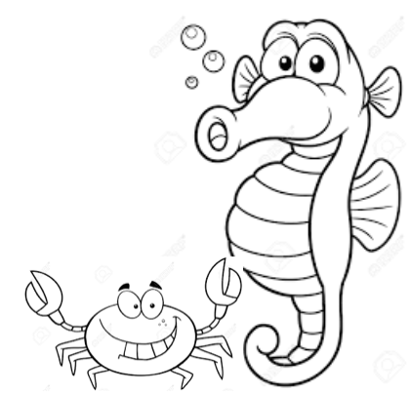

SeaHorn: Software Model Checking with SMT and AI
Arie Gurfinkel
Department of Electrical and Computer Engineering
University of Waterloo
Waterloo, Ontario, Canada
http://ece.uwaterloo.ca/~agurfink
based on work with Teme Kahsai, Jorge Navas, Anvesh Komuravelli, Jeffrey Gennari, Ed Schwartz, and many others …
Notes:
Title Slide
Title and Subtitle text blocks should not be moved from their position if at all possible.

Slide 2


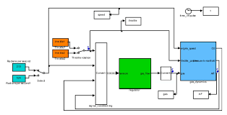
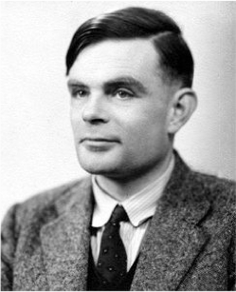
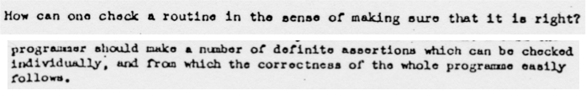
Automated (Software) Verification
Program and/or model
Correct
Automated
Reasoning
Incorrect
Alan M. Turing. 1936: “Undecidable”
Alan M. Turing. ”Checking a large routine” 1949

Slide 3
Automated Software Analysis
Model Checking
[Clarke and Emerson, 1981] [Queille and Sifakis, 1982]
Abstract Interpretation
Symbolic Execution
[Cousot and Cousot, 1977 ]
[King, 1976 ]
Notes:
The field of software verification has been growing rapidly during the last decades with many available techniques

Slide 4
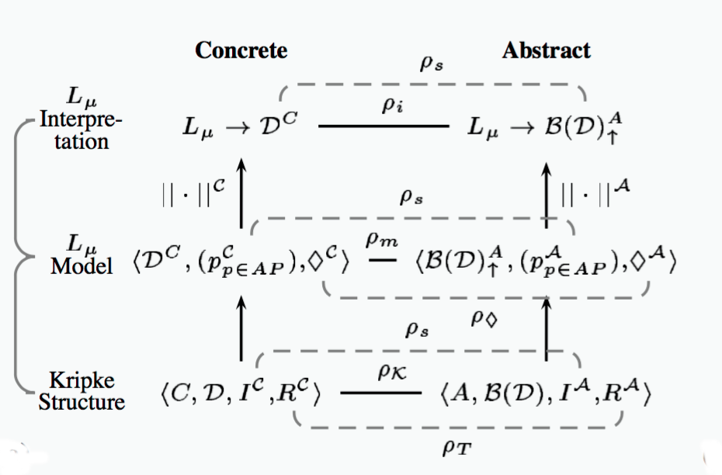
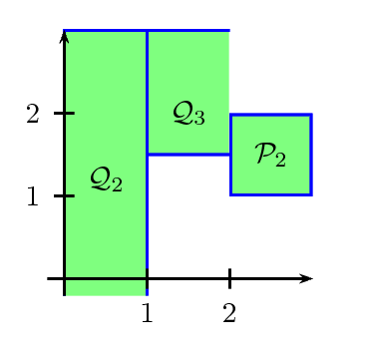

2000
BLAST
VMCAI
started PhD in MC at UofT
multi-valued model checking
VMCAI’06
2006
SMC Yasm: safety, liveness, multi-valued abstraction for MC
2010
Boxes abstract domain (SAS’10)
2012
UFO: MC + AI: SAS’12
SV-COMP
2015
SeaHorn: MC (Spacer) and AI (Crab)

Slide 5
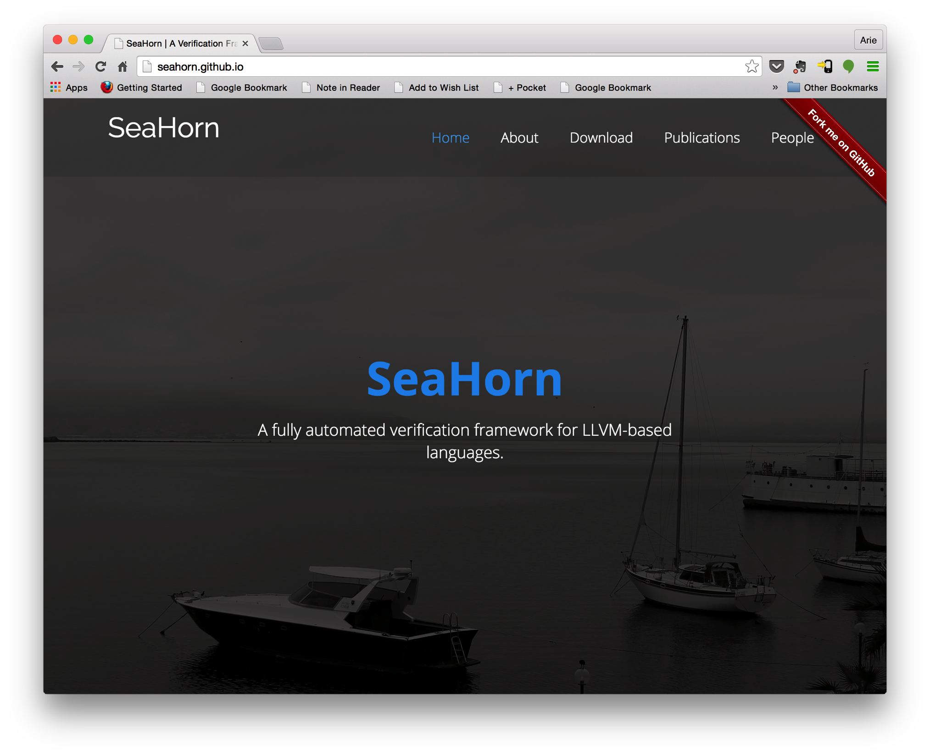
http://seahorn.github.io

Slide 6
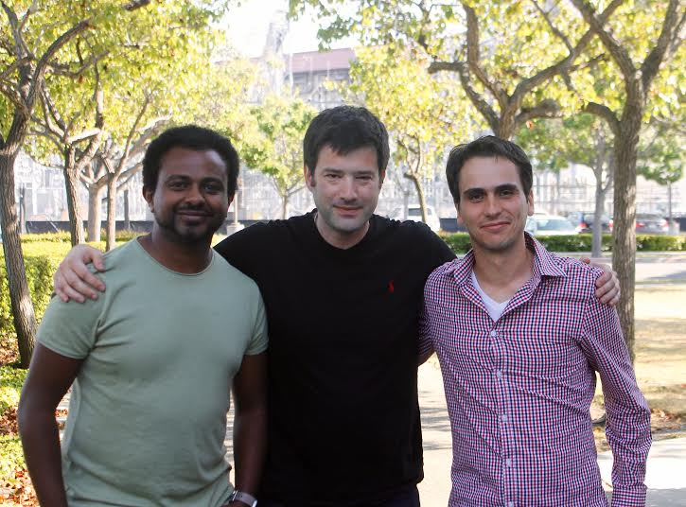
Temesghen Kahsai (Amazon)
Jorge Navas (SRI)
http://seahorn.github.io

Slide 7
Automated Verification
Deductive Verification
  A user provides a program and a verification certificate
    e.g., inductive invariant, pre- and post-conditions, function summaries, etc.
  A tool automatically checks validity of the certificate
    this is not easy! (might even be undecidable)
  Verification is manual but machine certified
Algorithmic Verification
  A user provides a program and a desired specification
    e.g., program never writes outside of allocated memory
  A tool automatically checks validity of the specification
    and generates a verification certificate if the program is correct
    and generates a counterexample if the program is not correct
  Verification is completely automatic – “push-button”

Slide 8
Algorithmic Logic-Based Verification
Safety Properties
Program + Spec
Verification Condition (in Logic)
Decision Procedure
Constrained Horn Clauses
Spacer
Yes
No

Slide 9
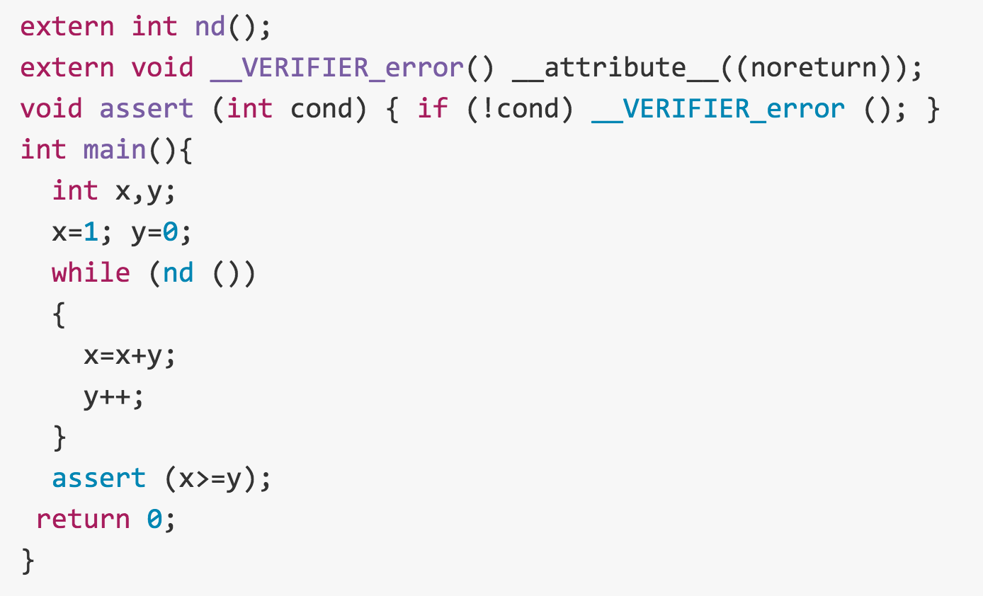

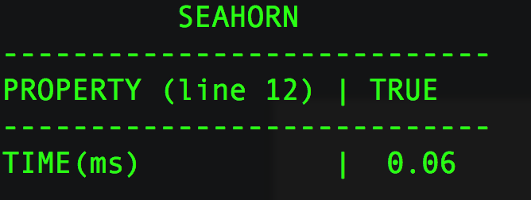


SeaHorn Usage
Example: in test.c, check that x is always greater than or equal to y
test.c
SeaHorn result:
SeaHorn command:

Slide 10
SeaHorn Workflow
Property Spec
Verification Environment
Property Checker
Code Under Analysis (CUA)
Verification Problem (VP)
SeaHorn
Good + Verification Certificate (Cert)
Bad + Counterexample (CEX)
TestGen
Test harness (Test)
Notes:
CUA – Code Under Analysis. A piece of code to be analyzed. Device driver. Library functionality. Small complete program.
Property Spec: specialization of the property as supported by the property checker
Verification Environment: stubs implementing system functionality that is outside of CUA (e.g., libc, memcpy, malloc, system calls, etc.)
Property Checker: instruments a program with a property monitor. See Property Checker slide for details.
Verification Problem: a slide of the program with an embedded monitor
SeaHorn outputs either that all is good and a certificate, or that property failed and a counterexample.
TestGen: test generator based on cex from SeaHorn.
Test harness: stubs for environment and stimulai of CUA (inputs, library functions, external memory, etc.) so that CUA shows a run that fails the property.

Slide 11
SeaHorn workflow components
Code Under Analysis (CUA)
  code being analyzed. Device driver, component, library, etc.
Verification Environment
  stubs for the environment with which CUA interacts
  e.g., libc, memcpy, malloc, OS system calls, user input, socket, file, …
Property Checker
  static instrumentation of a program with a monitor that indicates when an error has happened
  similar to dynamic sanitizers, but can use verifier-specific API to perform symbolic actions
  property spec is specific to a property checker
Verification Problem
  a prepared instance of program with embedded assertions, potentially simplified by abstracting away irrelevant parts of execution
Test Gen
  generates a test harness that includes all stubs and stimuli to guide CUA to a property failure discovered by the verifier

Slide 12
Developing a Static Property Checker
A static property checker is similar to a dynamic checker
  e.g., clang sanitizer (address, thread, memory, etc.)
A significant development effort for each new property
  new specialized static analyses to rule out trivial cases
  different instrumentations have affect on performance
Developed by a domain expert
  understanding of verification techniques is useful (but not required)
  3-6 month effort for a new property
    but many things can be reused between similar properties
    e.g., memory safety, null-dereference, taint checking, use-after-free, etc.
SeaHorn property checkers:
  memory safety (out of bound uses, null pointer)
    ongoing work to improve scalability and usability
  taint analysis (being developed by Princeton)

Slide 13
Architecture of Seahorn

Slide 14
DEMO

Slide 15
SeaHorn Philosophy
Build a state-of-the-art Software Model Checker
  useful to “average” users
    user-friendly, efficient, trusted, certificate-producing, …
  useful to researchers in verification
    modular design, clean separation between syntax, semantics, and logic, …
Stand on the shoulders of giants
  reuse techniques from compiler community to reduce verification effort
    SSA, loop restructuring, induction variables, alias analysis, …
    static analysis and abstract interpretation
  reduce verification to logic
    verification condition generation
    Constrained Horn Clauses
Build reusable logic-based verification technology
  “SMT-LIB” for program verification

Slide 16
SeaHorn Memory Model
Block-based memory model
  each allocation (malloc/alloca/etc) creates a new object
  a pointer is a pair (id,off), called cell, where id is an object identifier and off is a positive numeric offset
  similar to the C memory model
Abstract Memory Model
  the number of allocation regions is finite
  allocation site is used as an object identifier
  custom pointer-analysis is used to approximate abstract points to graph
Pointer Analysis: Sea-DSA
  unification-based (like LLVM-DSA)
  context-, field-, and array-sensitive

Slide 17
Crab Abstract Interpretation Library
Crab – Cornucopia of Abstract Domains
  Numerical domains (intervals, zones, boxes)
  3rd party domains (apron, elina)
  arrays, uninterpreted functions, null, pointer
Language independent core with plugins for LLVM bitcode
  fixed-point engine
  widening / narrowing strategies
  crab-llvm : integrates LLVM optimizations and analysis of LLVM bitcode
Support for inter-procedural analysis
  pre-, post-conditions, function summaries
Extensible, publicly available on GitHub, open C++ API

Slide 18
Numeric Abstract Interpretation
Analysis is restricted to a fixed Abstract Domain
Abstract Domain ≡ “a (possibly infinite) set of predicates from a fixed theory” + efficient (abstract) operations
Common Numeric Abstract Domains
Abstract Domain | Abstract Elements
Sign | 0 < x, x = 0, x > 0
Box (or Interval) | c₁ ≤ x ≤ c₂
Octagon | ± x ± y ≤ c
Polyhedra | a₁x₁ + a₂x₂ + a₃x₃ + a₄ ≤ 0
Legend
x,y | program variables
c,c_{i},a_{i} | numeric constants

Slide 19

Abstract Interpretation w/ Box Domain (1)
Program
0<= x <=2
x := 0
while (x < 1000) {
x := x + 1;
}
assert (x == 1000);
0<= x <=1000
0<= x <=1
x = 0
0<= x <=2
x = 0
0<= x < 1000
0<= x <=1
widening
1<= x <=3
x = 1
1<= x <= 1000
1<= x <=2
x = 1000
Steps:
1
2
3
4
5
6
7
8
9
10
11
12
13
14

Slide 20
Abstract Domain as an Interface
interface AbstractDomain(V) :
  V – set of variables
  A – abstract elements
  E – expressions
  S – statements
α : E → A γ : A → E meet : A × A → A
isTop : A → bool isBot : A → bool join : A × A → A
leq : A × A → bool αPost : S → (A → A) widen : A × A → A
All operations are over-approximations, e.g.,
γ (a) || γ (b) ⇒ γ ( join (a, b) )
γ (a) && γ (b) ⇒ γ (meet (a,b) )
abstract
concretize
order
abstract transformer

Slide 21
Example: Box Abstract Domain
abstract
concretize
α
γ
1 ≤ x ≤ 10
(1, 10)
1 ≤ x ≤ 10
Definition of Operations
Examples
(a, b) meet (c, d) = (max(a,c), min(b,d))
(1, 10) meet (2, 12) = (2,10)
(a, b) join (c, d) = (min(a,c),max(b,d))
(1, 3) join (7, 12) = (1,12)
αPost (x := x + 1) ((a, b)) = (a+1, b+1)
(1, 10) + 1 = (2, 11)
over-approximation

Slide 22
Crab Abstract Domains
Numerical Domains
  interval with congruence: 0 <= x <= 10 && x mod 2 == 0
  zone: x – y <= k
  non-convex
    DisIntervals: x <= -1 || x >= 1
    Boxes: Boolean combinations of intervals
Symbolic Domains
  numeric domains extended with uninterpreted functions
  0 <= x <= 10 && y == f(…) && z == f(…) ➔ 0 <= x <= 10 && y = z
Array Domains
  array smashing: common properties of all array cells
  array graph domain:
Domains from Apron and Elina 3rd party libraries
  octagons, polyhedra, etc.

Slide 23
Architecture of Crab and Crab-Llvm
https://github.com/seahorn/crab-llvm

Slide 24
Abstract Interpretation w/ Box Domain (2)
Program
assume (i=1 || i=2)
if (i = 1)
x1 := i;
else if (i = 2)
x2 := -4;
if (i = 1)
assert (x1 > 0);
else if (i = 2)
assert (x2 < 0);
1 <= i <= 2
i=1
1 <= i <= 2
i=1 && x1=1
Loss of precision due to join
i=2
i=2 && x2=-4
i=1
False
Positive
i=2
Steps:
1
2
3
4
5
6
7
8

Slide 25
Precise Logic-based Program Verification
Low-Level Bounded Model Checking (BMC)
  decide whether a low level program/circuit has an execution of a given length that violates a safety property
  effective decision procedure via encoding to propositional SAT
High-Level (Word-Level) Bounded Model Checking
  decide whether a program has an execution of a given length that violates a safety property
  efficient decision procedure via encoding to SMT
What is an SMT-like equivalent for Safety Verification?
  Logic: SMT-Constrained Horn Clauses
  Decision Procedure: Spacer / GPDR
    extend IC3/PDR algorithms from Hardware Model Checking

Slide 26

Inductive Invariants
System State Space
Inv
Bad
Initial
  System S is safe iff there exists an inductive invariant Inv:
  Initiation: Initial $⊆$ Inv
  Safety: Inv $∩$ Bad = $∅$
  Consecution: TR(Inv) $⊆$ Inv
i.e., if s $∈$ Inv and s$↝$t
then t $∈$ Inv

Slide 27
Inductive Invariants
System State Space
Inv
Bad
Reach
Initial
  System S is safe iff there exists an inductive invariant Inv:
  Initiation: Initial $⊆$ Inv
  Safety: Inv $∩$ Bad = $∅$
  Consecution: TR(Inv) $⊆$ Inv
i.e., if s $∈$ Inv and s$↝$t
then t $∈$ Inv
System S is safe if Reach $∩$ Bad = $∅$

Slide 28
Symbolic Reachability Problem
P = (V, Init, Tr, Bad)
P is UNSAFE if and only if there exists a number N s.t.
P is SAFE if and only if there exists a safe inductive invariant Inv s.t.
Inductive
Safe

Slide 29
Constrained Horn Clauses (CHC)
A Constrained Horn Clause (CHC) is a FOL formula of the form
8 V . (Á ∧ p₁[X₁] ∧ … ∧ p_{n}[X_{n}] → h[X]),
where
  A is a background theory (e.g., Linear Arithmetic, Arrays, Bit-Vectors, or combinations of the above)
  Á is a constrained in the background theory A
  p₁, …, p_{n}, h are n-ary predicates
  p_{i}[X] is an application of a predicate to first-order terms

Slide 30
Horn Clauses for Program Verification
De Angelis et al. Verifying Array Programs by Transforming Verification Conditions. VMCAI'14
Bjørner, Gurfinkel, McMillan, and Rybalchenko:
Horn Clause Solvers for Program Verification

Slide 31
Horn Clauses for Concurrent / Distributed / Parameterized Systems
Hojjat et al. Horn Clauses for Communicating Timed Systems. HCVS'14
Rybalchenko et al. Synthesizing Software Verifiers from Proof Rules. PLDI'12
Gurfinkel et al. SMT-Based Verification of Parameterized Systems. FSE 2016
Hoenicke et al. Thread Modularity at Many Levels. POPL'17
Notes:
Rybalchenko Threader, Podelski POPL’17, Philipp Ruemer Workshop

Slide 32
From Programs to Logic
Program
CFG
CHC

Slide 33
IC3, PDR, and Friends (1)
IC3: A SAT-based Hardware Model Checker
  Incremental Construction of Inductive Clauses for Indubitable Correctness
  A. Bradley: SAT-Based Model Checking without Unrolling. VMCAI 2011
PDR: Explained and extended the implementation
  Property Directed Reachability
  N. Eén, A. Mishchenko, R. K. Brayton: Efficient implementation of property directed reachability. FMCAD 2011
PDR with Predicate Abstraction (easy extension of IC3/PDR to SMT)
  A. Cimatti, A. Griggio, S. Mover, St. Tonetta: IC3 Modulo Theories via Implicit Predicate Abstraction. TACAS 2014
  J. Birgmeier, A. Bradley, G. Weissenbacher: Counterexample to Induction-Guided Abstraction-Refinement (CTIGAR). CAV 2014

Slide 34
IC3, PDR, and Friends (2)
GPDR: Non-Linear CHC with Arithmetic constraints
  Generalized Property Directed Reachability
  K. Hoder and N. Bjørner: Generalized Property Directed Reachability. SAT 2012
SPACER: Non-Linear CHC with Arithmetic
  fixes an incompleteness issue in GPDR and extends it with under-approximate summaries
  A. Komuravelli, A. Gurfinkel, S. Chaki: SMT-Based Model Checking for Recursive Programs. CAV 2014
PolyPDR: Convex models for Linear CHC
  simulating Numeric Abstract Interpretation with PDR
  N. Bjørner and A. Gurfinkel: Property Directed Polyhedral Abstraction. VMCAI 2015
ArrayPDR: CHC with constraints over Airthmetic + Arrays
  Required to model heap manipulating programs
  A. Komuravelli, N. Bjørner, A. Gurfinkel, K. L. McMillan:Compositional Verification of Procedural Programs using Horn Clauses over Integers and Arrays. FMCAD 2015

Slide 35

Generalizing from Bounded Proofs
T, N=0
A counterexample of length N exists?
Yes
No, N:=N+1
SMT
Is a safe inductive invariant?
YES
No + bounded proof
SMT
Generalize proof
candidate Inv
SMT

Slide 36
Algorithm Overview
bounded safety
strengthen result

Slide 37
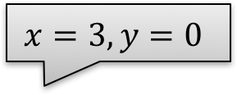
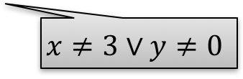
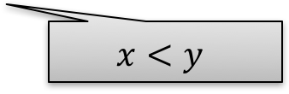

Spacer/IC3/PDR In Pictures: MkSafe
MkSafe
$$x=3,y=0$$
$$x=1,y=0$$
$$x<y$$
$$x≠3∨y≠0$$
F₂
F₃
F₁
F₀

Slide 38
Spacer/IC3/PDR in Pictures: Push
Push
Inductive
Algorithm Invariants
F_{i} → : Bad Init → F_{i}
F_{i} → F_{i+1} F_{i} ∧ Tr → F’_{i+1}

Slide 39
Spacer: Solving SMT-constrained CHC
Spacer: a solver for SMT-constrained Horn Clauses
  now part of Z3
    https://github.com/Z3Prover/z3 since commit 72c4780
    use option fixedpoint.engine=spacer
  development version at http://bitbucket.org/spacer/code
Supported SMT-Theories
  Best-effort support for many SMT-theories
    data-structures, bit-vectors, non-linear arithmetic
  Linear Real and Integer Arithmetic
  Quantifier-free theory of arrays
  Universally quantified theory of arrays + arithmetic (work in progress)
Support for Non-Linear CHC
  for procedure summaries in inter-procedural verification conditions
  for compositional reasoning: abstraction, assume-guarantee, thread modular, etc.

Slide 40
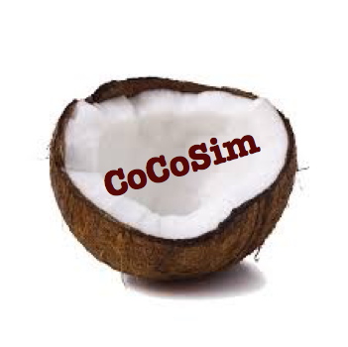


Logic-based Algorithmic Verification
Simulink
C/C++
concurrent /distributed systems
Java
SeaHorn
Lustre
CPR
Termination for C
T2
Spacer

Slide 41
SV-COMP 2015
http://sv-comp.sosy-lab.org/2015/
4th Competition on Software Verification held at TACAS 2015
Goals
  Provide a snapshot of the state-of-the-art in software verification to the community.
  Increase the visibility and credits that tool developers receive.
  Establish a set of benchmarks for software verification in the community.
Participants:
  Over 22 participants, including most popular Software Model Checkers and Bounded Model Checkers
Benchmarks:
  C programs with error location (programs include pointers, structures, etc.)
  Over 6,000 files, each 2K – 100K LOC
  Linux Device Drivers, Product Lines, Regressions/Tricky examples
  http://sv-comp.sosy-lab.org/2015/benchmarks.php

Slide 42
Results for DeviceDriver category

Slide 43
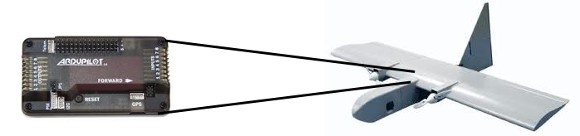
Applications of SeaHorn at NASA
Absence of Buffer Overflows
  Open source auto-pilots
    paparazzi and mnav autopilots
  Automatically instrument buffer accesses with runtime checks
  Use SeaHorn to validate that run-time checks never fail
    slower than pure abstract interpretation
    BUT, much more precise!
Verify Level 5 requirements of the LADEE software stack
  Manually encode requirements in Simulink model
  Verify that the requirements hold in auto-generated C
Memory safety of C++ controller code
  ongoing…

Slide 44
SeaHorn at a glance
Publicly Available (http://seahorn.github.io) state-of-the-art Software Model Checker
Industrial-strength front-end based on Clang and LLVM
Advanced Abstract Interpretation engine: Crab
SMT-based verification engine: Spacer
Bit-precise Bounded Model Checker and Symbolic Execution
Executable Counter-Examples
A framework for research and application of logic-based verification

Slide 45
Current and Future Work
Precise Memory Analysis
  pointer / alias analysis for LLVM
  bug discovery using symbolic execution
  verification of buffer overflows, null-deref, memory safety
  specialized checkers / proof rules / verification conditions
Verification of Concurrent / Distributed / Parametrized Systems
  modular verification (per thread, per task, per node)
  scale to systems with large / unbounded interacting components
Scalability and Precision
  develop and implement new algorithms to increase scalability and/or precision
  effective modular reasoning / slicing / lemma learning
  bit-precise verification

Slide 46
References
Tools:
  SeaHorn: http://seahorn.github.io/
Papers:
  Blog: http://seahorn.github.io/blog/
  A. Gurfinkel, T. Kahsai, J.A. Navas: Algorithmic logic-based verification. SIGLOG News 2(2): 29-38 (2015)
  A. Gurfinkel, T. Kahsai, A. Komuravelli, J.A. Navas: The SeaHorn Verification Framework. CAV (1) 2015: 343-361
  A. Komuravelli, A. Gurfinkel, S. Chaki: SMT-based model checking for recursive programs. Formal Methods in System Design 48(3): 175-205 (2016)
  A. Gurfinkel, J.A. Navas: A Context-Sensitive Memory Model for Verification of C/C++ Programs. SAS 2017: 148-168
  C. Urban, A. Gurfinkel, T. Kahsai: Synthesizing Ranking Functions from Bits and Pieces. TACAS 2016: 54-70A.
  Gurfinkel, S. Chaki: Boxes: A Symbolic Abstract Domain of Boxes. SAS 2010: 287-303

Slide 47
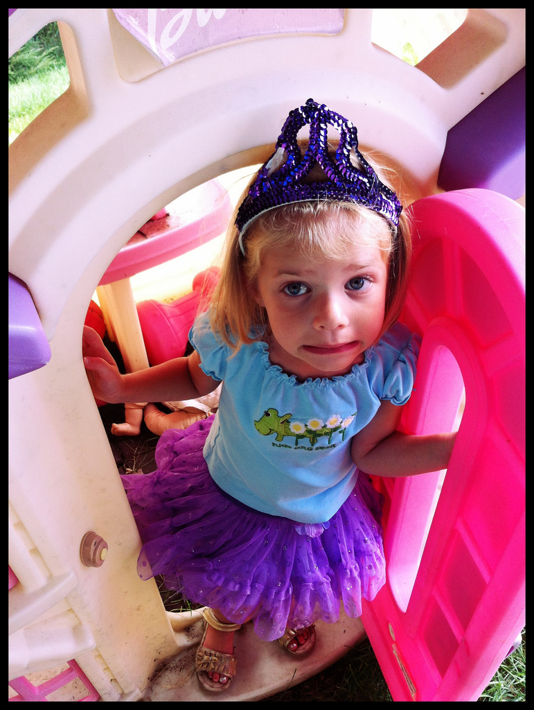
?
?
?
?
?
?

Slide 48
Property-Directed Test-Case Generation
efficient complete traces
PDTG
interaction between SMC and SE
Software Model Checker
property
executable harness
trace
program
Directed Symbolic Execution
precise abstract traces
executable
Notes:
Summarize the concrete technical features of your project. This is the “heavy lift” slide – do not skimp on technical details and be mindful of whether the challenge of the work justifies it being executed at SEI.
The emphasis is on the what (key technical challenges and approach) and the how (key technical ideas, access and use of data).
Avoid vague words like “explore”, “investigate”, “leverage”, “produce synergy” etc.
Note that later charts address the why (operational and technical significance) and the who (technical and operational stakeholders, internal and external).
Font size 18 or larger.

Slide 49
A Counterexample Harness
if (get_input() == 0x1234 &&
get_input() == 0x8765) {
__VERIFIER_error();
} else {
return 0;
}
get_input() is an external function
Program considered buggy if and only if __VERIFIER_error() is reachable
void __get_input() {
static int x = 0;
switch (x++) {
case 0: return 0x1234;
case 1: return 0x8765;
default: return 0; }
}
Implementation of external functions linked to original source code
Causes program to execute __VERIFIER_error()

Slide 50
Generating Harnesses for Linux Device Drivers
void *ldv_ptr(void)
{
void *tmp;
tmp = __c();
return tmp;
}
…
void *is_got = ldv_ptr();
if (is_got <= (long)2012)
{ ... }
  Sample from Linux Device Verification (LDV) project¹
  Harness functions returning pointers are tricky
    May not be reasonable addresses
    Might return “new” memory
  Original program instrumented with memory read/store hooks that control access to external memory
¹http://linuxtesting.org/ldv

Slide 51
Virtual External Memory
Program
External Memory Access
Memory
Internal Memory Access
Accesses to external “virtual” memory are mapped to real memory
  opportunistically allocate memory for new accesses
  ignore invalid stores, return a default value for an invalid load

