Slide 1

Program Verification with Constrained Horn Clauses
Prof. Arie Gurfinkel
Department of Electrical and Computer Engineering
University of Waterloo
Waterloo, Ontario, Canada
August 10, 2022
CAV, FLOC, 2022
joint work with A. Komuravelli, S. Chaki, G. Fedyukovich, S. Shoham, N. Bjørner, Hari Govind V. K., Y. (Jeff) Chen
Notes:
Title Slide
Title and Subtitle text blocks should not be moved from their position if at all possible.

Slide 2

Software Model Checking of Programs / Transitions Systems / Push-down Systems
=
Satisfiability of Constrained Horn Logic (CHC) fragment of First Order Logic
Reduce Model Checking to FOL Satisfiability

Slide 3
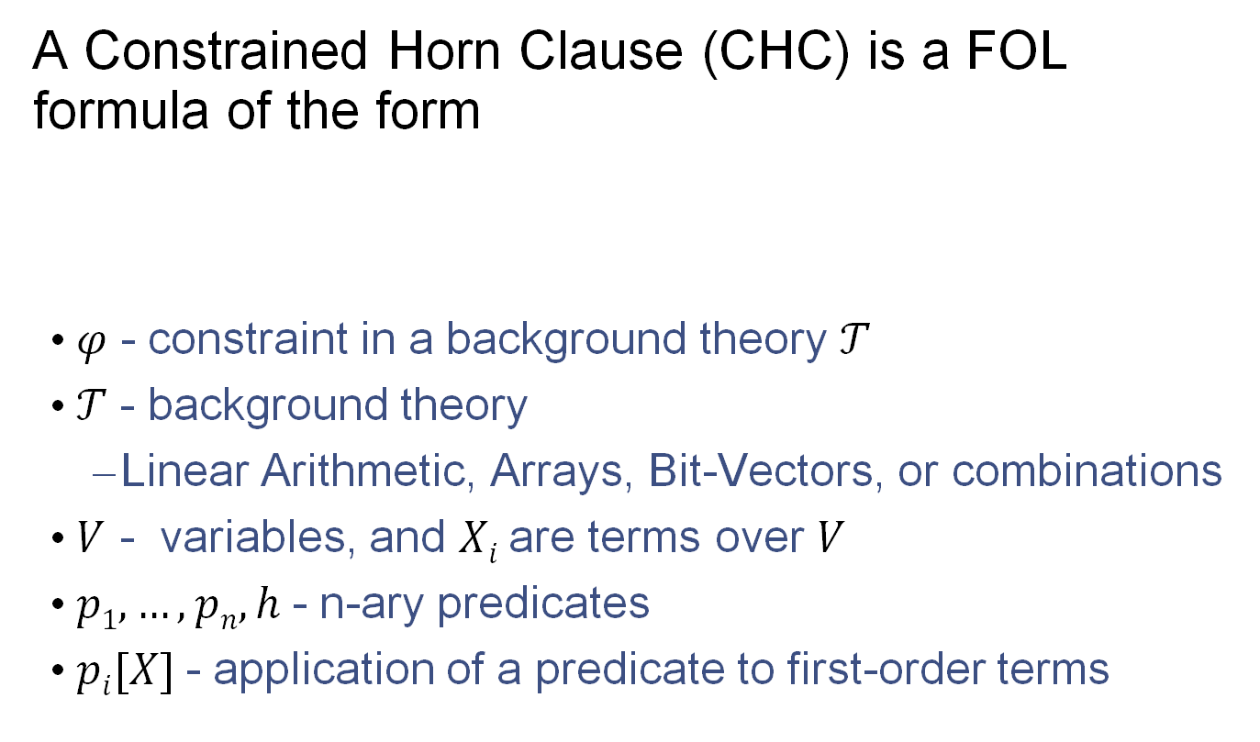
Constrained Horn Clauses (CHC)
A Constrained Horn Clause (CHC) is a FOL formula of the form
  𝜑 - constraint in a background theory 𝒯
  𝒯 - background theory
    Linear Arithmetic, Arrays, Bit-Vectors, or combinations
  $V$ - variables, and $Xi$ are terms over $V$
  $p1, …, pn, h$- n-ary predicates
  $pi[X]$- application of a predicate to first-order terms

Slide 4
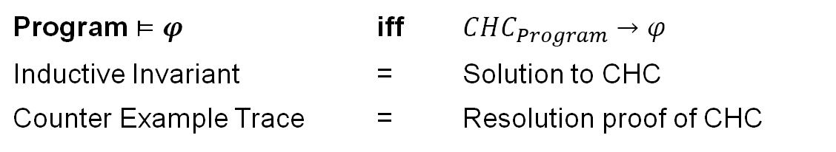
CHC Satisfiability
𝛱 - set of CHCs
M - 𝒯-model of a set of 𝛱
M satisfies 𝒯
M satisfies 𝛱 – through first-order interpretation of each predicate p_{i}
A set of clauses is satisfiable if and only if it has a model
  This is the usual FOL satisfiability
𝒯-solution of a set of CHCs 𝛱 is a substitution 𝜎 from predicates p_{i} to 𝒯-formulas such that 𝛱𝜎 is 𝒯-valid
In the context of program verification
Program $⊨φ$ | iff | $CHC_{Program}→φ$
Inductive Invariant | = | Solution to CHC
Counter Example Trace | = | Resolution proof of CHC

Slide 5
Example CHC: Is this SAT?
Yes! This set of clauses is satisfiable
The model is an extension of the standard model of arithmetic with:
Note that P(x) is definable by LIA predicate x <= 5

Slide 6
Validating the solution
Original CHC
Validation of P(x) = {x | x <= 5}

Slide 7
Example CHC: is this SAT?
No! This set of clauses is unsatisfiable
Justification is a refutation by resolution and instantiation

Slide 8
Example CHC: is this SAT?
Refutation

Slide 9
A Brief History of Modern CHC in MC
PLDI 2012 S. Grebenshchikov, N. P. Lopes, C. Popeea, A. Rybalchenko , “Synthesizing software verifiers from proof rules”
  Constrained Horn Clauses as input format for Software Model Checkers
SAT 2012 K. Hoder, N. Bjørner , “Generalized Property Directed Reachability”
  IC3/PDR for SMT == Solving CHCs
SMT 2012 N. Bjørner, K. L. McMillan, A. Rybalchenko, “Program Verification as Satisfiability Modulo Theories”
  CHC format extension for SMT-LIB
CAV 2014 A. Komuravelli, G., S. Chaki, “SMT-Based Model Checking of Recursive Programs”
  First version of SPACER as an extension of GPDR in Z3
CAV 2015 G, T. Kahsai, A. Komuravelli, J. Navas , “The SeaHorn Verification Framework”
  First robust and efficient automated verification tool based on CHC solving
2018 1st CHC-COMP, SPACER merged into Z3 master
  https://chc-comp.github.io/2018/

Slide 10
Horn Clauses for Program Verification
Rybalchenko et al. Synthesizing Software Verifiers from Proof Rules. PLDI'12
De Angelis et al. Verifying Array Programs by Transforming Verification Conditions. VMCAI'14
Bjørner, Gurfinkel, McMillan, and Rybalchenko:
Horn Clause Solvers for Program Verification

Slide 11
Horn Clauses for Concurrent / Distributed / Parameterized Systems
Hojjat et al. Horn Clauses for Communicating Timed Systems. HCVS'14
Rybalchenko et al. Synthesizing Software Verifiers from Proof Rules. PLDI'12
Gurfinkel et al. SMT-Based Verification of Parameterized Systems. FSE 2016
Hoenicke et al. Thread Modularity at Many Levels. POPL'17
Notes:
Rybalchenko Threader, Podelski POPL’17, Philipp Ruemer Workshop

Slide 12
Program Verification with HORN(LIA)
z = x; i = 0;
assume (y > 0);
while (i < y) {
z = z + 1;
i = i + 1;
}
assert(z == x + y);
IS SAT?
z = x & i = 0 & y > 0 ➔ Inv(x, y, z, i)
Inv(x, y, z, i) & i < y & z1=z+1 & i1=i+1 ➔ Inv(x, y, z1, i1)
Inv(x, y, z, i) & i >= y & z != x+y ➔ false

Slide 13
In SMT-LIB
(set-logic HORN)
;; Inv(x, y, z, i)
(declare-fun Inv ( Int Int Int Int) Bool)
(assert
(forall ( (A Int) (B Int) (C Int) (D Int))
(=> (and (> B 0) (= C A) (= D 0))
(Inv A B C D)))
)
(assert
(forall ( (A Int) (B Int) (C Int) (D Int) (C1 Int) (D1 Int) )
(=>
(and (Inv A B C D) (< D B) (= C1 (+ C 1)) (= D1 (+ D 1)))
(Inv A B C1 D1)
)
)
)
(assert
(forall ( (A Int) (B Int) (C Int) (D Int))
(=> (and (Inv A B C D) (>= D B) (not (= C (+ A B))))
false
)
)
)
(check-sat)
(get-model)
$ z3 add-by-one.smt2
sat
(model
(define-fun Inv ((x!0 Int) (x!1 Int) (x!2 Int) (x!3 Int)) Bool
(and (<= (+ x!2 (* (- 1) x!0) (* (- 1) x!3)) 0)
(<= (+ x!2 (* (- 1) x!0) (* (- 1) x!1)) 0)
(<= (+ x!0 x!3 (* (- 1) x!2)) 0)))
)
Inv(x, y, z, i)
z = x + i
z <= x + y

Slide 14
Program Verification with HORN(LIA)
int inc(int z) { return z + 1; }
assume(x <= 0);
while (x < 5) {
x = inc(x);
}
assert(x < 10);
IS SAT?
r = z + 1 ➔ Inc(z, r)
x <= 0 ➔ Inv(x)
Inv(x) & x < 5 & Inc(x, y) ➔ Inv(y)
Inv(x) & x >= 5 & x >= 10 ➔ false

Slide 15
In SMT-LIB
(set-logic HORN)
(set-option :fp.xform.inline_linear false)
(set-option :fp.xform.inline_eager false)
(declare-fun Inv ( Int ) Bool)
(declare-fun Inc ( Int Int ) Bool)
(assert (forall ((z Int)) (Inc z (+ z 1))))
(assert (forall ((x Int)) (=> (<= x 0) (Inv x))))
(assert (forall ((x Int) (y Int)) (=> (and (< x 5) (Inc x y)) (Inv y))))
(assert (forall ((x Int)) (=> (and (Inv x) (>= x 5) (>= x 10)) false)))
(check-sat)
(get-model)
$ z3 add-by-one-fn.smt2
sat
(
(define-fun Inc ((x!0 Int) (x!1 Int)) Bool
(not (>= (+ x!1 (* (- 1) x!0)) 2)))
(define-fun Inv ((x!0 Int)) Bool
(not (>= x!0 6)))
)
Inc(x0,x1) :=
x1 <= x0 + 1
Inv(x0) :=
x0 <= 5

Slide 16
Applications of CHCs
Prototyping different strategies and proof rules for verification
  verification by inductive invariants
  modular invariants
  predicate abstraction
  modular proof rules for concurrent systems
  verification of parameterized systems
  type inference for refinement type systems
  synthesis
  …
  create new verification tools by reducing to CHCs
Building automated verification tools
  SeaHorn, JayHorn, RustHorn, …
  SmartACE, SolCMC, …

Slide 17

Logic-based Algorithmic Verification
C/C++
SeaHorn
Spacer

Slide 18



Logic-based Algorithmic Verification
Simulink
C/C++
concurrent /distributed systems
Java
SeaHorn
Lustre
CPR
Termination for C
Smart Contracts
T2
Spacer

Slide 19
Logic-based Algorithmic Verification (in 2022)
Data Trees
@ CAV2022
C/C++
SmartACE
Java
Rust
Synthesis
SeaHorn
RustHorn
Solidity
SolType
MESSY
SolCMC
@ CAV2022
Simulink
Spacer

Slide 20
Current State of CHC Solving
Multiple mature solvers using competing techniques and algorithms
  Spacer (in Z3), Eldarica, FreqHorn, Golem, …
Annual competition
  CHC-COMP: https://chc-comp.github.io/
  in 2022, 7 tracks with 5+1 solvers
Growing collection of benchmarks
  maintained by CHC-COMP
  established (simplified) format
  organized in separate repos under https://github.com/chc-comp
Growing number of academic and industrial users
  SeaHorn, JayHorn, RustHorn, MESSY, SolType, SolC SMTChecker, …

Slide 21
Solving Constrained Horn Clauses

Slide 22
A little bit of complexity
Satisfiability of CHC over most interesting theories is undecidable
  e.g., CHC(Linear Real Arithmetic), CHC(Linear Integer Arithmetic)
  proof: many easy reductions, for example, counter automata
Satisfiability of Linear CHC over Propositional logic is decidable
  Finite state model checking of transition systems
  Complexity: linear in the size of the graph induced by the transition system
Satisfiability of Non-Linear CHC over Propositional logic is decidable
  Finite state model checking of pushdown systems
  Complexity: cubic in the size of the pushdown system
  Decidability of some classes of CHC: Difference arithmetic (= timed automata)

Slide 23
Procedures for Solving CHC(T)
Predicate abstraction by lifting Model Checking to HORN
  QARMC, Eldarica, …
Maximal Inductive Subset from a finite Candidate space (Houdini)
  TACAS’18: hoice, FreqHorn
Machine Learning
  PLDI’18: sample, ML to guess predicates, DT to guess combinations
Abstract Interpretation (Poly, intervals, boxes, arrays…)
  Approximate least model by an abstract domain (SeaHorn, …)
Interpolation-based Model Checking
  Duality, QARMC, …
SMT-based Unbounded Model Checking (building on IC3/PDR)
  SPACER, Implicit Predicate Abstraction

Slide 24
Spacer: Solving SMT-constrained CHC
Spacer: SAT procedure for SMT-constrained Horn Clauses
  now the default CHC solver in Z3
    https://github.com/Z3Prover/z3
    dev branch at https://github.com/agurfinkel/z3
Supported SMT-Theories
  Linear Real and Integer Arithmetic
  Quantifier-free theory of arrays
  Universally quantified theory of arrays + arithmetic
  Good support for many other SMT-theories
    bit-vectors, ADT, recursive functions, …
Supports Non-Linear CHC
  for procedure summaries in inter-procedural verification conditions
  for compositional reasoning: abstraction, assume-guarantee, thread modular, etc.

Slide 25
A Magician’s Guide to Solving Undecidable Problems
Develop a procedure P for a decidable problem
Show that P is a decision procedure for the problem
  e.g., model checking of finite-state systems
Choose one of
  Always terminate with some answer (over-approximation)
  Always make useful progress (under-approximation)
Extend procedure P to procedure Q that “solves” the undecidable problem
  Ensure that Q is still a decision procedure whenever P is
  Ensure that Q either always terminates or makes progress

Slide 26
SPACER’s guiding principles for solving CHCs
Make Progress
  always make progress
  if input CHC is unsatisfiable, after enough time, the solving procedure must terminate with UNSAT
  e.g., examine longer and longer resolution proofs (i.e., unfoldings)
Keep Decidability
  decision procedure for decidable fragments
  usually, we ensure that solving procedures are decision procedures for CHC over Propositional logic (i.e., finite state model checking)
  ”sharpen” decidability result based on specific domain (i.e., LIA, ADT, etc.)
  many open decidability questions remain
    e.g., is Spacer a decision procedure for (encoding) of timed automata?

Slide 27





IC3, PDR, and friends
$$Init$$
$$Tr$$
$$Tr$$
$$¬Bad$$
Finite State Machines
(HW model checking)
[Bradley, VMCAI 2011]
$$Init$$
$$Tr$$
$$Tr$$
$$¬Bad$$
Push Down Machines
(SW model checking)
[Hoder&Bjørner, SAT 2012]

Slide 28
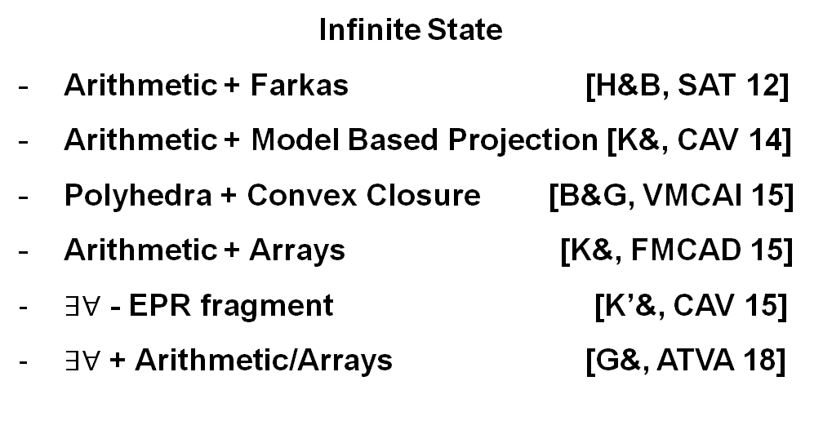






IC3, PDR and friends
$$Init$$
$$Tr$$
$$Tr$$
$$¬Bad$$
Finite State
Incremental SAT solving [Bradley, VMCAI 11]
Fast prime implicants [Een& FMCAD 11]
Basis for predicate abstraction
[Cimatti& TACAS 14, Birgmeier& CAV 14]
Finite State Machines
(HW model checking)
[Bradley, VMCAI 2011]
$$Init$$
$$Tr$$
$$Tr$$
$$¬Bad$$
Infinite State
Arithmetic + Farkas [H&B, SAT 12]
Arithmetic + Model Based Projection [K&, CAV 14]
Polyhedra + Convex Closure [B&G, VMCAI 15]
Arithmetic + Arrays [K&, FMCAD 15]
$∃∀$ - EPR fragment [K’&, CAV 15]
$∃∀$ + Arithmetic/Arrays [G&, ATVA 18]
Push Down Machines
(SW model checking)
[Hoder, Bjørner, SAT 2012]

Slide 29
IC3, PDR and friends
$$Init$$
$$Tr$$
$$Tr$$
$$¬Bad$$
Finite State
SAT
Infinite State
SMT
Arithmetic
Arrays
Quantifiers
Search Strategies
[Bradley, VMCAI 11]
CTI – Counter Examples To Induction
[G&Ivrii, FMCAD 15]
Under and over-approximations
[Vizel&G, CAV 14]
Use SAT for blocking
IC3 for pushing
Finite State Machines
(HW model checking)
[Bradley, VMCAI 2011]
$$Init$$
$$Tr$$
$$Tr$$
$$¬Bad$$
Push Down Machines
(SW model checking)
[Hoder, B, SAT 2012]

Slide 30

Verification by Incremental Generalization
T, N=0
A counterexample of length N exists?
Yes
No, N:=N+1
SMT
Is a safe inductive invariant?
YES
No + bounded proof
SMT
Generalize proof
candidate Inv
SMT

Slide 31

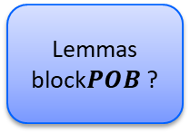





SPACER
Is $POB$reachable?
$$POB$$
IC3-style search for solutions to CHCs
Works by recursively blocking proof obligations (POB)
POB
  BAD states
  Predecessors to BAD states
Generate predecessors using quantifier elimination (Model Based Projection)
Generate predecessor
$POB$’
Is $POB′$ reachable?
NO
NO
Reachable states intersect with $POB$ ?
YES
NO
Lemmas block$POB$ ?
Learn reachable state
Learn lemma
YES
YES
YES
NO

Slide 32
Linear CHC Satisfiability
Satisfiability of a set of linear CHCs is reducible to satisfiability of THREE clauses of the form
where, X’ = {x’ | x in X}, P a fresh predicate, and Init, Bad, and Tr are constraints
Proof:
  add extra arguments to distinguish between predicates
  Q(y) ∧ tau → W(y, z)
    P(id=‘Q’, y) ∧ tau → P(id=‘W’, y, z)

Slide 33
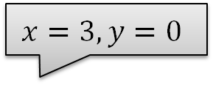


IC3/PDR In Pictures: Search for Finite Cexs
$$x=3,y=0$$
$$x=1,y=0$$
$$x<y$$
Predecessor
NewLemma

Slide 34
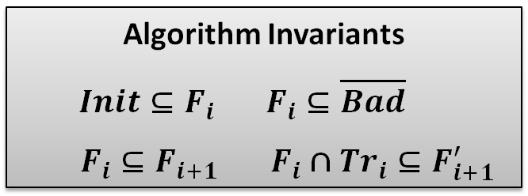
IC3/PDR in Pictures: Is Inductive
Inductive
Algorithm Invariants
$Init⊆F_{i} F_{i}⊆\overline{Bad}$
$F_{i}⊆F_{i+1}$ $F_{i}∩Tr_{i}⊆F_{i+1}^{′}$

Slide 35

IC3/PDR: Solving Linear (Propositional) CHC
Unreachable and Reachable
  terminate the algorithm when a solution is found
Unfold
  increase search bound by 1
Candidate
  choose a bad state in the last frame
Predecessor
  extend a pob (backward) consistent with the current frame
  choose an assignment s s.t. $(s ⋀ Fi ⋀ Tr ⋀ pob’)$is SAT
NewLemma
  construct a lemma to explain why pob cannot be extended
  Find a clause L s.t. $L⇒¬pob$, $Init ⇒ L$, and $Fi ⋀ Tr ⇒ L’$
Induction
  propagate a lemma as far into the future as possible
  (optionally) strengthen by dropping literals

Slide 36
Extending IC3/PDR to CHC Solving
Theories with infinitely many models
  infinitely many satisfying assignments
  can’t simply enumerate (when computing predecessor)
  can’t block one assignment at a time (when blocking)
Non-Linear Horn Clauses
  multiple interdependent predecessors
  when a CHC clause depends on multiple predicates
CHC solving is undecidable in general
  want an algorithm that makes progress
  doesn’t get stuck in a decidable sub-problem
  guaranteed to find a counterexample (if it exists)

Slide 37
IC3/PDR: Solving Linear (Propositional) CHC
Unreachable and Reachable
  terminate the algorithm when a solution is found
Unfold
  increase search bound by 1
Candidate
  choose a bad state in the last frame
Predecessor
  extend a pob (backward) consistent with the current frame
  choose an assignment s s.t. $(s ⋀ Fi ⋀ Tr ⋀ pob’)$is SAT
NewLemma
  construct a lemma to explain why pob cannot be extended
  Find a clause L s.t. $L⇒¬pob$, $Init ⇒ L$, and $Fi ⋀ Tr ⇒ L’$
Induction
  propagate a lemma as far into the future as possible
  (optionally) strengthen by dropping literals
Theory dependent

Slide 38

New Lemma (Spacer)
$$\left(\left(F_{i}∧Tr\right)∨Init^{′}\right)⇒φ^{′}, φ^{′}⇒¬pob′$$
Looking for $φ’$

Slide 39
Spacer: NewLemma Rule
Proof obligation (pob) is blocked using Craig Interpolation
  summarizes the reason why the pob cannot be extended
Generalization is not inductive
  weaker than IC3/PDR
  inductive generalization for arithmetic is still an open problem

Slide 40
Interpolation in Spacer
Much simpler than general interpolation problem for A ∧ B
  B is always a conjunction of literals (B is the pob)
  A is dynamically split into DNF by the SMT solver (A is the constraint)
  the signature of B is shared with the signature of A
Interpolation algorithm is reduced to analyzing all theory lemmas in a proof produced by the SMT solver
  every theory-lemma that mixes B-pure literals with other literals is interpolated to produce a single literal in the final solution
  interpolation is restricted to clauses of the form (∧ B_{i} ⇒ ⋁ A_{j})
Interpolating (UNSAT) Cores
  improve interpolation algorithms and definitions to the specific case of Spacer
  classical interpolation focuses on eliminating non-shared symbols
  in Spacer, the focus is on finding good generalizations

Slide 41
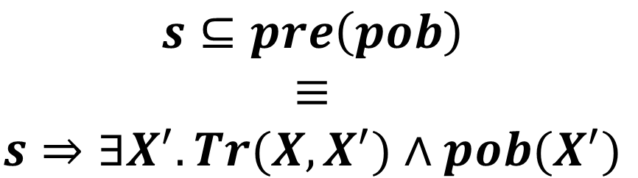
predecessor
$$s⊆pre\left(pob\right)$$
$$≡$$
$$s⇒∃X^{′}. Tr(X, X^{′})∧pob(X^{′})$$
Computing a predecessor s of a proof obligation pob

Slide 42
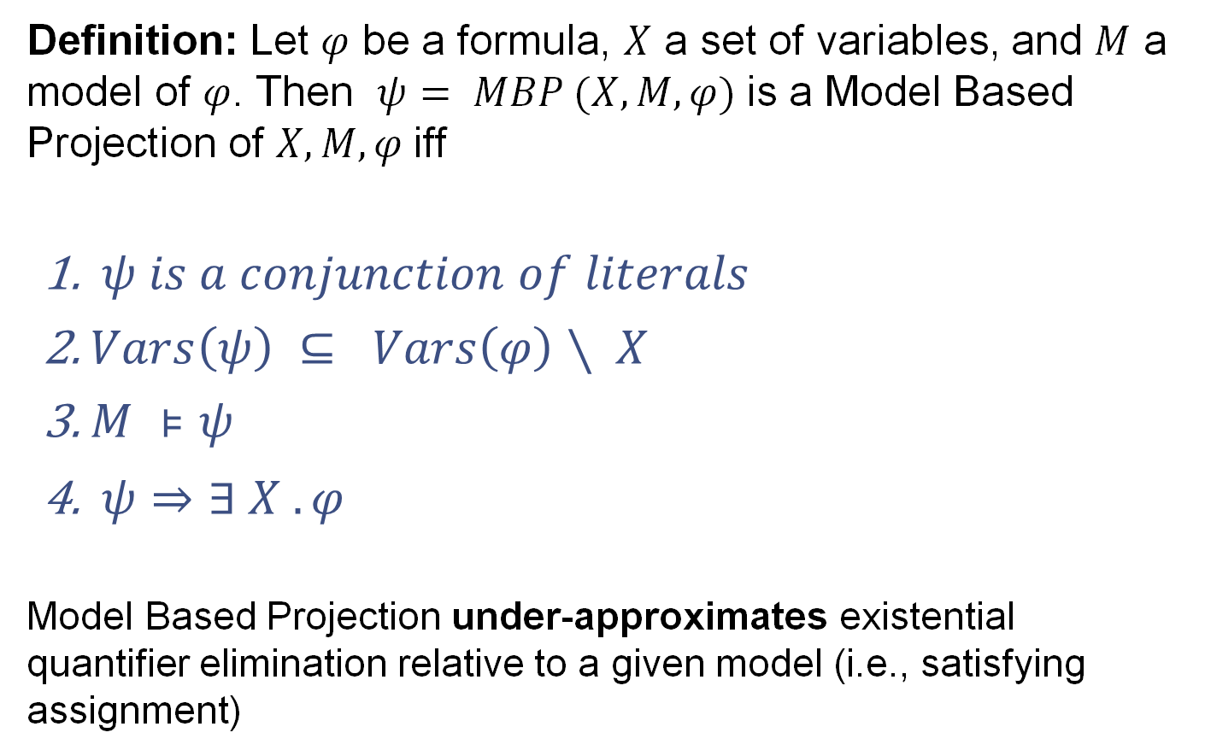
Model Based Projection
Definition: Let $φ$ be a formula, $X$ a set of variables, and $M$ a model of $φ$. Then $ψ= MBP (X, M, φ)$is a Model Based Projection of $X, M, φ$iff
  $ψ is a conjunction of literals$
  $Vars\left(ψ\right) ⊆ Vars\left(φ\right)∖ X$
  $M ⊧ψ$
  $ψ⇒∃ X . φ$
Model Based Projection under-approximates existential quantifier elimination relative to a given model (i.e., satisfying assignment)

Slide 43
Model Based Projection
Expensive to find a quantifier-free
ψ₁
Find model M of φ (x,y)
M
2. Compute a disjunct of ∃x.φ containing M
ψ₆
Models of
ψ₅
ψ₃
ψ₂
ψ₄

Slide 44
Fourier–Motzkin Quantifier Elimination for LRA
Quadratic increase in the formula size per each eliminated variable

Slide 45
Fourier-Motzkin by Example

Slide 46
Quantifier Elimination with Assumptions
Quantifier elimination is simplified by a choice of a minimal upper bound
  For each choice of minimal upper bound, no increase in term size
  Dually, can use largest lower bound
How to chose the assumptions?!
  MBP == use the order chosen by the model

Slide 47
MBP Example
an assumption
qelim under the assumption

Slide 48
MBP for Linear Rational Arithmetic
Input: a formula F, variable x, a model M of F
Use the model M to pick the right assumption to eliminate x
N. Bjørner, M. Janota: Playing with Quantified Satisfaction. LPAR (short papers) 2015

Slide 49
Spacer: Predecessor Rule
Compute a predecessor pob using Model Based Projection
To ensure progress, Predecessor must be finite
  finitely many possible pob predecessors when all other arguments are fixed

Slide 50
Spacer: Solving CHC(LRA)
Unreachable and Reachable
  terminate the algorithm when a solution is found
Unfold
  increase search bound by 1
Candidate
  choose a bad state in the last frame
Predecessor
  extend a pob (backward) consistent with the current frame
  find a model M of s s.t. (F_{i} ⋀ Tr ⋀ pob’), and let s = MBP(X’, F_{i} ⋀ Tr ⋀ pob’)
NewLemma
  construct a lemma to explain why pob cannot be extended
  Find an interpolant L s.t. L⇒¬pob , Init ⇒ L , and F_{i} ⋀ Tr ⇒ L’
Induction
  propagate a lemma as far into the future as possible
  (optionally) strengthen by dropping literals

Slide 51
Non-Linear CHC Satisfiability
Satisfiability of a set of arbitrary (i.e., linear or non-linear) CHCs is reducible to satisfiability of THREE (3) clauses of the form
where, X’ = {x’ | x in X}, Xº = {xº | x in X}, P a fresh predicate, and Init, Bad, and Tr are constraints

Slide 52
Multiple Predecessor POBs
How to compute a predecessor for a proof obligation z > 0
Predecessor over the constraint is:
Need to create two different proof obligations
  one for P(x) and one for P(y)
  project y using MBP for P(x)
  project x using MBP for P(y)

Slide 53
Search non-linear CHC
Bad
Level
In Predecessor, unfold the derivation tree in a fixed depth-first order
  use MBP to create new pobs
Successor: Learn new facts (reachable states) on the way up
  use MBP to propagate facts bottom up

Slide 54
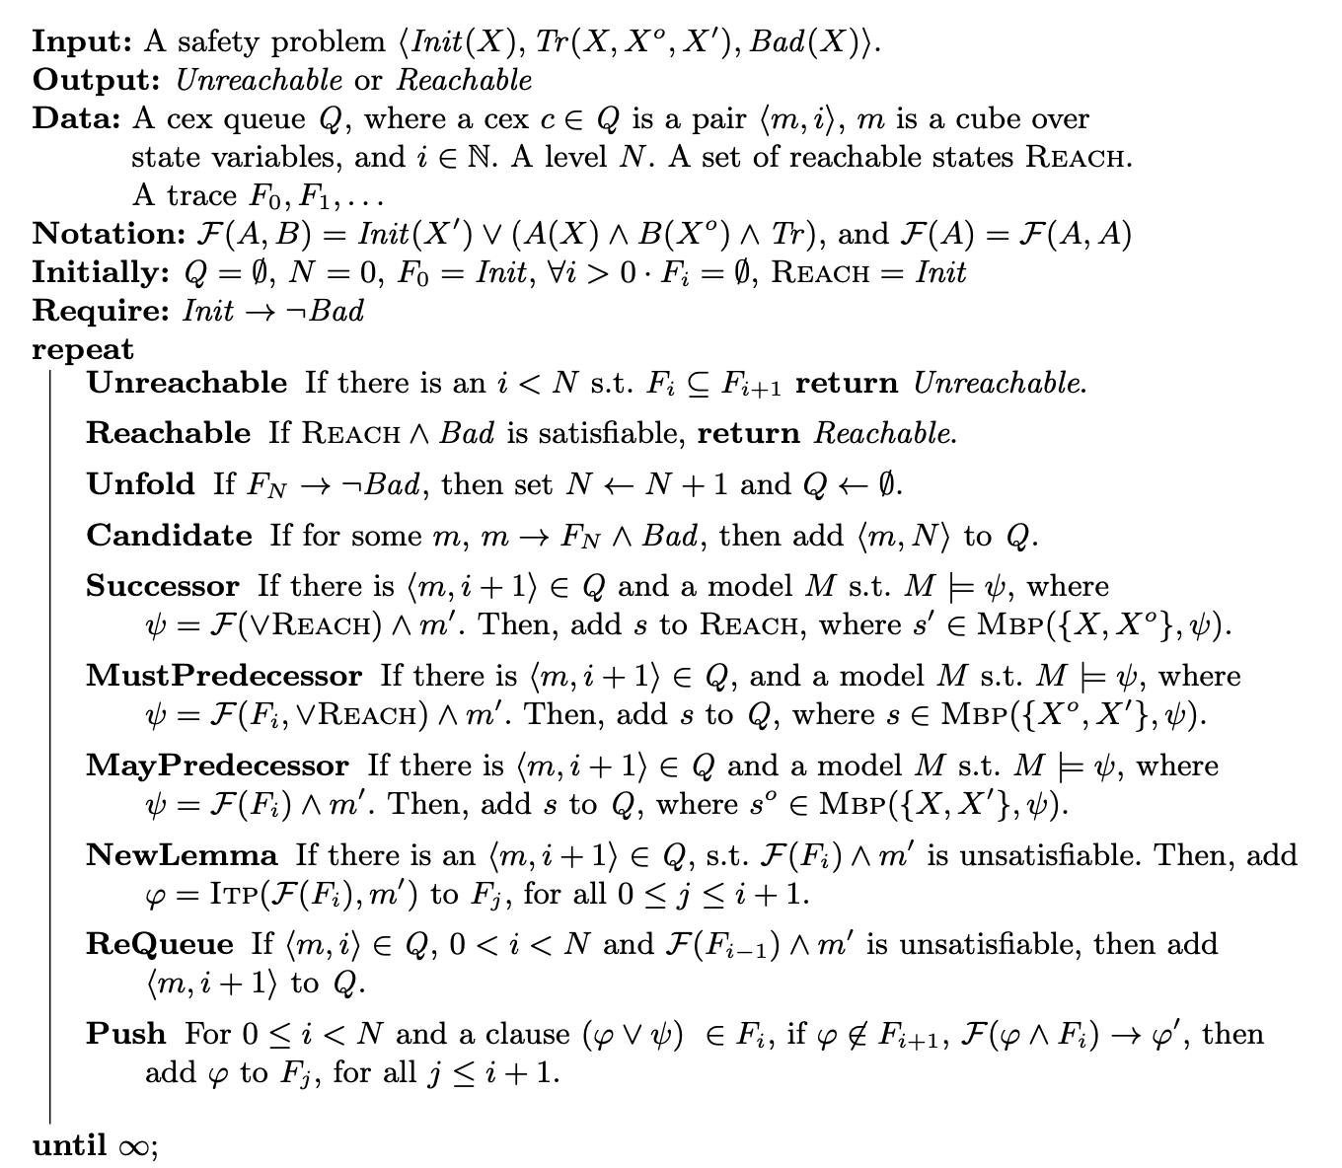
Spacer
Cache Reachable states
Pob queue as in IC3/PDR
Successor and two Predecessor rules use MBP
NewLemma rule uses ITP
A. Komuravelli, G., S. Chaki: SMT-Based Model Checking for Recursive Programs. CAV 2014

Slide 55

The Curse of Interpolantion
INTERPOLANTS
Hari Govind V. K., J. Chen, S. Shoham, G.; Global Guidance for Local Generalization in Model Checking. CAV 2020
Notes:
https://www.flickr.com/photos/eamoncurry/8735833706

Slide 56
The Curse of Interpolation
Interpolation is capable of generating many interesting terms
  (almost) any inductive invariant is an interpolant of something under the right conditions!
Interpolation often works in practice
  creates false sense of security
  predicate / term generation is a solved problem
However, interpolation is very hard to control!
  Small changes to input result in big change in interpolants
  Small changes to solver parameter result in big change in interpolants
  Works well overall (i.e., large benchmark set), but poorly for any given user problem!

Slide 57

Spacer Tom ONLY knows how to do
Local reasoning
Generalizing from single predecessors
results in limited exploration horizon
Generalization typically relies on interpolation
Interpolation can work wonders!
  e.g., generate breakthrough terms like equality: a = b
Notes:
One aspect of such MC algorithms is local reasoning

Slide 58

Ground Control to Spacer Tom:
We've got a PROBLEM!
Not aware of the structure of the inductive proof so far
Interpolant is very much dependent
on heuristics in the underlying SMT engine
  a + b < 4 is just as likely as a = b
Crucial in infinite-state systems than in finite-state systems
  there are usually infinitely many generalizations to choose from
Notes:
That is itp only works sometimes

Slide 59


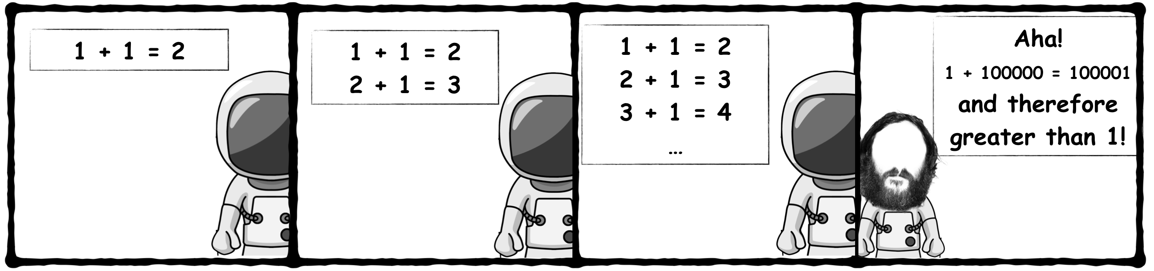
Spacer Tom can be MISSGUIDED!
As illustrated by
Myopic generalization
Excessive generalization
Getting stuck in a rut

Slide 60
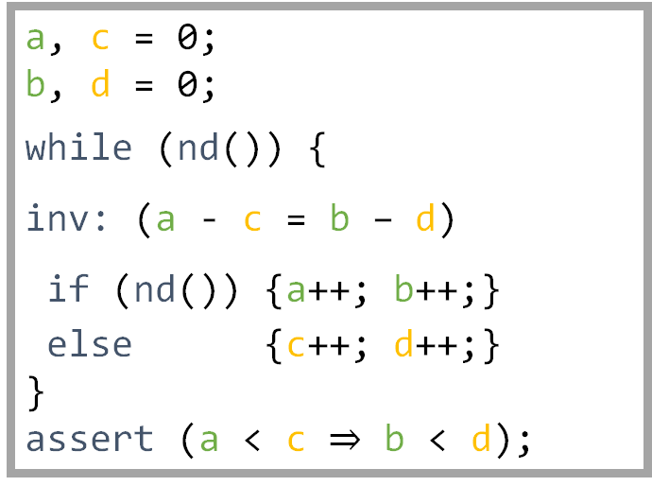
Spacer Tom can be MISSGUIDED!
Myopic Generalization
a, c = 0;
b, d = 0;
while (nd()) {
inv: (a - c = b – d)
if (nd()) {a++; b++;}
else {c++; d++;}
}
assert (a < c $⇒$ b < d);
nd() returns a non-deterministic Boolean value.

Slide 61
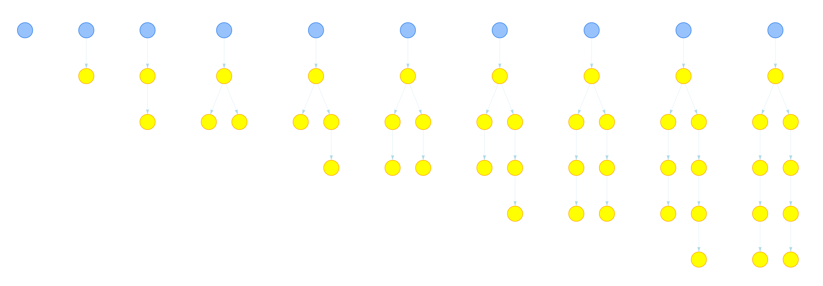

a, c = 0;
b, d = 0;
while (nd()) {
inv: (a - c = b – d)
if (nd()) {a++; b++;}
else {c++; d++;}
}
assert (a < c $⇒$ b < d);
Notes:
The yellow dots are proof obligations. The blue dot denotes current depth of exploration.

Slide 62

a – c < 0 $⇒$b – d < 0
a, c = 0;
b, d = 0;
while (nd()) {
inv: (a - c = b – d)
if (nd()) {a++; b++;}
else {c++; d++;}
}
assert (a < c $⇒$ b < d);
Notes:
In the first iteration, spacer proves that the property holds at level 1.

Slide 63

a – c < 0 $⇒$b – d < 0
a < c
$⇒$b < d
a, c = 0;
b, d = 0;
while (nd()) {
inv: (a - c = b – d)
if (nd()) {a++; b++;}
else {c++; d++;}
}
assert (a < c $⇒$ b < d);

Slide 64


a – c < 0 $⇒$b – d < 0
a – c < 1 $⇒$b – d < 1
a – c < -1 $⇒$b – d < -1
a, c = 0;
b, d = 0;
while (nd()) {
inv: (a - c = b – d)
if (nd()) {a++; b++;}
else {c++; d++;}
}
assert (a < c $⇒$ b < d);
Notes:
At a higher level, Spacer establishes the property by proving that a – c < 1 ➔ b – d < 1. Spacer, in fact, learn more lemmas that these but these are the interesting ones. I am not going to explain why these were learned. This is caused by a combination of the heuristics inside SMT, interpolation and MBP.

Slide 65



a – c < 0 $⇒$b – d < 0
a – c < 1 $⇒$b – d < 1
a – c < -1 $⇒$b – d < -1
a, c = 0;
b, d = 0;
while (nd()) {
inv: (a - c = b – d)
if (nd()) {a++; b++;}
else {c++; d++;}
}
assert (a < c $⇒$ b < d);
a – c < 2 $⇒$b – d < 2
a – c < -2 $⇒$b – d < -2
Notes:
What can be done? Lets take a closer look on how Spacer diverges.
Below each vertical group is one of the lemmas learned in that iteration.

Slide 66



a – c < 0 $⇒$b – d < 0
a – c < 1 $⇒$b – d < 1
a – c < -1 $⇒$b – d < -1
a, c = 0;
b, d = 0;
while (nd()) {
inv: (a - c = b – d)
if (nd()) {a++; b++;}
else {c++; d++;}
}
assert (a < c $⇒$ b < d);
a – c < 2 $⇒$b – d < 2
a – c < -2 $⇒$b – d < -2
a – c < 3 $⇒$b – d < 3
a – c < -3 $⇒$b – d < -3
Notes:
What can be done? Lets take a closer look on how Spacer diverges.
Below each vertical group is one of the lemmas learned in that iteration.

Slide 67
Data Driven Generalization & Lemma Discovery
Global view of the current solver state
  group lemmas (and pobs) based on syntactic/semantic similarity
    we currently use anti-unification on interpreted constants
  detect whenever global proof is diverging and mitigate
One lemma to rule them all
  merge lemmas in group to form a single universal lemma
  interpolation and inductive generalization can be applied to generalize further
  new lemma reduces the global proof by blocking all POBs in its group
Reduce, reuse, recycle
  under-approximate groups that cannot be merged in current theory
  learn multiple (simple) lemmas to block a (complex) proof obligation

Slide 68










Ground Control to Spacer Tom:
Global Guidance
$$⟨α, i+1⟩$$
$$\text{𝓞}i$$
POB Queue
Lemma Trace
$${⟨α}^{′}, i⟩$$
$$ℓ$$
$$ℓ$$
$$⟨φ, j⟩$$
$$\text{ℒ}⊆\text{𝓞}\text{k}$$
$$⟨γ, t⟩$$
$$ψ$$
Notes:
We design a guidance technique that takes as input all lemmas in the trace, the proof obligation and the new lemma and give as out either a pob or a new lemma.

Slide 69
Ground Control to Spacer Tom:
Global Guidance trinity
Subsume
combine multiple lemmas into one
Concretize
Conjecture
simplify terms by concrete values
drop literals that are in the way

Slide 70
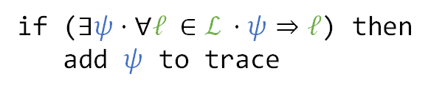
1st Global Guidance to GSpacer Tom:
Subsume Rule
if ($∃ψ⋅∀ℓ ∈\text{ℒ} ⋅ψ⇒ℓ$) then
add $ψ$ to trace

Slide 71
1st Global Guidance to GSpacer Tom:
Subsume Rule
if ($∃ψ⋅∀ℓ ∈\text{ℒ} ⋅ψ⇒ℓ$) then
add $ψ$ to trace

Slide 72
1st Global Guidance to GSpacer Tom:
Subsume Rule
if ($∃ψ⋅∀ℓ ∈\text{ℒ} ⋅ψ⇒ℓ$) then
add $ψ$ to trace

Slide 73
1st Global Guidance to GSpacer Tom:
Subsume Rule
if ($∃ψ⋅∀ℓ ∈\text{ℒ} ⋅ψ⇒ℓ$) then
add $ψ$ to trace

Slide 74






Subsume Rule in Action:
Subsume Rule on LIA
$$ℓ_{1}$$
a – c
a – c
a – c < 1 $⇒$b – d < 1
$$ℓ_{2}$$
a – c < 0 $⇒$b – d < 0
b – d
a – c < -1 $⇒$b – d < -1
$$ℓ_{3}$$
Notes:
These are the lemmas from the example in cube form.

Slide 75






Subsume Rule in Action:
Subsume Rule on LIA
a – c
a – c < 1 $∧$ b – d > 1
$${¬ℓ}_{1}$$
a – c < 0 $∧$b – d > 0
b – d
a – c < -1 $∧$ b – d > -1
$${¬ℓ}_{2}$$
$${¬ℓ}_{3}$$
Notes:
These are the lemmas from the example in cube form.

Slide 76
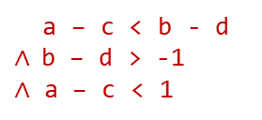
Subsume Rule in Action:
Subsume Rule on LIA
a – c
a – c < b - d $∧$b – d > -1
$∧$ a – c < 1
b – d

Slide 77
Subsume Rule in Action:
Subsume Rule on LIA
a – c
a – c < b - d
b – d

Slide 78

Subsume Rule in Action:
Subsume Rule on LIA
a – c
a – c
a – c
$$ψ$$
b – d
Notes:
These are the lemmas from the example in cube form.

Slide 79
Summary of Subsume Rule in Spacer
In general, subsume rule requires
  a method to cluster lemmas/pobs together to discover common pattern
  i.e., multiple lemmas are different instances of some more general pattern
  a method to merge lemmas into a single lemma that strengthens all lemmas in a cluster
For LIA, we implement subsume as follows
  clustering: anti-unification on constants
  two lemmas are cluster if they only differ in some numeric constants
  merge: convex closure (CC)
  implement CC symbolically using quantifier elimination, approximate by MBP
Integrated in Spacer via the strategy
    cluster lemmas as they are learned
    when the cluster is large enough, merge and create a conjecture
    add conjecture as may pob

Slide 80
Ground Control to Spacer Tom:
Global Guidance
$$⟨α, i+1⟩$$
$$\text{𝓞}i$$
POB Queue
Lemma Trace
$${⟨α}^{′}, i⟩$$
$$ℓ$$
$$ψ$$
$$⟨γ, t⟩$$
$$ℓ$$
$$⟨φ, j⟩$$
$$\text{ℒ}⊆\text{𝓞}\text{k}$$
Conjecture
Concretize
Subsume
Notes:
We design a guidance technique that takes as input all lemmas in the trace, the proof obligation and the new lemma and give as out either a pob or a new lemma.

Slide 81
Implementation and Evaluation
Implemented in Spacer (still PR in Z3)
  https://github.com/Z3Prover/z3/pull/6026
Supports
  Linear Integer Arithmetic, Linear Real Arithmetic
  Linear and Non-linear CHCs
  (in progress) Quantified Arrays and Fixed-Size Bit-Vectors
Evaluated on LIA instances from CHC-COMP

Slide 82
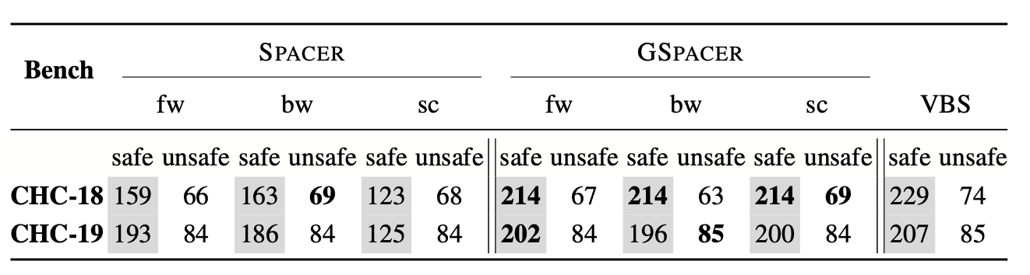
Evaluation on CHC-COMP
No interpolation!
fw and bw are different interpolation strategies
sc configuration disables interpolation
GSpacer won 3 of the 4 tracks at CHC-COMP 2020
Notes:
We compared with Spacer with a timeout of 10 mins

Slide 83
Evaluation

Slide 84
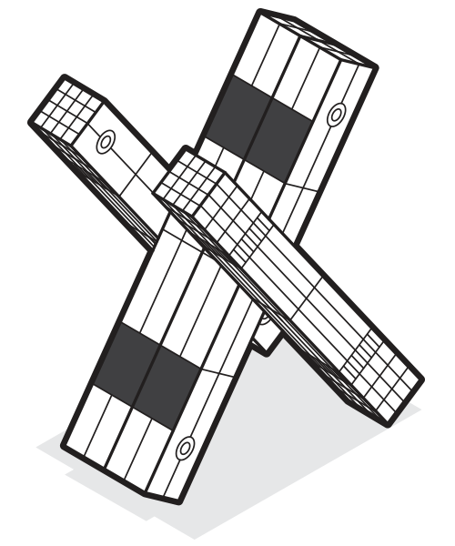
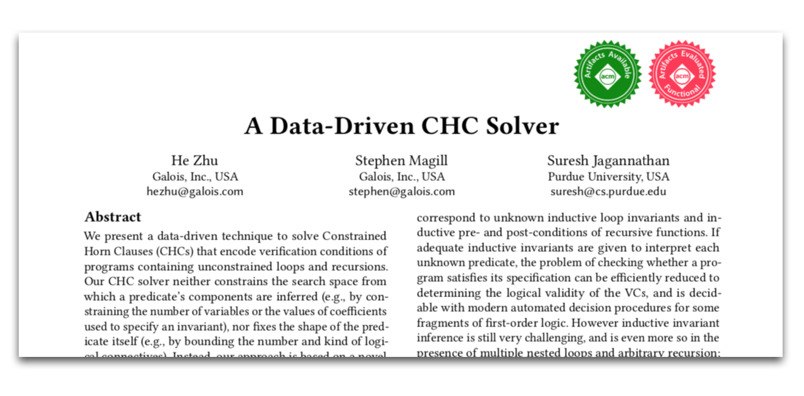
Linear Arbitrary (LArb) from PLDI 18
Data-driven, machine learning based invariant inference algorithm
Evaluation showed promise on
a subset of SV-COMP benchmarks
H. Zhu, S. Magill, S. Jagannathan: A data-driven CHC solver. PLDI 2018

Slide 85
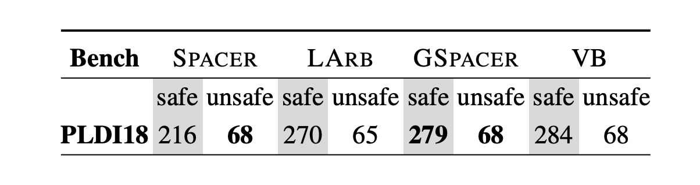
GSpacer versus LArb
On CHC-COMP instnaces, LArb is not competitive even against Spacer w/o global guidance
Instead, we compare GSpacer and LArb on benchmarks from PLDI’18 paper
VB stands for virtual best

Slide 86

Conclusion
a – c
Ground Control to Spacer Tom:
Global Guidance
POB Queue
Lemma Trace
Conjecture
Concretize
Subsume
Global guidance technique to mitigate limitations of local reasoning
Stable under different interpolation strategies
Data driven guidance for MC is better than both invariant inference and local reasoning

Slide 87
CHC MODULO Bit-Vectors
Hari Govind V. K., G. Fedyukovich, G: Word Level Property Directed Reachability. ICCAD 2020

Slide 88
Motivating example
uint32_t x = 1, y = 1;
while (1)
invariant: (x + y) & 1 == 0
{
x = x + 2 * nd();
y = y + 2 * nd();
assert(x + y != 1);
}
Predecessors to Bad states:
  (x = -1, y = -2),
  (x = 1, y = 0),
  (x + y = 1),
  (x + y = −3) …
Very specific
How to generalize from
  (x + y != 1),
  (x + y != −3) …
  to
  ((x + y) & 1 == 0) ?
nd() returns a non-deterministic
uint32_t value.

Slide 89

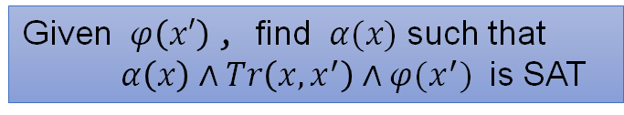

Computing predecessors
Given $φ\left(x′\right)$, find $α(x)$ such that $α\left(x\right)∧Tr\left(x, x^{′}\right)∧φ(x^{′})$ is SAT
PROBLEM:
Eliminate $x′$from $∃x^{′}⋅Tr\left(x, x^{′}\right)∧φ(x^{′})$
Model Based Projection (MBP):
Compute: $𝒫\left(y\right)⇒∃x⋅ψ(x, y)$
Given: $M⊨ψ(x, y)$

Slide 90
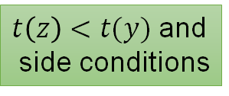



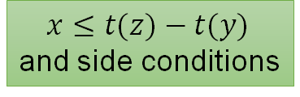


MBP for arithmetic operators in BV
$$x+t\left(y\right)≤t(z)$$
$ψ\left(x,y\right)$, $M⊨ψ(x, y)$
$x≤t(z)−t(y)$
and side conditions
Model Based Rewriting
Conjunction of literals: $t(x) ⋈t(y, z)$
Model Based Resolving
$$x≤t\left(y\right)∧x>t(z)$$
$$𝒫(y)$$
$t\left(z\right)<t(y)$ and
side conditions

Slide 91
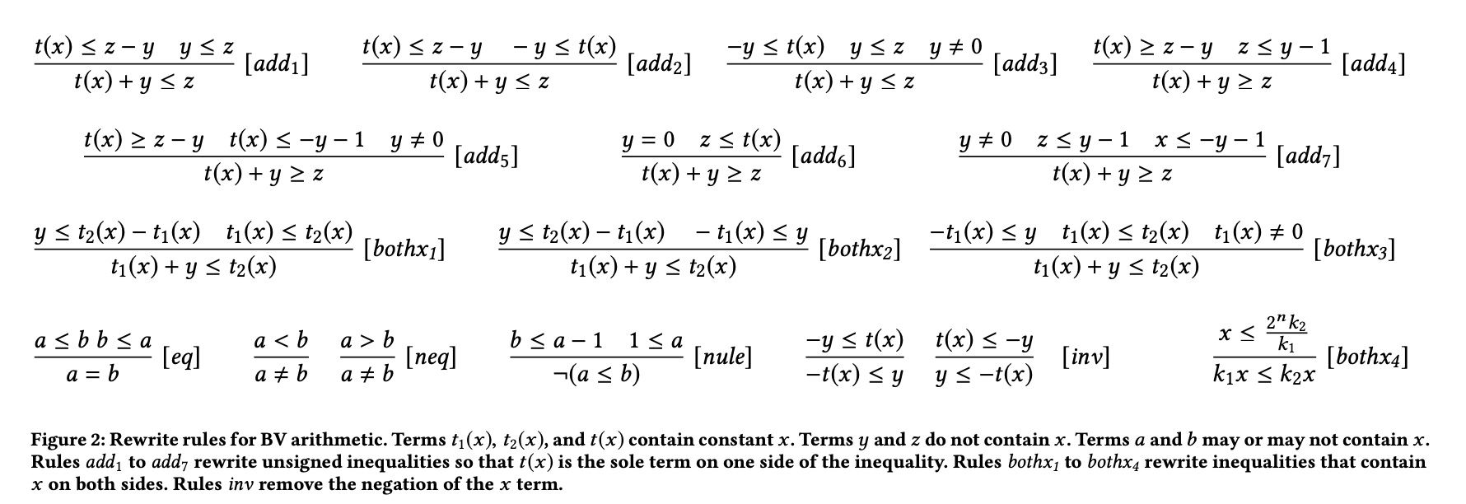
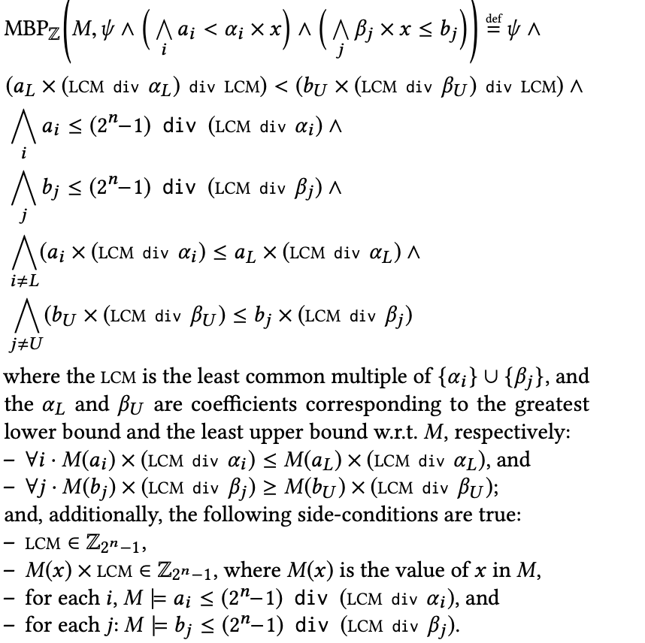
MBP for arithmetic operators in BV
$ψ\left(x,y\right)$, $M⊨ψ(x, y)$
Model Based Rewriting
Conjunction of literals: $t(x) ⋈t(y, z)$
Model Based Resolving
$$𝒫(y)$$

Slide 92


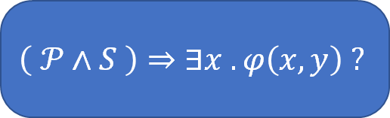

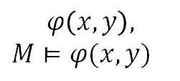





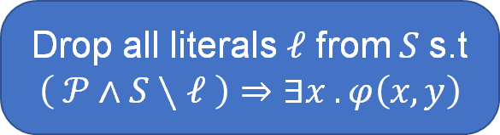
MBP for full BV
$$MBP_{Z}(ψ, x, M)$$
$$𝒫$$
$ψ\left(x,y\right)←$ arithmetic literals in $φ(x, y)$
$$φ\left(x, y\right),$$
$M⊨φ(x, y)$
$$π←φ\left(x, y\right)∖ψ(x, y)$$
$$π[x→M\left(x\right)]$$
$$S$$
$$S←S∧ψ[x→M(x)]$$
no
$$\left( 𝒫∧S \right)⇒∃x . φ\left(x, y\right) ?$$
Drop all literals $ℓ$ from $S$ s.t
$$\left( 𝒫∧S∖ℓ \right)⇒∃x . φ\left(x, y\right)$$
yes
$$𝒫∧S$$

Slide 93
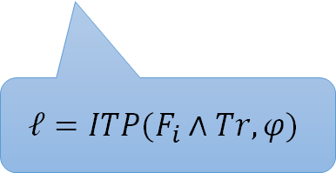

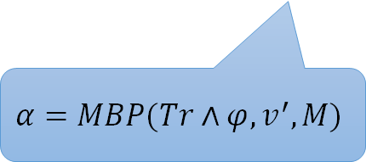

Spacer
$$⟨φ, i+1⟩$$
$$\text{𝓞}i$$
POB Queue
Lemma Trace
$$⟨α, i⟩$$
$$ℓ$$
$$α=MBP(Tr∧φ, v^{′}, M)$$
$$ℓ=ITP(F_{i}∧Tr, φ)$$
But there are no good interpolation strategies for BV !!!

Slide 94
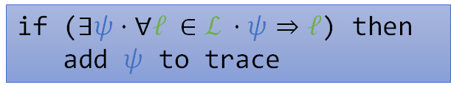
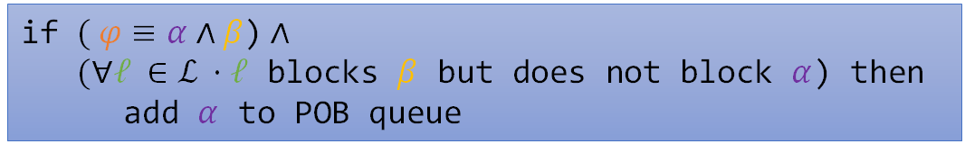
Instantiated guidance rules for BV
Subsume
Conjecture
if ($∃ψ⋅∀ℓ ∈\text{ℒ} ⋅ψ⇒ℓ$) then
add $ψ$ to trace
if $( φ≡α∧β\text{)}$ $∧$
$(∀ℓ ∈\text{ℒ} ⋅ℓ$ blocks $β$ but does not block $α$) then
add $α$ to POB queue

Slide 95
CHC Solvers
beyond Spacer

Slide 96


https://chc-comp.github.io/CHC-COMP2022_presentation.pdf

Slide 97

The Eldarica Horn Solver
A Horn solver tailored to verification of software and infinite-state systems
  Algorithms: Predicate abstraction, CEGAR, Craig interpolation
  Theories: LIA, NIA, BV, ADTs, arrays, heap
  Input formats: SMT-LIB, Prolog (+ built-in C front-end)
  Output: Full solution + counterexample output
Open-source, entirely implemented in Scala
Started in 2011, since then developed continuously
  E.g., integration of new theories, hand-in-hand with development of new decision/interpolation procedures
  Upcoming: LRA, improved heap support
https://github.com/uuverifiers/eldarica

Slide 98
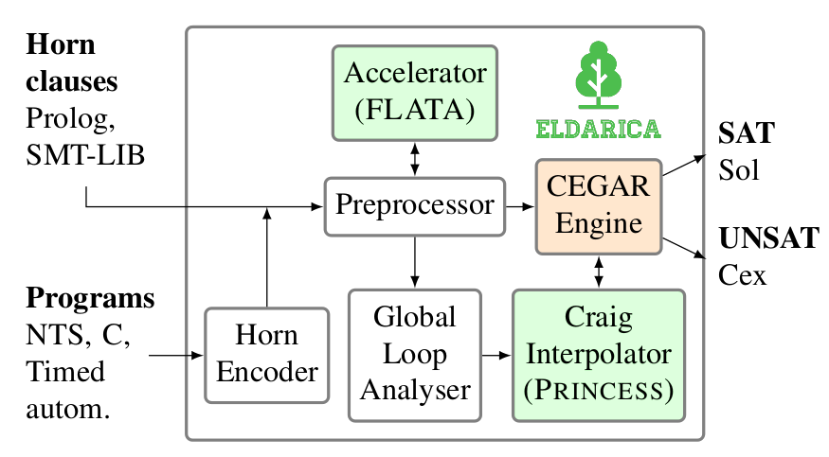
Architecture
Hossein Hojjat, Philipp Rümmer: “The ELDARICA Horn Solver” (FMCAD 2018)

Slide 99
Key feature: global invariant generation methods
Replace cycles with closed-form representations
Identify arithmetic progressions, variable relationships, etc.

Slide 100

FreqHorn: CHC solving by enumerative search
G. Fedyukovich, S. Kaufman, R. Bodik, FMCAD’17
High-level view:
  Loop between a candidate generator and SMT-solver
  Synthesizes lemmas separately
Candidate generator
  Syntax-Guided Synthesis (SyGuS)
  Non-recursive grammars
  obtained from ASTs of verification conditions
  Learnes from positive / negative candidates
SMT-based decision maker
  Off-the-shelf SMT solver
  Does not need interpolation or quantifier elimination
  Easy to maintain
Bad tries
Candidates
(Grammar)
Lemmas
SMT check 1
SMT check 2
…
SMT check n

Slide 101

FreqHorn: CHC applications/extensions
Safety of numerical programs:
  Accelerated using interpolation and Houdini
  Accelerated using data learning and quantifier elimination
  Extended to arrays and quantified invariants
  Extended to disjunctive invariants
(Non)-termination of programs
  Ranking functions, recurrence sets
Modular analysis
  Generation of function summaries
  Proving hyperproperties
Specification synthesis
  From invariants to spec and back
Test case generation
  Invariants block unreachable branches
Fedyukovich and R. Bodík, TACAS’18
Fedyukovich, Prabhu, Madhukar, Gupta, FMCAD’18
-||-, CAV’19
Riley and Fedyukovich, FSE’22
Fedyukovich, Zhang, Gupta, CAV’18
Pick, Fedyukovich, Gupta, VMCAI’21
Pick, Fedyukovich, Gupta, FMCAD’20
Prabhu, Fedyukovich, Madhukar, D’Souza, PLDI’21
Zlatkin and Fedyukovich, TACAS’22

Slide 102
Golem: Overview
Solver for Constrained Horn Clauses
Developed at USI Formal Verification and Security Lab (Lugano, Switzerland) by Martin Blicha et al.
Craig interpolation-based algorithm for CHC solving
Tight integration with interpolating SMT solver OpenSMT
Supports linear real and integer arithmetic as the background theory
Available at https://github.com/usi-verification-and-security/golem

Slide 103
Golem: Brief History
Summer 2020
  first commits
Winter 2020
  Impact engine [McMillan ’06] (Lazy Abstraction with Interpolants)
March 2021
  3 medals at CHC-COMP ’21
May 2021
  Spacer engine [Komuravelli et al. ’16]
Summer 2021
  TPA engine [Blicha et al. ’22] (Transition Power Abstraction)
April 2022
  4 medals at CHC-COMP ’22

Slide 104
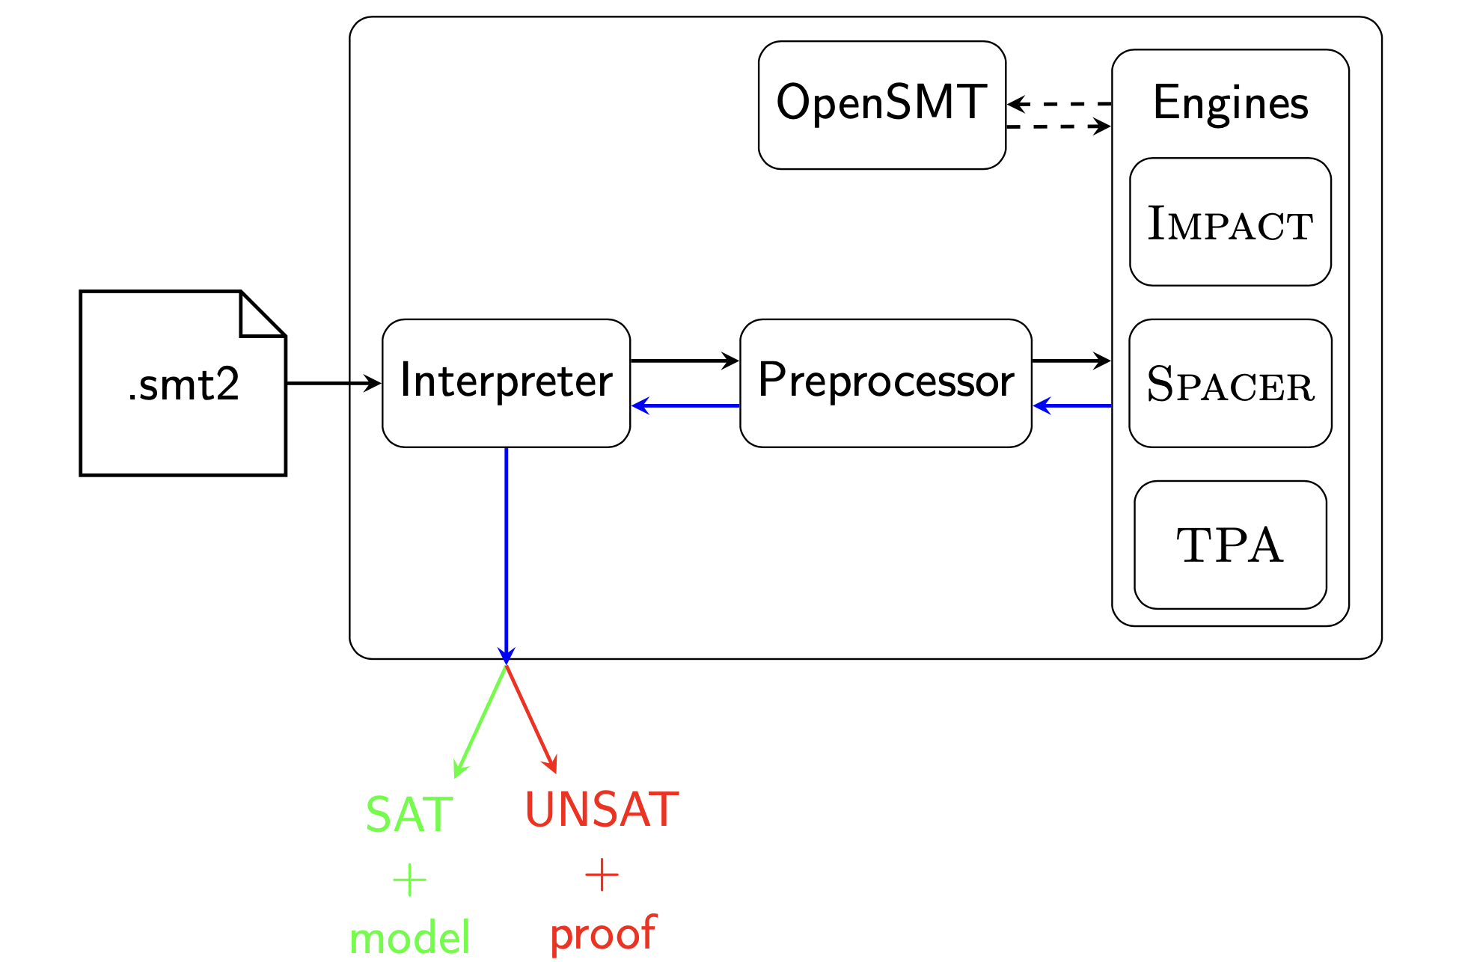
Golem: Architecture

Slide 105
Golem: Future
Extend supported background theories (arrays, ADTs)
Extend TPA engine to support nonlinear CHC systems
Golem as backend for Korn
Golem as backend for SolCMC (Alt et al. ’22)
Develop proper API for Golem as library
Support Datalog input format

Slide 106




Helping Users of CHC Solvers
SAT (SAFE)
method Main(x: List, i: Int)
requires length(x) == i
{
while(*)
inv: ?
{
if (x != nil) {
x, i := x.tail, i – 1;
}
}
assert(i >= 0);
}
CHC
VC GEN
CHC solver
UNSAT
(UNSAFE)
rust-horn

Slide 107
HST: Spacer Visualizer (ver. 1)
Created by Matteo Marescotti as a side-project to understand Spacer behavior
Extremely useful in understanding what Spacer is doing
Intendent for internal use only

Slide 108
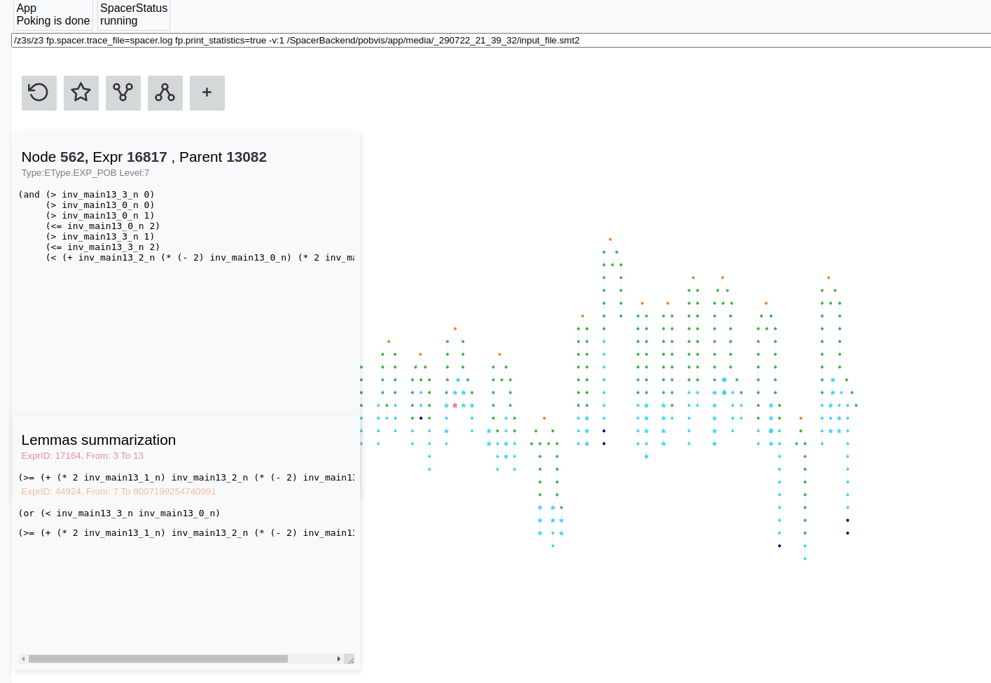
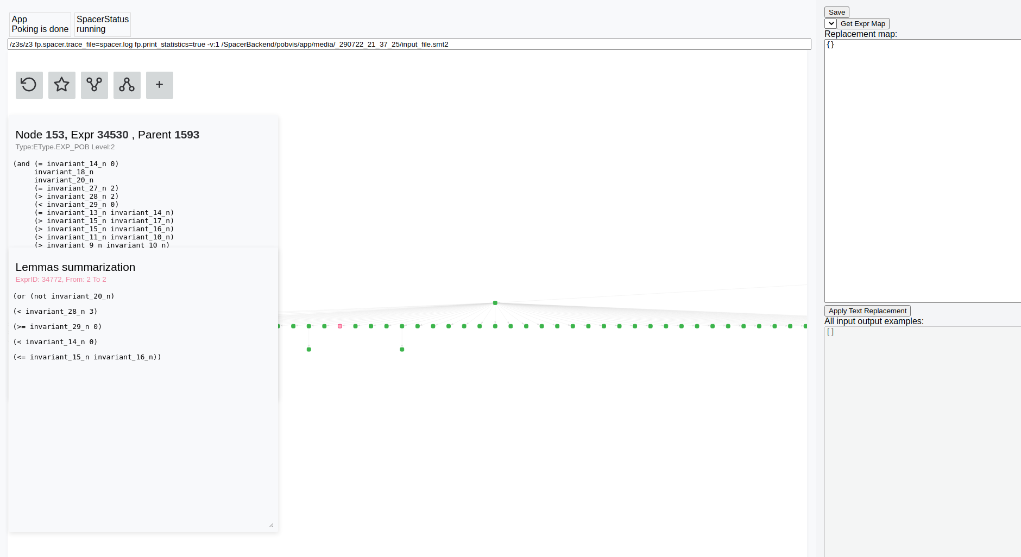
HST: Spacer Visualizer (ver. 2)
with Aishwarya Ramanathan, Nham Le, and Richard Trefler
  based on Vampire Visualizer by Bernhard Gleiss
https://github.com/nhamlv-55/spacer-visualization/

Slide 109
Art, Science, and Magic of CHCs
Model Checking of Safety Properties is CHC satisfiability
  Logic: Constrained Horn Clauses (CHC)
  “Decision” procedure: Spacer
  Constraints: arithmetic, bv, arrays, quantifiers, adt + recfn, …
Art: finding the right encoding from the problem domain to logic
  the difference between easy to impossible
  encodings can “simulate” specialized algorithms
Science: Progress, termination (when decidable)
  while the underlying problem is undecidable, many fragment or sub-problems are decidable
Magic: actually solving useful problems
  interpolation, heuristics, generalizations, …
  the list is endless

Slide 110
END

