Slide 1

Program Verification with Constrained Horn Clauses
Prof. Arie Gurfinkel
Department of Electrical and Computer Engineering
University of Waterloo
Waterloo, Ontario, Canada
April 12th , 2023
joint work with A. Komuravelli, S. Chaki, G. Fedyukovich, S. Shoham, N. Bjørner, Hari Govind V. K., Y. (Jeff) Chen
Notes:
Title Slide
Title and Subtitle text blocks should not be moved from their position if at all possible.

Slide 2
Infamous Software Disasters
Between 1985 and 1987, Therac-25 gave patients massive overdoses of radiation, approximately 100 times the intended dose. Three patients died as a direct consequence.
On February 25, 1991, during the Gulf War, an American Patriot Missile battery in Dharan, Saudi Arabia, failed to track and intercept an incoming Iraqi Scud missile. The Scud struck an American Army barracks, killing 28 soldiers and injuring around 100 other people.
On June 4, 1996 an unmanned Ariane 5 rocket launched by the European Space Agency forty seconds after lift-off. The rocket was on its first voyage, after a decade of development costing $7 billion. The destroyed rocket and its cargo were valued at $500 million.
http://www5.in.tum.de/~huckle/bugse.html

Slide 3
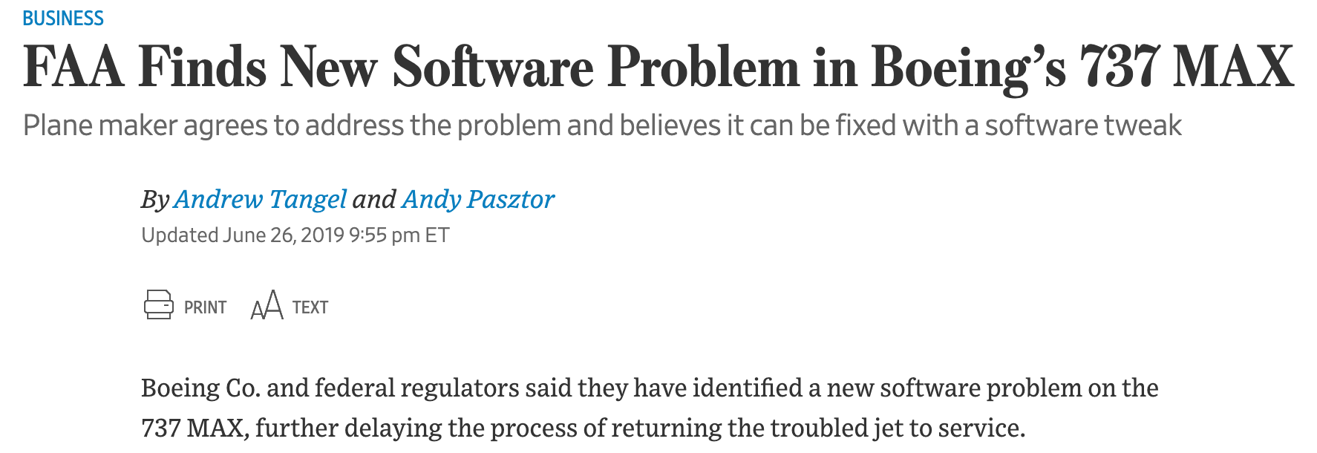
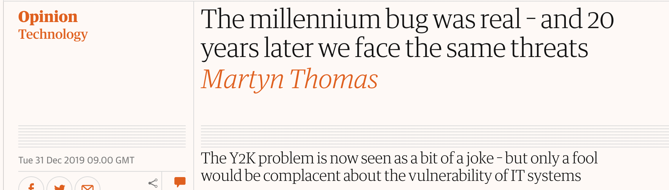
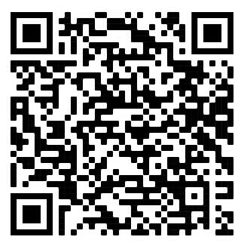
“Recent” Software “Disasters”
https://www.computerworld.com/article/3412197/top-software-failures-in-recent-history.html#slide1

Slide 4
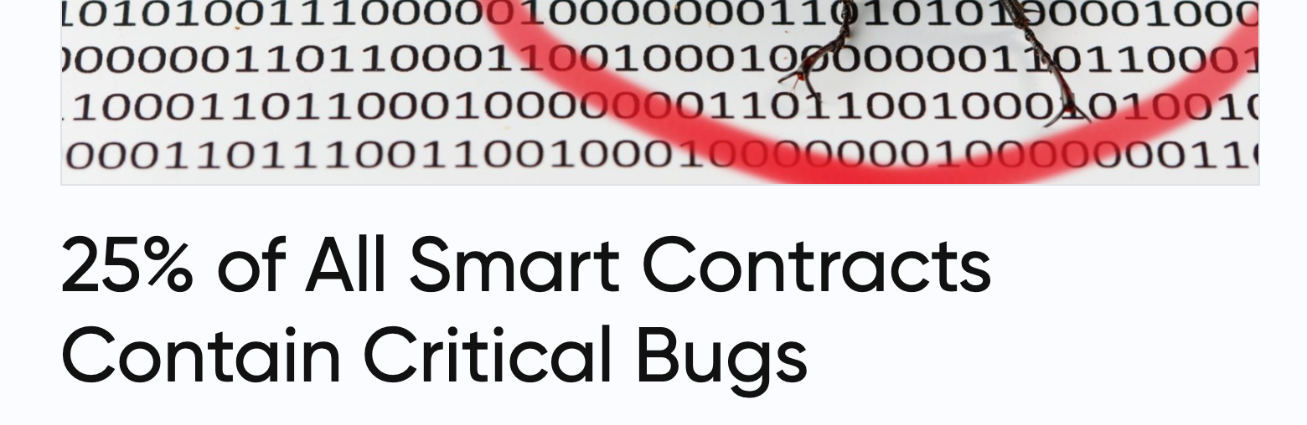


“Smart” Contracts Disasters
https://news.bitcoin.com/25-of-all-smart-contracts-contain-critical-bugs/

Slide 5

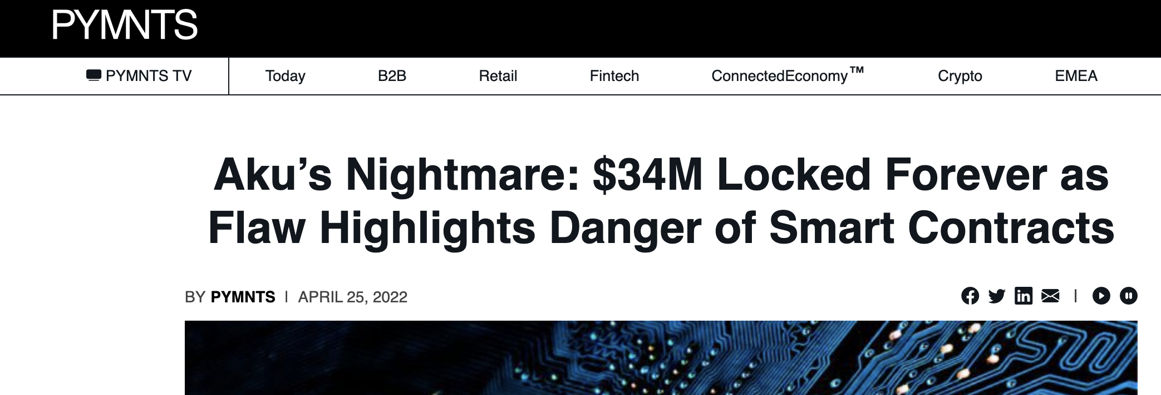
“Smart” Contracts Disasters
https://www.pymnts.com/blockchain/2022/akus-nightmare-34m-locked-forever-as-flaw-highlights-danger-of-smart-contracts/
  https://twitter.com/0xInuarashi/status/1517674505975394304

Slide 6

http://envisage-project.eu/proving-android-java-and-python-sorting-algorithm-is-broken-and-how-to-fix-it/

Slide 7


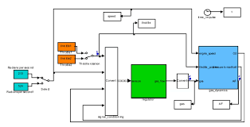
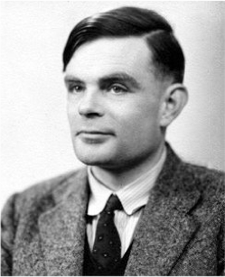
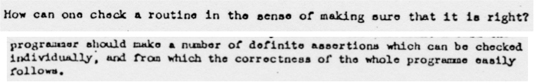
Automated (Software) Verification
Program and/or model
Correct
Automated
Reasoning
Incorrect
Alan M. Turing. 1936: “Undecidable”
Alan M. Turing. ”Checking a large routine” 1949

Slide 8
Automated Software Analysis
Model Checking
[Clarke and Emerson, 1981] [Queille and Sifakis, 1982]
Abstract Interpretation
Symbolic Execution
[Cousot and Cousot, 1977 ]
[King, 1976 ]
Notes:
The field of software verification has been growing rapidly during the last decades with many available techniques

Slide 9
Automated Verification
Deductive Verification
  A user provides a program and a verification certificate
    e.g., inductive invariant, pre- and post-conditions, function summaries, etc.
  A tool automatically checks validity of the certificate
    this is not easy! (might even be undecidable)
  Verification is manual but machine certified
Algorithmic Verification
  A user provides a program and a desired specification
    e.g., program never writes outside of allocated memory
  A tool automatically checks validity of the specification
    and generates a verification certificate if the program is correct
    and generates a counterexample if the program is not correct
  Verification is completely automatic – “push-button”

Slide 10

Software Model Checking of Programs / Transitions Systems / Push-down Systems
=
Satisfiability of Constrained Horn Logic (CHC) fragment of First Order Logic
Reduce Model Checking to FOL Satisfiability

Slide 11
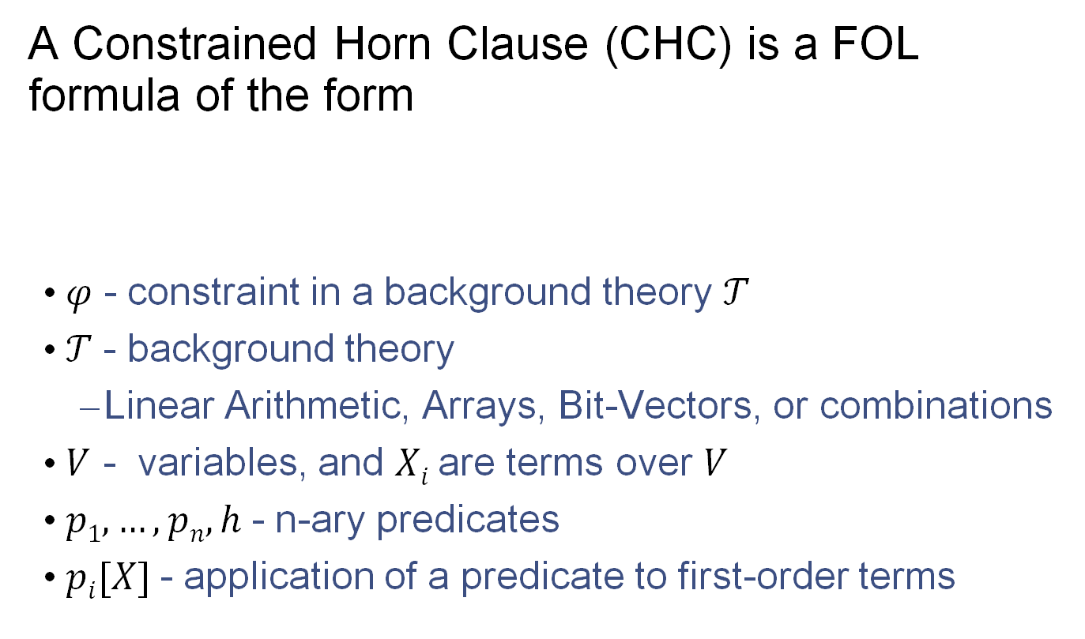
Constrained Horn Clauses (CHC)
A Constrained Horn Clause (CHC) is a FOL formula of the form
  𝜑 - constraint in a background theory 𝒯
  𝒯 - background theory
    Linear Arithmetic, Arrays, Bit-Vectors, or combinations
  $V$ - variables, and $Xi$ are terms over $V$
  $p1, …, pn, h$- n-ary predicates
  $pi[X]$- application of a predicate to first-order terms

Slide 12
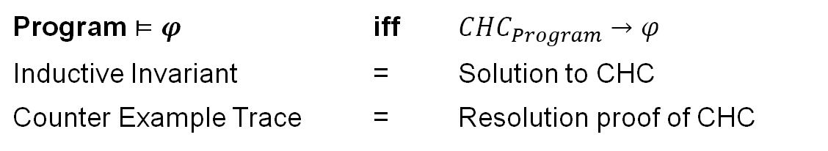
CHC Satisfiability
𝛱 - set of CHCs
M - 𝒯-model of a set of 𝛱
M satisfies 𝒯
M satisfies 𝛱 – through first-order interpretation of each predicate p_{i}
A set of clauses is satisfiable if and only if it has a model
  This is the usual FOL satisfiability
𝒯-solution of a set of CHCs 𝛱 is a substitution 𝜎 from predicates p_{i} to 𝒯-formulas such that 𝛱𝜎 is 𝒯-valid
In the context of program verification
Program $⊨φ$ | iff | $CHC_{Program}→φ$
Inductive Invariant | = | Solution to CHC
Counter Example Trace | = | Resolution proof of CHC

Slide 13
Example CHC: Is this SAT?
Yes! This set of clauses is satisfiable
The model is an extension of the standard model of arithmetic with:
Note that P(x) is definable by LIA predicate x <= 5

Slide 14
Validating the solution
Original CHC
Validation of P(x) = {x | x <= 5}

Slide 15
Example CHC: is this SAT?
No! This set of clauses is unsatisfiable
Justification is a refutation by resolution and instantiation

Slide 16
Example CHC: is this SAT?
Refutation

Slide 17



Interactive tutorial
Spacer
https://github.com/agurfinkel/spacer-on-jupyter/blob/master/FSU_2023.ipynb
try it on Google Colab

Slide 18
Program Verification with HORN(LIA)
z = x; i = 0;
assume (y > 0);
while (i < y) {
z = z + 1;
i = i + 1;
}
assert(z == x + y);
IS SAT?
z = x & i = 0 & y > 0 ➔ Inv(x, y, z, i)
Inv(x, y, z, i) & i < y & z1=z+1 & i1=i+1 ➔ Inv(x, y, z1, i1)
Inv(x, y, z, i) & i >= y & z != x+y ➔ false

Slide 19
In SMT-LIB
(set-logic HORN)
;; Inv(x, y, z, i)
(declare-fun Inv ( Int Int Int Int) Bool)
(assert
(forall ( (A Int) (B Int) (C Int) (D Int))
(=> (and (> B 0) (= C A) (= D 0))
(Inv A B C D)))
)
(assert
(forall ( (A Int) (B Int) (C Int) (D Int) (C1 Int) (D1 Int) )
(=>
(and (Inv A B C D) (< D B) (= C1 (+ C 1)) (= D1 (+ D 1)))
(Inv A B C1 D1)
)
)
)
(assert
(forall ( (A Int) (B Int) (C Int) (D Int))
(=> (and (Inv A B C D) (>= D B) (not (= C (+ A B))))
false
)
)
)
(check-sat)
(get-model)
$ z3 add-by-one.smt2
sat
(model
(define-fun Inv ((x!0 Int) (x!1 Int) (x!2 Int) (x!3 Int)) Bool
(and (<= (+ x!2 (* (- 1) x!0) (* (- 1) x!3)) 0)
(<= (+ x!2 (* (- 1) x!0) (* (- 1) x!1)) 0)
(<= (+ x!0 x!3 (* (- 1) x!2)) 0)))
)
Inv(x, y, z, i)
z = x + i
z <= x + y

Slide 20
Program Verification with HORN(LIA)
int inc(int z) { return z + 1; }
assume(x <= 0);
while (x < 5) {
x = inc(x);
}
assert(x < 10);
IS SAT?
r = z + 1 ➔ Inc(z, r)
x <= 0 ➔ Inv(x)
Inv(x) & x < 5 & Inc(x, y) ➔ Inv(y)
Inv(x) & x >= 5 & x >= 10 ➔ false

Slide 21
In SMT-LIB
(set-logic HORN)
(set-option :fp.xform.inline_linear false)
(set-option :fp.xform.inline_eager false)
(declare-fun Inv ( Int ) Bool)
(declare-fun Inc ( Int Int ) Bool)
(assert (forall ((z Int)) (Inc z (+ z 1))))
(assert (forall ((x Int)) (=> (<= x 0) (Inv x))))
(assert (forall ((x Int) (y Int)) (=> (and (< x 5) (Inc x y)) (Inv y))))
(assert (forall ((x Int)) (=> (and (Inv x) (>= x 5) (>= x 10)) false)))
(check-sat)
(get-model)
$ z3 add-by-one-fn.smt2
sat
(
(define-fun Inc ((x!0 Int) (x!1 Int)) Bool
(not (>= (+ x!1 (* (- 1) x!0)) 2)))
(define-fun Inv ((x!0 Int)) Bool
(not (>= x!0 6)))
)
Inc(x0,x1) :=
x1 <= x0 + 1
Inv(x0) :=
x0 <= 5

Slide 22
Applications of CHCs
Prototyping different strategies and proof rules for verification
  verification by inductive invariants
  modular invariants
  predicate abstraction
  modular proof rules for concurrent systems
  verification of parameterized systems
  type inference for refinement type systems
  synthesis
  …
  create new verification tools by reducing to CHCs
Building automated verification tools
  SeaHorn, JayHorn, RustHorn, …
  SmartACE, SolCMC, …

Slide 23
Horn Clauses for Program Verification
Rybalchenko et al. Synthesizing Software Verifiers from Proof Rules. PLDI'12
De Angelis et al. Verifying Array Programs by Transforming Verification Conditions. VMCAI'14
Bjørner, Gurfinkel, McMillan, and Rybalchenko:
Horn Clause Solvers for Program Verification

Slide 24
Horn Clauses for Concurrent / Distributed / Parameterized Systems
Hojjat et al. Horn Clauses for Communicating Timed Systems. HCVS'14
Rybalchenko et al. Synthesizing Software Verifiers from Proof Rules. PLDI'12
Gurfinkel et al. SMT-Based Verification of Parameterized Systems. FSE 2016
Hoenicke et al. Thread Modularity at Many Levels. POPL'17
Notes:
Rybalchenko Threader, Podelski POPL’17, Philipp Ruemer Workshop

Slide 25

Logic-based Algorithmic Verification
C/C++
SeaHorn
Spacer

Slide 26
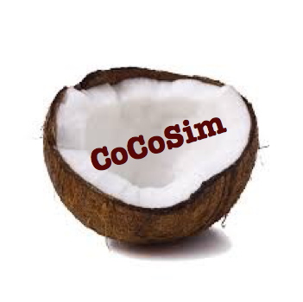


Logic-based Algorithmic Verification
Simulink
C/C++
concurrent /distributed systems
Java
SeaHorn
Lustre
CPR
Termination for C
Smart Contracts
T2
Spacer

Slide 27
Logic-based Algorithmic Verification (in 2022)
Data Trees
@ CAV2022
C/C++
SmartACE
Java
Rust
Synthesis
SeaHorn
RustHorn
Solidity
SolType
MESSY
SolCMC
@ CAV2022
Simulink
Spacer

Slide 28
A Brief History of Modern CHC in MC
PLDI 2012 S. Grebenshchikov, N. P. Lopes, C. Popeea, A. Rybalchenko , “Synthesizing software verifiers from proof rules”
  Constrained Horn Clauses as input format for Software Model Checkers
SAT 2012 K. Hoder, N. Bjørner , “Generalized Property Directed Reachability”
  IC3/PDR for SMT == Solving CHCs
SMT 2012 N. Bjørner, K. L. McMillan, A. Rybalchenko, “Program Verification as Satisfiability Modulo Theories”
  CHC format extension for SMT-LIB
CAV 2014 A. Komuravelli, G., S. Chaki, “SMT-Based Model Checking of Recursive Programs”
  First version of SPACER as an extension of GPDR in Z3
CAV 2015 G, T. Kahsai, A. Komuravelli, J. Navas , “The SeaHorn Verification Framework”
  First robust and efficient automated verification tool based on CHC solving
2018 1st CHC-COMP, SPACER merged into Z3 master
  https://chc-comp.github.io/2018/

Slide 29
Current State of CHC Solving
Multiple mature solvers using competing techniques and algorithms
  Spacer (in Z3), Eldarica, FreqHorn, Golem, …
Annual competition
  CHC-COMP: https://chc-comp.github.io/
  in 2022, 7 tracks with 5+1 solvers
Growing collection of benchmarks
  maintained by CHC-COMP
  established (simplified) format
  organized in separate repos under https://github.com/chc-comp
Growing number of academic and industrial users
  SeaHorn, JayHorn, RustHorn, MESSY, SolType, SolC SMTChecker, …

Slide 30
Art, Science, and Magic of CHCs
Model Checking of Safety Properties is CHC satisfiability
  Logic: Constrained Horn Clauses (CHC)
  “Decision” procedure: Spacer
  Constraints: arithmetic, bv, arrays, quantifiers, adt + recfn, …
Art: finding the right encoding from the problem domain to logic
  the difference between easy to impossible
  encodings can “simulate” specialized algorithms
Science: Progress, termination (when decidable)
  while the underlying problem is undecidable, many fragment or sub-problems are decidable
Magic: really solving useful problems
  interpolation, heuristics, generalizations, …
  the list is endless

Slide 31
END

Slide 32
Solving Constrained Horn Clauses

Slide 33
A little bit of complexity
Satisfiability of CHC over most interesting theories is undecidable
  e.g., CHC(Linear Real Arithmetic), CHC(Linear Integer Arithmetic)
  proof: many easy reductions, for example, counter automata
Satisfiability of Linear CHC over Propositional logic is decidable
  Finite state model checking of transition systems
  Complexity: linear in the size of the graph induced by the transition system
Satisfiability of Non-Linear CHC over Propositional logic is decidable
  Finite state model checking of pushdown systems
  Complexity: cubic in the size of the pushdown system
  Decidability of some classes of CHC: Difference arithmetic (= timed automata)

Slide 34
Procedures for Solving CHC(T)
Predicate abstraction by lifting Model Checking to HORN
  QARMC, Eldarica, …
Maximal Inductive Subset from a finite Candidate space (Houdini)
  TACAS’18: hoice, FreqHorn
Machine Learning
  PLDI’18: sample, ML to guess predicates, DT to guess combinations
Abstract Interpretation (Poly, intervals, boxes, arrays…)
  Approximate least model by an abstract domain (SeaHorn, …)
Interpolation-based Model Checking
  Duality, QARMC, …
SMT-based Unbounded Model Checking (building on IC3/PDR)
  SPACER, Implicit Predicate Abstraction

Slide 35
Spacer: Solving SMT-constrained CHC
Spacer: SAT procedure for SMT-constrained Horn Clauses
  now the default CHC solver in Z3
    https://github.com/Z3Prover/z3
    dev branch at https://github.com/agurfinkel/z3
Supported SMT-Theories
  Linear Real and Integer Arithmetic
  Quantifier-free theory of arrays
  Universally quantified theory of arrays + arithmetic
  Good support for many other SMT-theories
    bit-vectors, ADT, recursive functions, …
Supports Non-Linear CHC
  for procedure summaries in inter-procedural verification conditions
  for compositional reasoning: abstraction, assume-guarantee, thread modular, etc.

Slide 36
A Magician’s Guide to Solving Undecidable Problems
Develop a procedure P for a decidable problem
Show that P is a decision procedure for the problem
  e.g., model checking of finite-state systems
Choose one of
  Always terminate with some answer (over-approximation)
  Always make useful progress (under-approximation)
Extend procedure P to procedure Q that “solves” the undecidable problem
  Ensure that Q is still a decision procedure whenever P is
  Ensure that Q either always terminates or makes progress

Slide 37
SPACER’s guiding principles for solving CHCs
Make Progress
  always make progress
  if input CHC is unsatisfiable, after enough time, the solving procedure must terminate with UNSAT
  e.g., examine longer and longer resolution proofs (i.e., unfoldings)
Keep Decidability
  decision procedure for decidable fragments
  usually, we ensure that solving procedures are decision procedures for CHC over Propositional logic (i.e., finite state model checking)
  ”sharpen” decidability result based on specific domain (i.e., LIA, ADT, etc.)
  many open decidability questions remain
    e.g., is Spacer a decision procedure for (encoding) of timed automata?

Slide 38





IC3, PDR, and friends
$$Init$$
$$Tr$$
$$Tr$$
$$¬Bad$$
Finite State Machines
(HW model checking)
[Bradley, VMCAI 2011]
$$Init$$
$$Tr$$
$$Tr$$
$$¬Bad$$
Push Down Machines
(SW model checking)
[Hoder&Bjørner, SAT 2012]

Slide 39
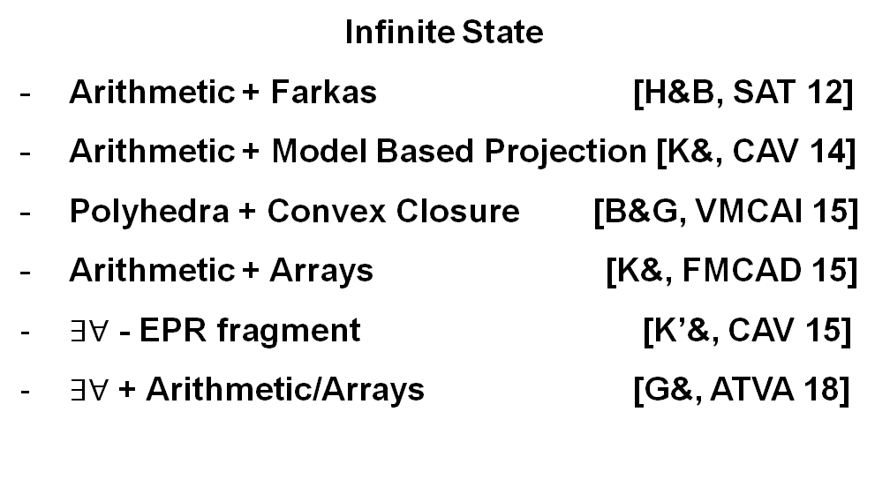






IC3, PDR and friends
$$Init$$
$$Tr$$
$$Tr$$
$$¬Bad$$
Finite State
Incremental SAT solving [Bradley, VMCAI 11]
Fast prime implicants [Een& FMCAD 11]
Basis for predicate abstraction
[Cimatti& TACAS 14, Birgmeier& CAV 14]
Finite State Machines
(HW model checking)
[Bradley, VMCAI 2011]
$$Init$$
$$Tr$$
$$Tr$$
$$¬Bad$$
Infinite State
Arithmetic + Farkas [H&B, SAT 12]
Arithmetic + Model Based Projection [K&, CAV 14]
Polyhedra + Convex Closure [B&G, VMCAI 15]
Arithmetic + Arrays [K&, FMCAD 15]
$∃∀$ - EPR fragment [K’&, CAV 15]
$∃∀$ + Arithmetic/Arrays [G&, ATVA 18]
Push Down Machines
(SW model checking)
[Hoder, Bjørner, SAT 2012]

Slide 40
IC3, PDR and friends
$$Init$$
$$Tr$$
$$Tr$$
$$¬Bad$$
Finite State
SAT
Infinite State
SMT
Arithmetic
Arrays
Quantifiers
Search Strategies
[Bradley, VMCAI 11]
CTI – Counter Examples To Induction
[G&Ivrii, FMCAD 15]
Under and over-approximations
[Vizel&G, CAV 14]
Use SAT for blocking
IC3 for pushing
Finite State Machines
(HW model checking)
[Bradley, VMCAI 2011]
$$Init$$
$$Tr$$
$$Tr$$
$$¬Bad$$
Push Down Machines
(SW model checking)
[Hoder, B, SAT 2012]

Slide 41

Verification by Incremental Generalization
T, N=0
A counterexample of length N exists?
Yes
No, N:=N+1
SMT
Is a safe inductive invariant?
YES
No + bounded proof
SMT
Generalize proof
candidate Inv
SMT

Slide 42

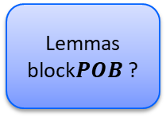





SPACER
Is $POB$reachable?
$$POB$$
IC3-style search for solutions to CHCs
Works by recursively blocking proof obligations (POB)
POB
  BAD states
  Predecessors to BAD states
Generate predecessors using quantifier elimination (Model Based Projection)
Generate predecessor
$POB$’
Is $POB′$ reachable?
NO
NO
Reachable states intersect with $POB$ ?
YES
NO
Lemmas block$POB$ ?
Learn reachable state
Learn lemma
YES
YES
YES
NO

Slide 43










Ground Control to Spacer Tom:
Global Guidance
$$⟨α, i+1⟩$$
$$\text{𝓞}i$$
POB Queue
Lemma Trace
$${⟨α}^{′}, i⟩$$
$$ℓ$$
$$ψ$$
$$⟨γ, t⟩$$
$$ℓ$$
$$⟨φ, j⟩$$
$$\text{ℒ}⊆\text{𝓞}\text{k}$$
Conjecture
Concretize
Subsume
Notes:
We design a guidance technique that takes as input all lemmas in the trace, the proof obligation and the new lemma and give as out either a pob or a new lemma.

Slide 44
CHC Solvers
beyond Spacer

Slide 45
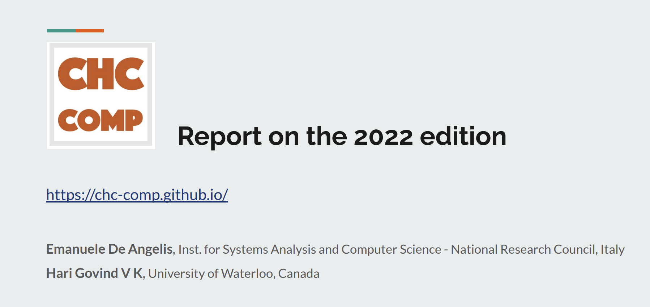

https://chc-comp.github.io/CHC-COMP2022_presentation.pdf

Slide 46

The Eldarica Horn Solver
A Horn solver tailored to verification of software and infinite-state systems
  Algorithms: Predicate abstraction, CEGAR, Craig interpolation
  Theories: LIA, NIA, BV, ADTs, arrays, heap
  Input formats: SMT-LIB, Prolog (+ built-in C front-end)
  Output: Full solution + counterexample output
Open-source, entirely implemented in Scala
Started in 2011, since then developed continuously
  E.g., integration of new theories, hand-in-hand with development of new decision/interpolation procedures
  Upcoming: LRA, improved heap support
https://github.com/uuverifiers/eldarica

Slide 47
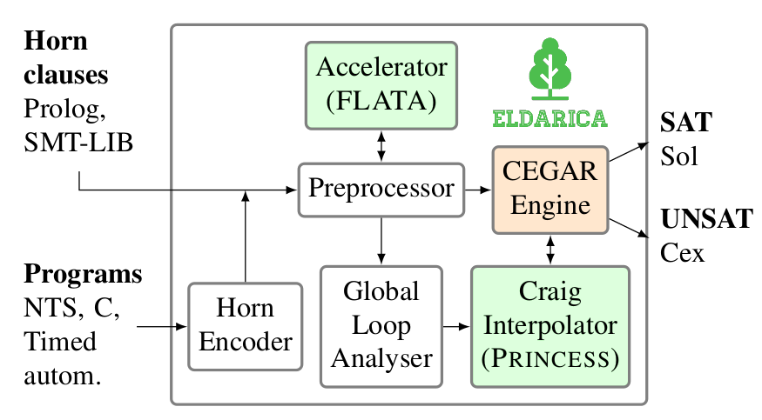
Architecture
Hossein Hojjat, Philipp Rümmer: “The ELDARICA Horn Solver” (FMCAD 2018)

Slide 48
Key feature: global invariant generation methods
Replace cycles with closed-form representations
Identify arithmetic progressions, variable relationships, etc.

Slide 49

FreqHorn: CHC solving by enumerative search
G. Fedyukovich, S. Kaufman, R. Bodik, FMCAD’17
High-level view:
  Loop between a candidate generator and SMT-solver
  Synthesizes lemmas separately
Candidate generator
  Syntax-Guided Synthesis (SyGuS)
  Non-recursive grammars
  obtained from ASTs of verification conditions
  Learnes from positive / negative candidates
SMT-based decision maker
  Off-the-shelf SMT solver
  Does not need interpolation or quantifier elimination
  Easy to maintain
Bad tries
Candidates
(Grammar)
Lemmas
SMT check 1
SMT check 2
…
SMT check n

Slide 50

FreqHorn: CHC applications/extensions
Safety of numerical programs:
  Accelerated using interpolation and Houdini
  Accelerated using data learning and quantifier elimination
  Extended to arrays and quantified invariants
  Extended to disjunctive invariants
(Non)-termination of programs
  Ranking functions, recurrence sets
Modular analysis
  Generation of function summaries
  Proving hyperproperties
Specification synthesis
  From invariants to spec and back
Test case generation
  Invariants block unreachable branches
Fedyukovich and R. Bodík, TACAS’18
Fedyukovich, Prabhu, Madhukar, Gupta, FMCAD’18
-||-, CAV’19
Riley and Fedyukovich, FSE’22
Fedyukovich, Zhang, Gupta, CAV’18
Pick, Fedyukovich, Gupta, VMCAI’21
Pick, Fedyukovich, Gupta, FMCAD’20
Prabhu, Fedyukovich, Madhukar, D’Souza, PLDI’21
Zlatkin and Fedyukovich, TACAS’22

Slide 51
Golem: Overview
Solver for Constrained Horn Clauses
Developed at USI Formal Verification and Security Lab (Lugano, Switzerland) by Martin Blicha et al.
Craig interpolation-based algorithm for CHC solving
Tight integration with interpolating SMT solver OpenSMT
Supports linear real and integer arithmetic as the background theory
Available at https://github.com/usi-verification-and-security/golem

Slide 52
Golem: Brief History
Summer 2020
  first commits
Winter 2020
  Impact engine [McMillan ’06] (Lazy Abstraction with Interpolants)
March 2021
  3 medals at CHC-COMP ’21
May 2021
  Spacer engine [Komuravelli et al. ’16]
Summer 2021
  TPA engine [Blicha et al. ’22] (Transition Power Abstraction)
April 2022
  4 medals at CHC-COMP ’22

Slide 53
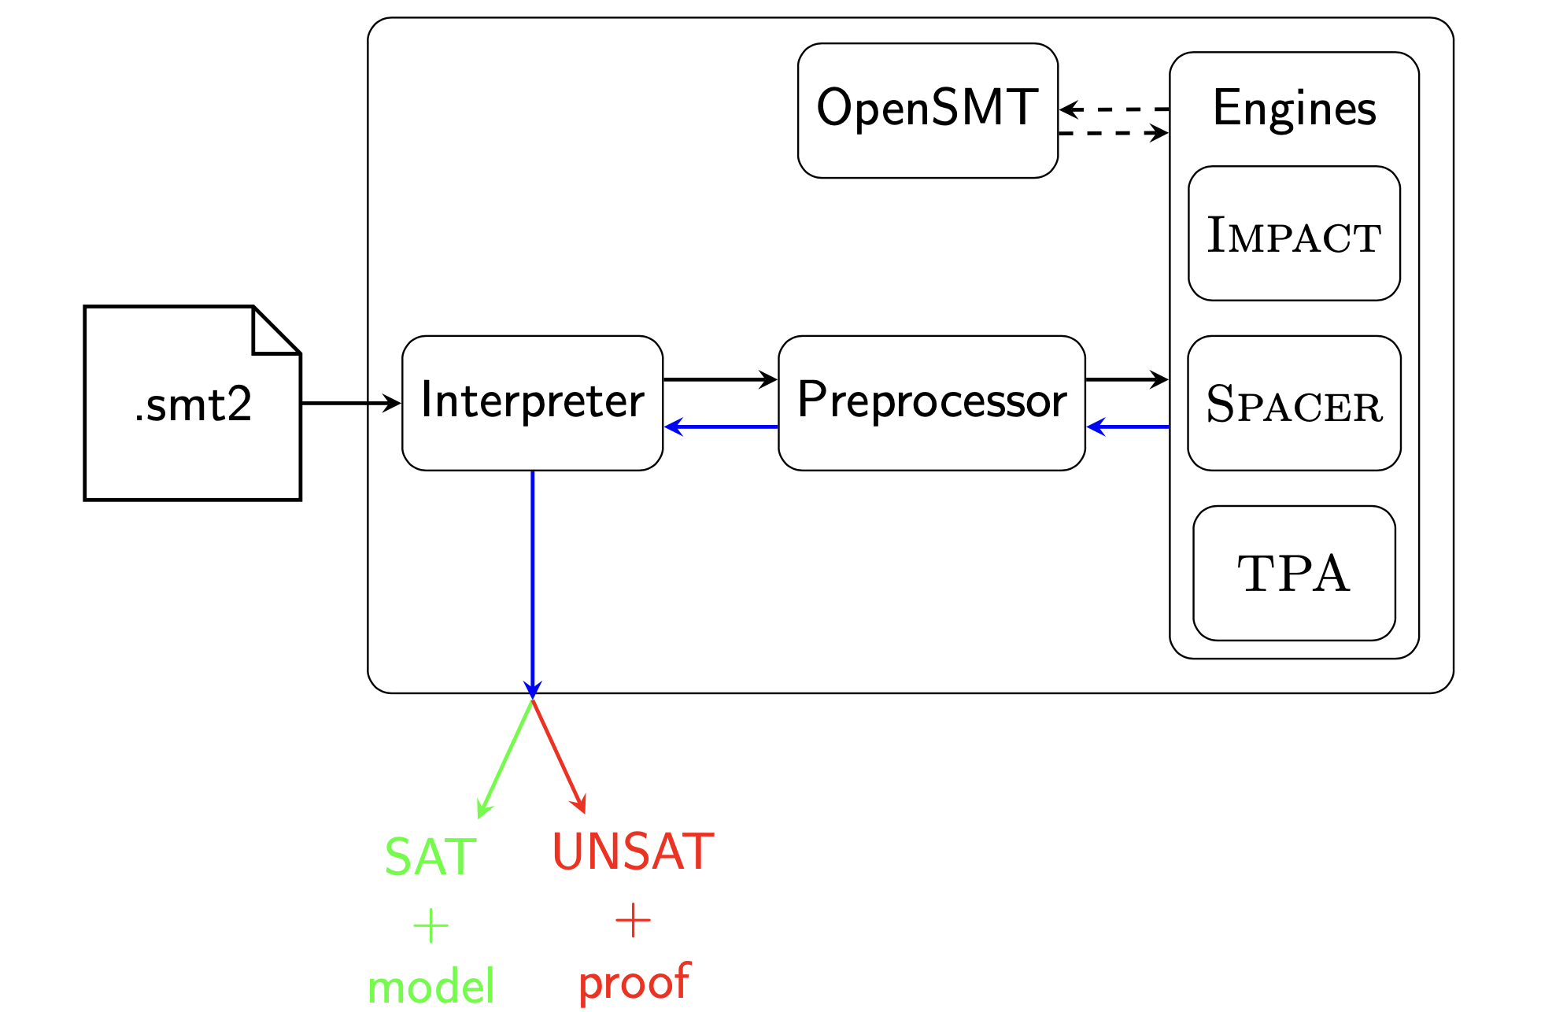
Golem: Architecture

Slide 54
Golem: Future
Extend supported background theories (arrays, ADTs)
Extend TPA engine to support nonlinear CHC systems
Golem as backend for Korn
Golem as backend for SolCMC (Alt et al. ’22)
Develop proper API for Golem as library
Support Datalog input format

Slide 55
Art, Science, and Magic of CHCs
Model Checking of Safety Properties is CHC satisfiability
  Logic: Constrained Horn Clauses (CHC)
  “Decision” procedure: Spacer
  Constraints: arithmetic, bv, arrays, quantifiers, adt + recfn, …
Art: finding the right encoding from the problem domain to logic
  the difference between easy to impossible
  encodings can “simulate” specialized algorithms
Science: Progress, termination (when decidable)
  while the underlying problem is undecidable, many fragment or sub-problems are decidable
Magic: really solving useful problems
  interpolation, heuristics, generalizations, …
  the list is endless

Slide 56
END

