Slide 1
UFO:
From Underapproximations to Overapproximations and Back!
Arie Gurfinkel (SEI/CMU)
with Aws Albarghouthi and Marsha Chechik (U. of Toronto)
and Sagar Chaki (SEI/CMU), and Yi Li (U. of Toronto)
TexPoint fonts used in EMF.
Read the TexPoint manual before you delete this box.: AAAA

Slide 2
Copyright 2013 Carnegie Mellon University
This material is based upon work funded and supported by the Department of Defense under Contract No. FA8721-05-C-0003 with Carnegie Mellon University for the operation of the Software Engineering Institute, a federally funded research and development center.
Any opinions, findings and conclusions or recommendations expressed in this material are those of the author(s) and do not necessarily reflect the views of the United States Department of Defense.
NO WARRANTY. THIS CARNEGIE MELLON UNIVERSITY AND SOFTWARE ENGINEERING INSTITUTE MATERIAL IS FURNISHED ON AN “AS-IS” BASIS. CARNEGIE MELLON UNIVERSITY MAKES NO WARRANTIES OF ANY KIND, EITHER EXPRESSED OR IMPLIED, AS TO ANY MATTER INCLUDING, BUT NOT LIMITED TO, WARRANTY OF FITNESS FOR PURPOSE OR MERCHANTABILITY, EXCLUSIVITY, OR RESULTS OBTAINED FROM USE OF THE MATERIAL. CARNEGIE MELLON UNIVERSITY DOES NOT MAKE ANY WARRANTY OF ANY KIND WITH RESPECT TO FREEDOM FROM PATENT, TRADEMARK, OR COPYRIGHT INFRINGEMENT.
This material has been approved for public release and unlimited distribution.
This material may be reproduced in its entirety, without modification, and freely distributed in written or electronic form without requesting formal permission. Permission is required for any other use. Requests for permission should be directed to the Software Engineering Institute at permission@sei.cmu.edu.
DM-0000399

Slide 3
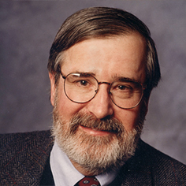
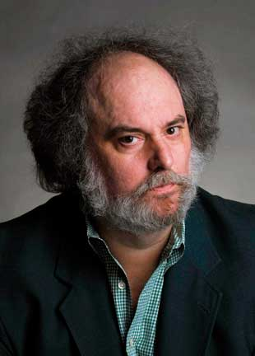
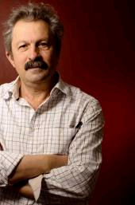
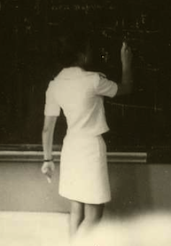
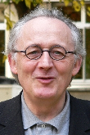
Automated Software Analysis
Automated
Analysis
Correct
Program
Incorrect
Software Model Checking with Predicate Abstraction
e.g., Microsoft’s SDV
Abstract Interpretation with Numeric Abstraction
e.g., ASTREE, Polyspace

Slide 4

UFO
A framework and a tool for software verification
Tightly integrates interpolation- and abstraction-based techniques
Check it out at:
http://bitbucket.org/arieg/ufo
References:
[SAS12] Craig Interpretation
[CAV12] UFO: A Framework for Abstraction- and Interpolation-based Software Verification
[TACAS12] From Under-approximations to Over-approximations and Back
[VMCAI12] Whale: An Interpolation-based Algorithm for Interprocedural Verification

Slide 5
Outline
Over- and Under-approximation Driven Approaches
UFO: From Under- to Over- and Back!
  Exploration Strategy
  Refinement Strategy
Software Verification Competition (SV-COMP’13)
Conclusion

Slide 6
Overapproximation-driven Approach (CEGAR)
Compute invariant
using abstract post
Is safe?
Program
Safe
Cex
Refine post operator
Is cex feasible?
Cex
Interpolation
or WP
SMT
e.g., BLAST, SLAM, CPAChecker, YaSM, SATAbs, etc.

Slide 7
Is ERROR Reachable?
Over-
Approximation
Program
Abstraction
Need This!
1:
1: int x = 2;
int y = 2;
2: while (y <= 2)
3: y = y – 1;
4: if (x == 2)
5: ERROR:;
6:
1: ;
2: while (*)
3: ;
4: if (*)
5: ERROR:;
6:
2:
4:
3:
5:
6:
CEGAR steps
Abstract
Translate
Check
Validate
Repeat
Notes:
TODO: Fixup animation

Slide 8
Over-Driven: Is ERROR Reachable?
Over-
Approximation
Program
Abstraction
(with y<=2)
bool b is (y <= 2)
1: b = T;
2: while (b)
3: b = b ? T : *;
4: if (*)
5: ERROR:;
6:
1:
1: int x = 2;
int y = 2;
2: while (y <= 2)
3: y = y – 1;
4: if (x == 2)
5: ERROR:;
6:
2:b=F
2:b=T
4:b=F
3:b=T
5:b=F
UNREACHABLE
6:b=F
CEGAR steps
Abstract
Translate
Check
NO ERROR

Slide 9
Underapproximation-driven Approach (LAWI)
Generate some paths to error
Are these paths feasible?
Program
Cex
SMT
No
No
Is result an inductive invariant?
Explain why safe
Safe
Interpolation/
WP
e.g., Impact, Impact2, Synergy, Dash, Wolverine

Slide 10
Under- Driven: Is ERROR Reachable?
Program
{true}
1:
{true}
1: int x = 2;
int y = 2;
2: while (y <= 2)
3: y = y – 1;
4: if (x == 2)
5: ERROR:;
6:
{y<=2}
2:
{y<=2}
{false}
4:
3:
{y<=2}
2:
{y<=2}
{false}
5:
4:
{false}
IMPACT steps
5:
{false}
Explore
Refine
Explore
Refine
Cover

Slide 11
Over- Driven v.s. Under- Driven in a Nutshell
OD
UD
int main(){
1 …
2 while (…){
…
}
E: ERROR
}
1
2
2
E
E
Unlabeled
Pred. abs. label
Interpolant label
Explore
Refine
Explore

Slide 12

Over- Driven v.s. Under- Driven in a Nutshell
OD
UD
int main(){
1 …
2 while (…){
…
}
E: ERROR
}
1
2
2
E
2
E
2
E
E
Unlabeled
Pred. abs. label
Interpolant label
Explore
Refine
Explore

Slide 13
Over- Driven v.s. Under- Driven in a Nutshell
OD
UD
int main(){
1 …
2 while (…){
…
}
E: ERROR
}
1
1
1
2
2
2
2
E
2
E
2
E
E
E
E
Unlabeled
Pred. abs. label
Interpolant label
Explore
Refine
Explore
Explore
Refine
Explore

Slide 14
OD vs. UD Approaches
OD
Cost of Exploration
UD
Number of Refinements

Slide 15

Our Algorithm: UFO
[TACAS’12]
UD algorithm
OD algorithm
Predicate
abstraction
based
Interpolation-based
Combination of UD and OD
+
A novel interpolation-based refinement
Multiple paths checked and refined with a single SMT call

Slide 16
UFO in a Nutshell
Iteration 2
Refinement
Iteration 1
L
L
L
E
E
E
E
L
L
L
Imprecise post → UD
Explore from root → OD
Unlabeled
Pred. abs. label
Interpolant label
L

Slide 17
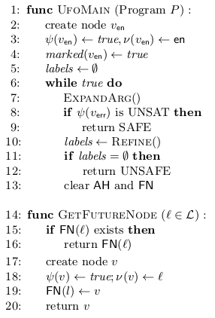
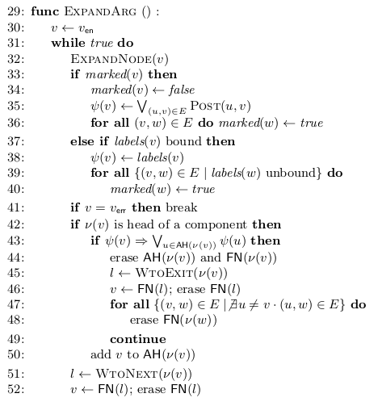
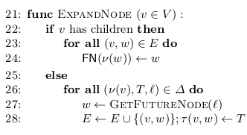
The UFO Algorithm
Explore
Explore
Refine

Slide 18
Weak Topological Ordering
DAG:
1
Definition (WTO):
A weak topological order (WTO) of a DAG G = (V, E) is a well-parenthesised total-order ¹ of V without two consecutive ‘(‘ such that for every edge (u, v) 2 E:
Elements between two matching paren. are called components
First element of a component is called head
!(u) is the set of heads of components containing u
2
7
3
4
5
6
WTO:
(1 (2 3 (4) 5 6) 7)

Slide 19
Refinement
DAG Interpolation

Slide 20
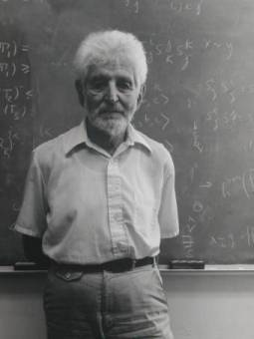
Craig Interpolation Theorem
Theorem (Craig 1957)
Let A and B be two First Order (FO) formulae such that A ) :B, then there exists a FO formula I, denoted ITP(A, B), such that
A ) I I ) :B atoms(I) 2 atoms(A) Å atoms(B)
Theorem (McMillan 2003)
A Craig interpolant ITP(A, B) can be effectively constructed from a resolution proof of unsatisfiability of A Æ B
In Model Checking, Craig Interpolation Theorem is used to safely over-approximate the set of (finitely) reachable states

Slide 21
Craig Interpolation in Model Checking
Over-Approximating Reachable States
  Let R^{i} be the i^{th} step of the transition relation
  Assume: = Init Æ R⁰ Æ … Æ R^{n} Æ Bad is UNSAT (no Bad in n steps)
  Let A = Init Æ R⁰ Æ … Æ R^{n} and B = Bad
  ITP (A, B) (if exists) is an over-approx of states reachable in n-steps that does not contain any Bad states
ITP(A,B)
A
B

Slide 22
Interpolation Sequence, a.k.a. Path Interpolants
Given a sequence of formulas A = {A_{i}}_{i=0}^{n}, an interpolation sequence ItpSeq(A) = {I₁, …, I_{n-1}} is a sequence of formulas such that
  I_{k} is an ITP (A₀ Æ … Æ A_{k-1}, A_{k} Æ … Æ A_{n}), and
  8 k<n . I_{k} Æ A_{k+1}) I_{k+1}
A₀ A₁ A₂ A₃ A₄ A₅ A₆
I₀ I₁ I₂ I₃ I₄ I₅
)
)
)
)
)
)
If A_{i} is a transition relation of step i, then the interpolation sequence is a proof why a program trace is safe.

Slide 23
DAG Interpolants: Solving the Refinement Prob.
Given a DAG G = (V, E) and a labeling of edges ¼:E→Expr. A DAG Interpolant (if it exists) is a labeling I:V→Expr such that
  for any path v₀, …, v_{n}, and 0 < k < n, I(v_{k}) = ITP (¼(v₀) Æ … Æ ¼ (v_{k-1}), ¼(v_{k}) Æ … Æ ¼(v_{n}))
  8 (u, v) 2 E . (I(u) Æ ¼ (u, v)) ) I(v)
1
I₁
¼₁
2
I₂
I₂ = ITP (¼₁, ¼₈)
I₂ = ITP (¼₁, ¼₂ Æ ¼₃ Æ ¼₆ Æ ¼₇)
…
(I₁ Æ ¼₁) ) I₂
(I₂ Æ ¼₈) ) I₇
(I₂ Æ ¼₂) ) I₃
…
¼₂
I₃
¼₃
3
¼₄
¼₈
4
I₄
5
I₅
I₇
7
¼₆
¼₅
¼₇
6
I₆

Slide 24
DAG Interpolation Algorithm
Reduce DAG Interpolation to Sequence Interpolation!
Encode input DAG by a set of constraints. One constraint per vertex.
DagItp ((V, E), ¼)
{
(A₀, …, A_{n}) = Encode(V, E, ¼)
(I₁, …, I_{n-1}) = SeqItp(A₀, …, A_{n})
for i in [1, n-1] do J_{i} = Clean(I_{i})
return (J₁, …, J_{n-1})
}
Compute interpolant sequence. One interpolant per vertex.
Remove out-of-scope variables

Slide 25
DagItp: Encode
A₁
v₁
v₁ ) v₂ Æ ¼₁
1
¼₁
2
Encode
A₂
v₂ ) (v₃ Æ ¼₂) Ç (v₇ Æ ¼₈)
¼₂
A₃
v₃ ) (v₄ Æ ¼₃) Ç (v₅ Æ ¼₄)
¼₃
3
¼₄
¼₈
4
5
A₄
v₄ ) v₆ Æ ¼₆
7
¼₆
¼₅
A₅
v₅ ) v₆ Æ ¼₅
¼₇
6
A₆
v₆ ) v₇ Æ ¼₇

Slide 26
DagItp: Sequence Interpolate
1
A₁
v₁
v₁ ) v₂ Æ ¼₁
1
2
A₂
v₂ ) (v₃ Æ ¼₂) Ç (v₇ Æ ¼₈)
L
3
A₃
v₃ ) (v₄ Æ ¼₃) Ç (v₅ Æ ¼₄)
I₄
3
A₄
v₄ ) v₆ Æ ¼₆
4
5
A₅
v₅ ) v₆ Æ ¼₅
7
A₆
v₆ ) v₇ Æ ¼₇
6

Slide 27
DagItp: Clean
Clean(I_{i}) =
The universal quantification is a major bottleneck in practice. We use many heuristics to limit its application. In the worst case, we use quantifier elimination by Loos and Weispfenning as implemented in Z3.
We are exploring several approaches that do not require quantifier elimination at all.

Slide 28

UFO Refinement
1
Construct DAG of current unfolding
Use DagItp to find new labels
Refinement is done with a single SMT call
Cleaning the labels with quantifier elimination is a major bottleneck
L
3
4
5
E
L’

Slide 29
UFO in a Nutshell
Iteration 2
Refinement
Iteration 1
L
L
L
E
E
E
E
L
L
L
Imprecise post → UD
Explore from root → OD
Unlabeled
Pred. abs. label
Interpolant label
L

Slide 30
UFO as a Framework: The Architecture
C Program
with assertions
C to LLVM
Optimizer
Cutpoint Graph
Mathsat
SMT interface
ARG Constructor
Z3
Refinement Strategy
Abstract Post
Expansion Strategy

Slide 31
Recent Related Work
Intra-procedural
Impact [McMillan 06]
  Original lazy abstraction with interpolants
Impact2 [McMillan 10]
  Targets testing/exploration
Wolverine [Weissenbacher 11]
  Bit-level interpolants
Ultimate [Ermis et al. 12]
  Impact with Large Block Encoding for Refinement
Whale [Our work 12]
  Inter-procedural verification with interpolants
FunFrog [Sery et al. 11]
  Function summarization using interpolants
Inter-procedural

Slide 32
More Recent Related Work
Software Model Checking via IC3 [Cimatti and Griggio, 12]
  IMPACT with IC3-style generalization
Duality [McMillan and Rybalchenko, 12]
  Interpolation-based algorithm for Relational Post-Fixed Point
Generalized Property Directed Reachability [Hoder and Bjorner, 12]
  Relational Post-Fixed Point in Z3
Solving Recursion-Free Horn Clauses over LI+UIF [Gupta et al. 11]
  solving DAG interpolation and beyond…
Alternate and Learn [Sinha et al. 12]
  strategies for inlining/instantiating procedures in bounded verification

Slide 33
Software Verification Competition (SV-COMP 2013)

Slide 34
SV-COMP 2013
http://sv-comp.sosy-lab.org/2013/
2nd Software Verification Competition held at TACAS 2013
Goals
  Provide a snapshot of the state-of-the-art in software verification to the community.
  Increase the visibility and credits that tool developers receive.
  Establish a set of benchmarks for software verification in the community.
Participants:
  BLAST, CPAChecker-Explicit, CPAChecker-SeqCom, CSeq, ESBMC, LLBMC, Predator, Symbiotic, Threader, UFO, Ultimate
Benchmarks:
  C programs with ERROR label (programs include pointers, structures, etc.)
  Over 2,000 files, each 2K – 100K LOC
  Linux Device Drivers, SystemC, “Old” BLAST, Product Lines
  http://sv-comp.sosy-lab.org/2013/benchmarks.php

Slide 35
SV-COMP 2013: Scoring Scheme
Points | Reported Result | Description
0 | UNKNOWN | Failure to compute verification result, out of resources, program crash.
+1 | FALSE/UNSAFE correct | The error in the program was found and an error path was reported.
-4 | FALSE/UNSAFE wrong | An error is reported for a program that fulfills the property (false alarm, incomplete analysis).
+2 | TRUE/SAFE correct | The program was analyzed to be free of errors.
-8 | TRUE/SAFE wrong | The program had an error but the competition candidate did not find it (missed bug, unsound analysis).
Ties are broken by run-time

Slide 36


UFO Results
UFO won gold in 4 categories
  Control Flow Integers (perfect score)
  Product Lines (perfect score)
  Device Drivers
  SystemC
Performed much better than mature Predicate Abstraction-based tools
http://sv-comp.sosy-lab.org/2013/results/index.php

Slide 37
Secret Sauce
UFO Front-End
Vinta: combining UFO with Abstract Interpretation [SAS ‘2012]
Boxes Abstract Domain [SAS ‘2010 w/ Sagar Chaki]
DAG Interpolation [TACAS ‘2012 and SAS ‘2012]
Run many variants in parallel

Slide 38
UFO Front End
In principle simple, but in practice very messy
  CIL passes to normalize the code (library functions, uninitialized vars, etc.)
  llvm-gcc (without optimization) to compile C to LLVM bitcode
  llvm opt with many standard, custom, and modified optimizations
    lower pointers, structures, unions, arrays, etc. to registers
    constant propagation + many local optimizations
    difficult to preserve intended semantics of the benchmarks
    based on very old LLVM 2.6 (newer version of LLVM are “too smart”)
Many benchmarks discharged by front-end alone
  1,321 SAFE (out of 1,592) and 19 UNSAFE (out of 380)
C Program
with assertions
C to LLVM
Optimizer
Cutpoint Graph

Slide 39

Vinta: Verification with INTERP and AI
SAFE
(+Invariant)
UNSAFE
(+CEX)
Unsafe Invariant
Abstract
Interpretation
Refinement
Program
Interpolation
Strengthening
  uses Cutpoint Graph (CPG)
  maintains an unrolling of CPG
  computes disjunctive invariants
  uses novel powerset widening
  uses SMT to check for CEX
  DAG Interpolation for Refinement
  Guided by AI-computed Invs
  Fills in “gaps” in AI

Slide 40
Boxes Abstract Domain: Semantic View *
Boxes are “finite union of box values”
(alternatively)
Boxes are “Boolean formulas over interval constraints”
*joint work w/ Sagar Chaki

Slide 41
Linear Decision Diagrams in a Nutshell*
Linear Decision Diagram
Linear Arithmetic Formula
(x + 2y < 10) OR
(x + 2y ≥ 10 AND z < 10)
false
edge
x + 2y < 10
Compact Representation
decision
node
z < 10
Sharing sub-expressions
Local numeric reductions
Dynamic node reordering
true
edge
Operations
0
1
Propositional (AND, OR, NOT)
Existential Quantification
false
terminal
true
terminal
*joint work w/ Sagar Chaki and Ofer Strichman

Slide 42
DAG Interpolants: Solving the Refinement Prob.
Given a DAG G = (V, E) and a labeling of edges ¼:E→Expr. A DAG Interpolant (if it exists) is a labeling I:V→Expr such that
  for any path v₀, …, v_{n}, and 0 < k < n, I(v_{k}) = ITP (¼(v₀) Æ … Æ ¼ (v_{k-1}), ¼(v_{k}) Æ … Æ ¼(v_{n}))
  8 (u, v) 2 E . (I(u) Æ ¼ (u, v)) ) I(v)
1
I₁
¼₁
2
I₂
I₂ = ITP (¼₁, ¼₈)
I₂ = ITP (¼₁, ¼₂ Æ ¼₃ Æ ¼₆ Æ ¼₇)
…
(I₁ Æ ¼₁) ) I₂
(I₂ Æ ¼₈) ) I₇
(I₂ Æ ¼₂) ) I₃
…
¼₂
I₃
¼₃
3
¼₄
¼₈
4
I₄
5
I₅
I₇
7
¼₆
¼₅
¼₇
6
I₆

Slide 43
Parallel Verification Strategy
Run 7 verification strategies in parallel until a solution is found
  cpredO3
    all LLVM optimizations + Cartesian Predicate Abstraction
  bpredO3
    all LLVM optimizations + Boolean PA + 20s TO
  bigwO3
    all LLVM optimizations + BOXES + non-aggressive widening + 10s TO
  boxesO3
    all LLVM optimizations + BOXES + aggressive widening
  boxO3
    all LLVM optimizations + BOX + aggressive widening + 20s TO
  boxesO0
    minimal LLVM optimizations + BOXES + aggressive widening
  boxbpredO3
    all LLVM opts + BOX + Boolean PA + aggressive widening + 60s TO

Slide 44
UFO
A framework and a tool for software verification
Tightly integrates interpolation- and abstraction-based techniques
Check it out at:
http://bitbucket.org/arieg/ufo
References:
[SAS12] Craig Interpretation
[CAV12] UFO: A Framework for Abstraction- and Interpolation-based Software Verification
[TACAS12] From Under-approximations to Over-approximations and Back
[VMCAI12] Whale: An Interpolation-based Algorithm for Interprocedural Verification

Slide 45
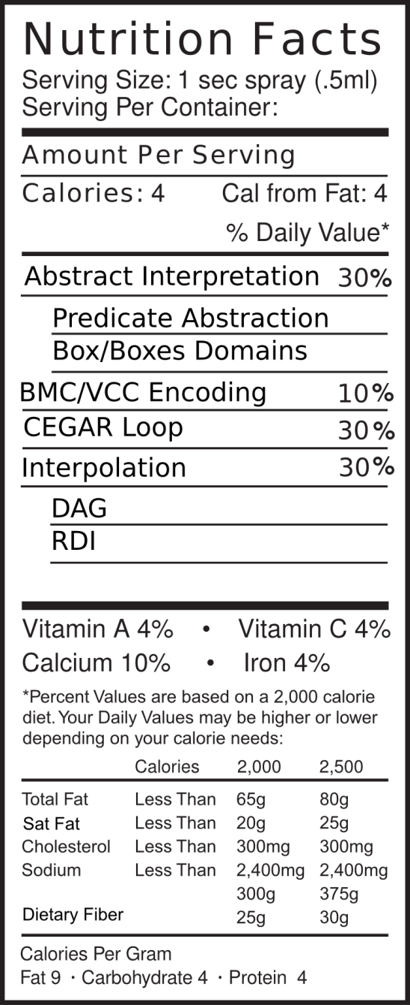
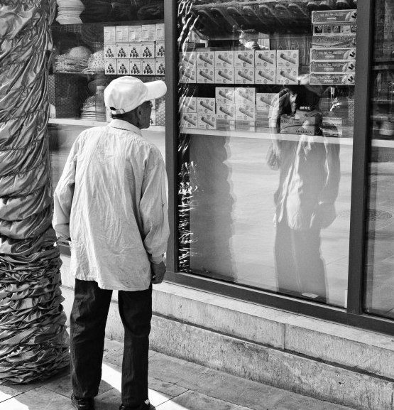
In The Box
Image courtesy of Aws Albarghouthi

Slide 46


UFO Family
Interpolation-based interprocedural analysis
Interpolants as procedure summaries
State/transition interpolation
  a.k.a. Tree Interpolants
Whale [VMCAI12]
Refinement with DAG interpolants
Tight integration of interpolation-based verification with predicate abstraction
UFO [TACAS12]
Refinement of Abstract Interpretation (AI)
AI-guided DAG Interpolation
Vinta [SAS12]

Slide 47

Thank You!
http://bitbucket.org/arieg/ufo

Slide 48
Contact Information
Presenter Arie Gurfinkel RTSS Telephone: +1 412-268-7788 Email: arie@cmu.edu | U.S. mail: Software Engineering Institute Customer Relations 4500 Fifth Avenue Pittsburgh, PA 15213-2612 USA
Web: www.sei.cmu.edu http://www.sei.cmu.edu/contact.cfm | Customer Relations Email: info@sei.cmu.edu Telephone: +1 412-268-5800 SEI Phone: +1 412-268-5800 SEI Fax: +1 412-268-6257

Slide 49
THE END

