Slide 1

Algorithmic Logic-Based Verification:
Parameterized Systems
Arie Gurfinkel
Department of Electrical and Computer Engineering
University of Waterloo
Waterloo, Ontario, Canada
http://ece.uwaterloo.ca/~agurfink
Notes:
Title Slide
Title and Subtitle text blocks should not be moved from their position if at all possible.

Slide 2

Algorithmic Logic-Based Verification
Safety Properties
Program + Spec
Verification Condition (in Logic)
Decision Procedure
Constrained Horn Clauses
Spacer
Yes
No

Slide 3

Symbolic reachability

Slide 5
Symbolic Reachability Problem
P = (V, Init, Tr, Bad)
P is UNSAFE if and only if there exists a number N s.t.
P is SAFE if and only if there exists a safe inductive invariant Inv s.t.
Inductive
Safe

Slide 6
Constrained Horn Clauses (CHC)
A Constrained Horn Clause (CHC) is a FOL formula of the forms
8 V . (Á Æ p₁[X₁] Æ…Æ p_{n}[X_{n}] → p_{n+1}[X])
8 V . (Á Æ p₁[X₁] Æ…Æ p_{n}[X_{n}] → false)
where
  Á is a constrained in a background theory A
    of combined theory of Linear Arithmetic, Arrays, Bit-Vectors, …
  p₁, …, p_{n+1} are n-ary predicates
  p_{i}[X] is an application of a predicate to first-order terms

Slide 7
Spacer: Solving SMT-constrained CHC
Spacer: a solver for SMT-constrained Horn Clauses
  stand-alone implementation in a fork of Z3
  http://bitbucket.org/spacer/code
Support for Non-Linear CHC
  model procedure summaries in inter-procedural verification conditions
  model assume-guarantee reasoning
  uses MBP to under-approximate models for finite unfoldings of predicates
  uses MAX-SAT to decide on an unfolding strategy
Supported SMT-Theories
  Best-effort support for arbitrary SMT-theories
    data-structures, bit-vectors, non-linear arithmetic
  Full support for Linear arithmetic (rational and integer)
  Quantifier-free theory of arrays
    only quantifier free models with limited applications of array equality

Slide 8

Abstraction-Refinement in Spacer
Program
Abstract
Under-Approximate
Refine
No
Proof-Based Abstraction
CEGAR
No
Check Safety
Feasible?
Feasible?
Safety Proof
Counterexample
Yes
Yes

Slide 9
IC3, PDR, and Friends (1)
IC3: A SAT-based Hardware Model Checker
  Incremental Construction of Inductive Clauses for Indubitable Correctness
  A. Bradley: SAT-Based Model Checking without Unrolling. VMCAI 2011
PDR: Explained and extended the implementation
  Property Directed Reachability
  N. Eén, A. Mishchenko, R. K. Brayton: Efficient implementation of property directed reachability. FMCAD 2011
PDR with Predicate Abstraction (easy extension of IC3/PDR to SMT)
  A. Cimatti, A. Griggio, S. Mover, St. Tonetta: IC3 Modulo Theories via Implicit Predicate Abstraction. TACAS 2014
  J. Birgmeier, A. Bradley, G. Weissenbacher: Counterexample to Induction-Guided Abstraction-Refinement (CTIGAR). CAV 2014

Slide 10
IC3, PDR, and Friends (2)
GPDR: Non-Linear CHC with Arithmetic constraints
  Generalized Property Directed Reachability
  K. Hoder and N. Bjørner: Generalized Property Directed Reachability. SAT 2012
SPACER: Non-Linear CHC with Arithmetic
  fixes an incompleteness issue in GPDR and extends it with under-approximate summaries
  A. Komuravelli, A. Gurfinkel, S. Chaki: SMT-Based Model Checking for Recursive Programs. CAV 2014
PolyPDR: Convex models for Linear CHC
  simulating Numeric Abstract Interpretation with PDR
  N. Bjørner and A. Gurfinkel: Property Directed Polyhedral Abstraction. VMCAI 2015
ArrayPDR: CHC with constraints over Airthmetic + Arrays
  Required to model heap manipulating programs
  A. Komuravelli, N. Bjørner, A. Gurfinkel, K. L. McMillan:Compositional Verification of Procedural Programs using Horn Clauses over Integers and Arrays. FMCAD 2015

Slide 11
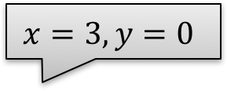
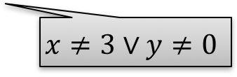
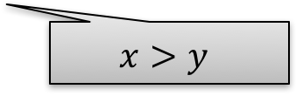

Spacer In Pictures
SpcrMkSafe
$$x=3,y=0$$
$$x=1,y=0$$
$$x>y$$
$$x≠3∨y≠0$$

Slide 12




Logic-based Algorithmic Verification
Simulink
C/C++
concurrent /distributed systems
Java
SeaHorn
Lustre
CPR
Termination for C
T2
Spacer

Slide 13

http://seahorn.github.io

Slide 14
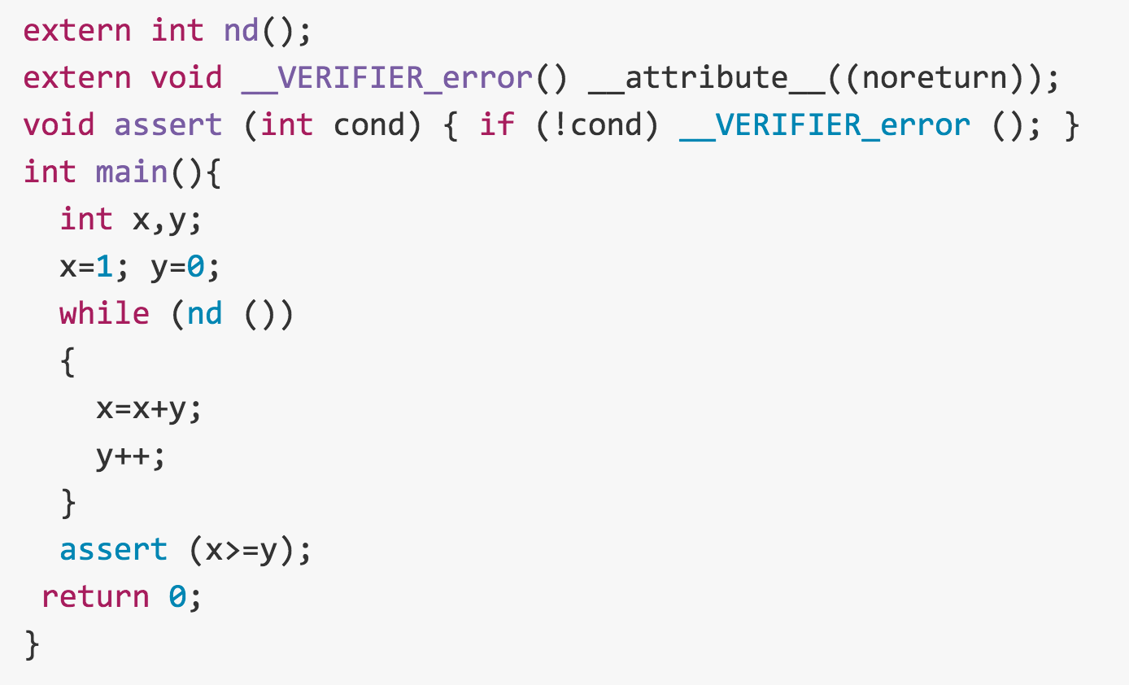

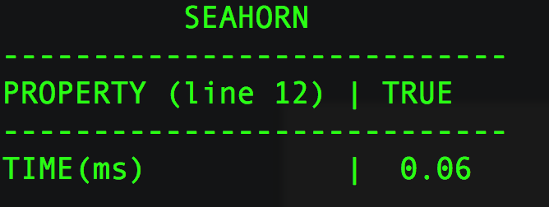


SeaHorn Usage
Example: in test.c, check that x is always greater than or equal to y
test.c
SeaHorn result:
SeaHorn command:

Slide 15
SeaHorn Architecture

Slide 16
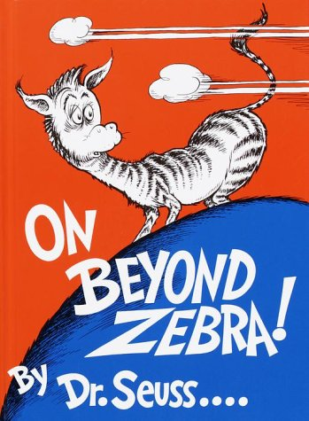
Parametrized Symbolic reachability
Arie Gurfinkel, Sharon Shoham, and Yuri Meshman. SMT-Based Verification of Parameterized Systems. FSE 2016.

Slide 17
What we want to do …

Slide 18
Parameterized Symbolic Reachability Problem
T = ( v, Init(N,v), Tr(i, N, v, v’), Bad (N,v) )
  v is a set of state variables
    each v_{k} 2 v is a map Nat→Rat
    v is partitioned into Local(v) and Global(v)
  Init(N,v) and Bad(N,v) are initial and bad states, respectively
  Tr(i, N, v, v’) is a transition relation, parameterized by a process identifier i and total number of processes N
All formulas are over the combined theories of arrays and LRA
Init(N,v) and Bad(N,v) contain at most 2 quantifiers
  Init(N,v) = 8 x,y . φ_{Init}(N, x, y, v), where φ_{Init} is quantifier free (QF)
  Bad(N,v) = 8 x,y . φ_{Bad}(N, x, y, v), where φ_{Bad} is QF
Tr contains at most 1 quantifier
  Tr(i, N, v, v’) = 8 j . ½ (i, j, N, v, v’)

Slide 19
A State of a Parameterized System
_{Global}
v₀ | v₁ | v₂ | v₃
_{PID} | _{Local}
 | v₄ | v₅ | v₆ | v₇
0
1
2
3
4
5
6
…
N

Slide 20
Parameterized Symbolic Reachability
T = (v, Init, Tr, Bad)
T is UNSAFE if and only if there exists a number K s.t.
T is SAFE if and only if there exists a safe inductive invariant Inv s.t.
VC(T)

Slide 21
Parameterized vs Non-Parameterized Reachability
VC(T)
Init, Bad, and Tr might contain quantifiers
  e.g., “ALL processes start in unique locations”
  e.g., “only make a step if ALL other processes are ok”
  e.g., “EXIST two distinct process in a critical section”
Inv cannot be assumed to be quantifier free
  QF Inv is either non-parametric or trivial
Decide existence of quantified solution for CHC
  stratify search by the number of quantifiers
  solutions with 1 quantifier, 2 quantifiers, 3 quantifiers, etc…

Slide 22

One quantifier two quantifier

Slide 23
One Quantifier (Solution)
VC₁(T)
Claim
  If VC₁(T) is QF-SAT then VC(T) is SAT
  If Tr does not contain functions that range over PIDs, then VC₁(T) is QF-SAT only if VC(T) admits a solution definable by a simple single quantifier formula
    simple == quantified id variables do not appear as arguments to functions
VC₁(T) is essentially Owicki-Gries for 2 processes i and j
If there are no global variables then (3) is unnecessary
  VC₁(T) is linear

Slide 24
How do we get it
1. Restrict Inv to a fixed number of quantifiers
  e.g., replace Inv(N, v) with ∀k.Inv₁(k, N, v)
2. Case split consecution Horn clause based on the process that makes the move
  w+1 cases for w-quantifiers
    one for each quantified id variable
    one for interference by “other” process (only for global variables)
3. Instantiate the universal quantifier in ∀k.Inv₁(k, N, v)
  use symmetry to reduce the space of instantiations
4. Other instantiations might be needed for quantifiers if
  id variables appear as arguments to functions

Slide 25
How do we get it
Restrict
Cases
Instantiate

Slide 26
Two Quantifier Solution
Claim
  If VC₂(T) is QF-SAT then VC(T) is SAT
  If Tr does not contain functions that range over PIDs, then VC₂(T) is QF-SAT only if VC(T) admits a solution definable by a simple two quantifier formula
  At least 2 quantifiers are “needed” for systems with global guards
Extends to k-quantifiers

Slide 27
Ticket Protocol
Thinking
self.t:=ticket ticket:=ticket+1
Hungry
[self.t=serving]
Eating
serving:=self.t+1
INIT: pc=Thinking, ticket=0, serving=0
BAD: self.pc=Eating, other.pc=Eating

Slide 28
Discovered Invariant

Slide 29
Putting it all together
Solve for Inductive Invariant
Look for bugs

Slide 30
Finite vs Infinite Number of Processes
Init b[i] and move to pc=D
Move to pc=E when all distinctly init
Tr does not depend on N (number of processes)
Safe for infinitely many processes. Invariant is:
Unsafe for N = 2!

Slide 31
Evaluation and Implementation
Python-based Implementation
  Simple language for specifying concurrent protocols
  Local and Universally guarded transitions
  Constraints over arrays and integer arithmetic
  Reduce to CHC using the rules and solve using Spacer
Evaluated on Simple/Tricky Well-Know Protocols
  Dining philosophers, bakery1, bakery2, collision avoidance, ticket
  Models are pretty close to an implementation
    limit abstraction in modeling, try to make verification hard
  Safe inductive invariants computed within seconds

Slide 32
Related Work
Kedar Namjoshi et al.
  Local Proofs for Global Safety Properties, and many other papers
  systematic derivation of proof rules for concurrent systems
  finite state and fixed number of processes
Andrey Rybalchenko et al.
  Compositional Verification of Multi-Threaded Programs, and others
  compositional proof rules for concurrent systems are CHC
  infinite state and fixed number of processes
Lenore Zuck et al.
  Invisible Invariants
  finite state and parametric number of processes
  finite model theorem for special classes of parametric systems
Nikolaj Bjørner, Kenneth L. McMillan, and Andrey Rybalchenko
  On Solving Universally Quantified Horn Clauses. SAS 2013:

Slide 33
Conclusion
Parameterized Verification == Quantified solutions for CHC
Quantifier instantiation to systematically derive proof rules for verification of safety properties of parameterized systems
  Parameterized systems definable with SMT-LIB syntax
Lazy vs Eager Quantifier Instantiation
  eager instantiation in this talk
  would be good to extend to lazy / dynamic / model-based instantiation
Connections with other work in parameterized verification
  complete instantiation = decidability ?
  relative completeness
  …

Slide 35

?
?
?
?
?
?

