Slide 1


System Verification by Abstract Interpretation
Arie Gurfinkel
Department of Electrical and Computer Engineering
University of Waterloo
Waterloo, Ontario, Canada
http://ece.uwaterloo.ca/~agurfink
Next 40 Years in Abstract Interpretation
January 21, 2017
Notes:
Title Slide
Title and Subtitle text blocks should not be moved from their position if at all possible.

Slide 2
System Verification by Abstract Interpretation
(and Model Checking)
Arie Gurfinkel
Department of Electrical and Computer Engineering
University of Waterloo
Waterloo, Ontario, Canada
http://ece.uwaterloo.ca/~agurfink
Next 40 Years in Abstract Interpretation
January 21, 2017
Notes:
Title Slide
Title and Subtitle text blocks should not be moved from their position if at all possible.

Slide 3
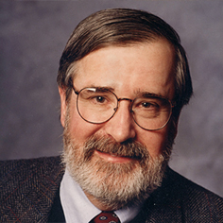
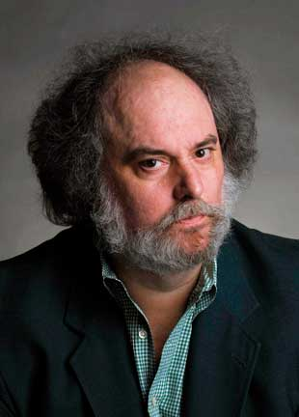
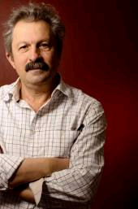
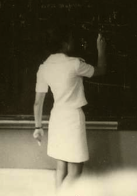
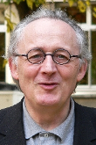
Automated Software Analysis
Automated
Analysis
Correct
Program
Incorrect
Software Model Checking with Predicate Abstraction
e.g., Microsoft’s SDV
Abstract Interpretation with Numeric Abstraction
e.g., Astrée, Polyspace

Slide 4
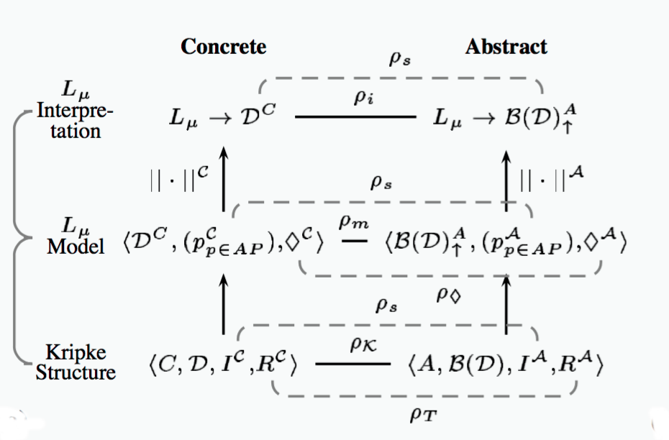
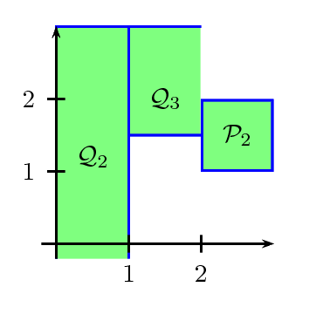


Personal History with Abstract Interpretation
2000
BLAST
VMCAI
started PhD in MC at UofT
multi-valued model checking
VMCAI’06
2006
SMC Yasm: safety, liveness, multi-valued abstraction for MC
2010
Boxes abstract domain (SAS’10)
2012
UFO: MC + AI: SAS’12
SV-COMP
2015
SeaHorn: MC (Spacer) and AI (Crab)

Slide 5
Automated Verification
Deductive Verification
  A user provides a program and a verification certificate
    e.g., inductive invariant, pre- and post-conditions, function summaries, etc.
  A tool automatically checks validity of the certificate
    this is not easy! (might even be undecidable)
  Verification is manual but machine certified
Algorithmic Verification
A user provides a program and a desired specification
    e.g., program never writes outside of allocated memory
  A tool automatically checks validity of the specification
    and generates a verification certificate if the program is correct
    and generates a counterexample if the program is not correct
  Verification is completely automatic – “push-button”

Slide 6
Algorithmic Logic-Based Verification
Safety Properties
Program + Spec
Verification Condition (in Logic)
Decision Procedure
Constrained Horn Clauses
Spacer
Yes
No

Slide 7
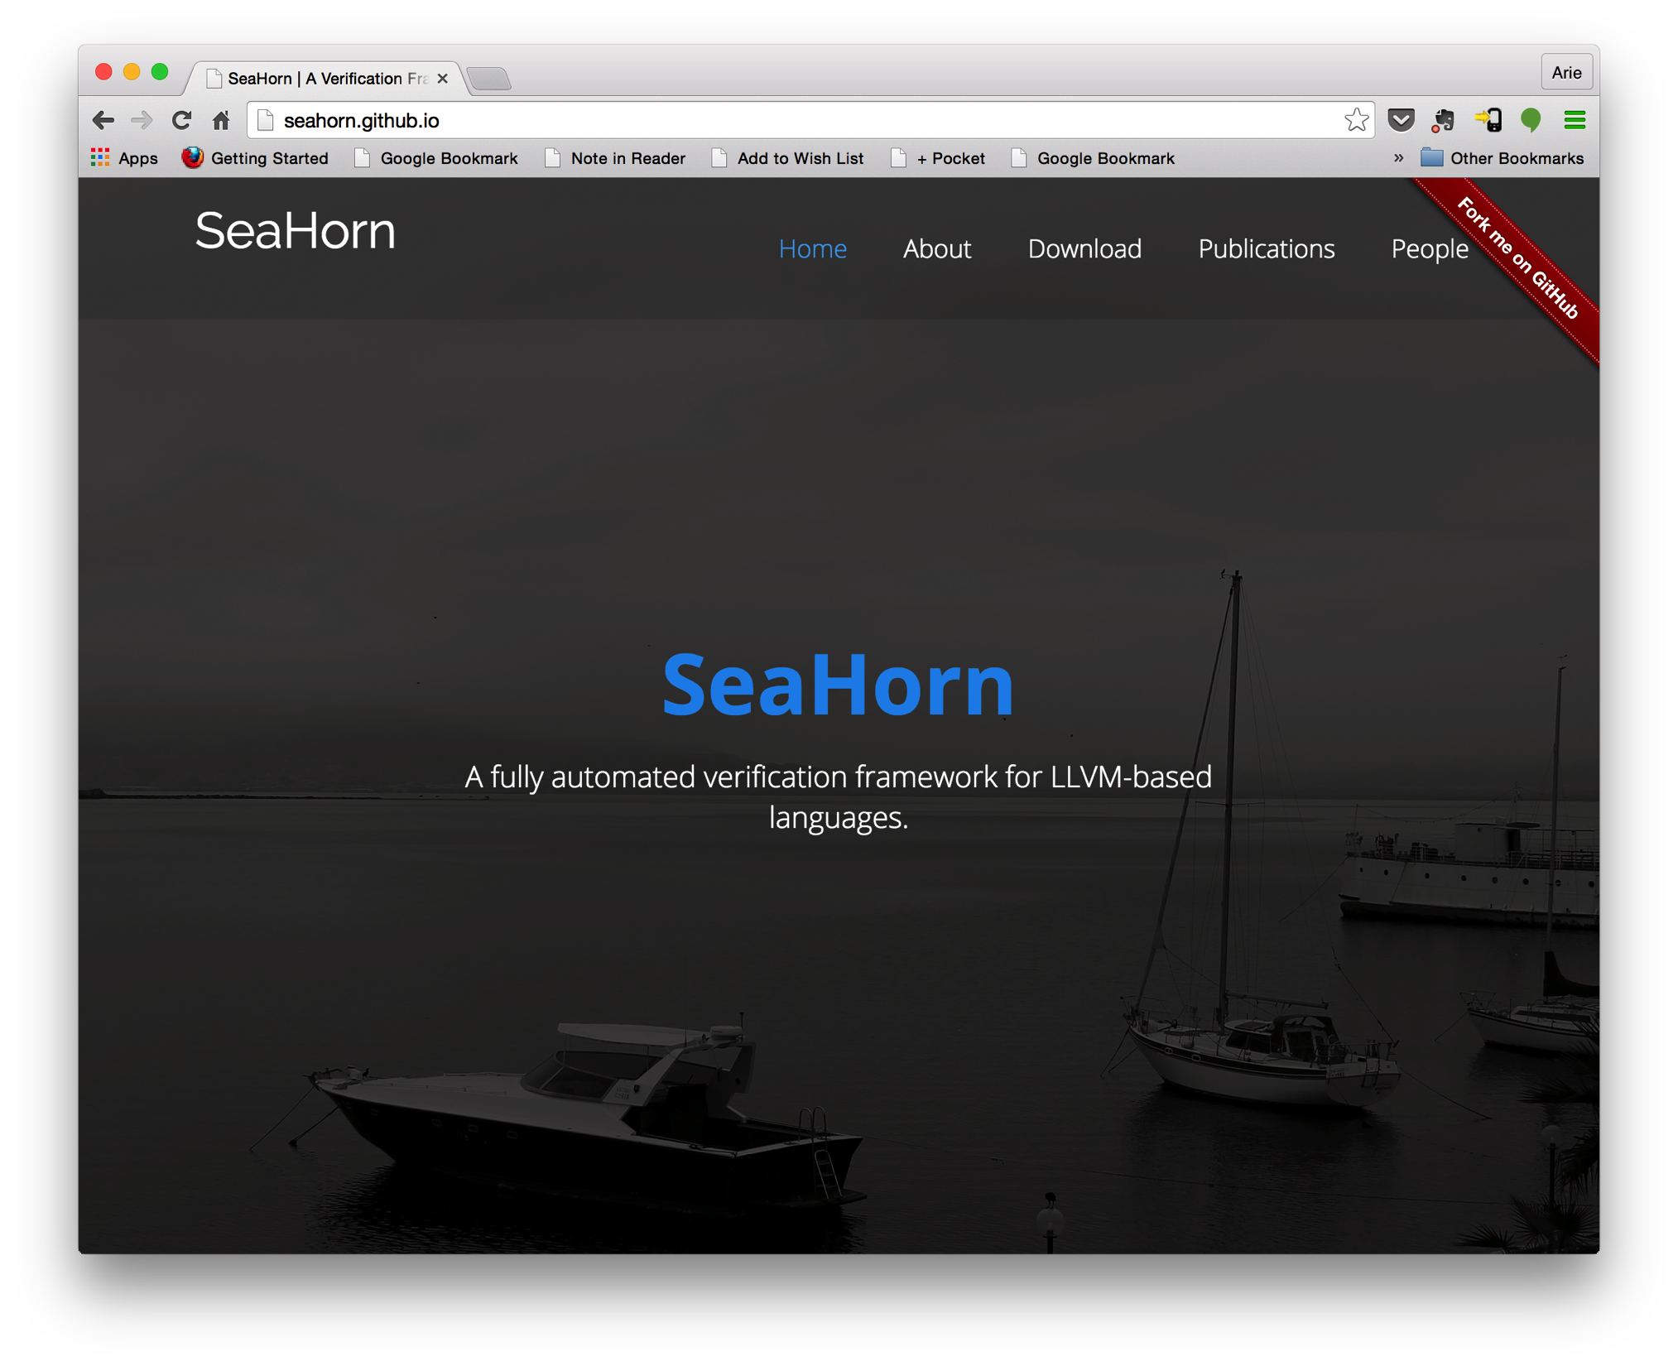
http://seahorn.github.io

Slide 8
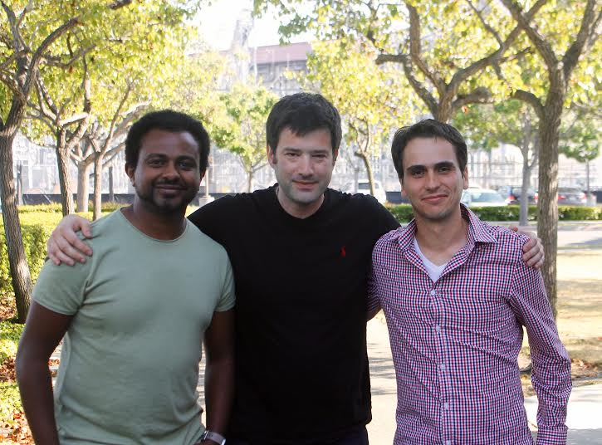
Temesghen Kahsai (NASA/CMU)
Jorge Navas (SRI)
http://seahorn.github.io

Slide 9
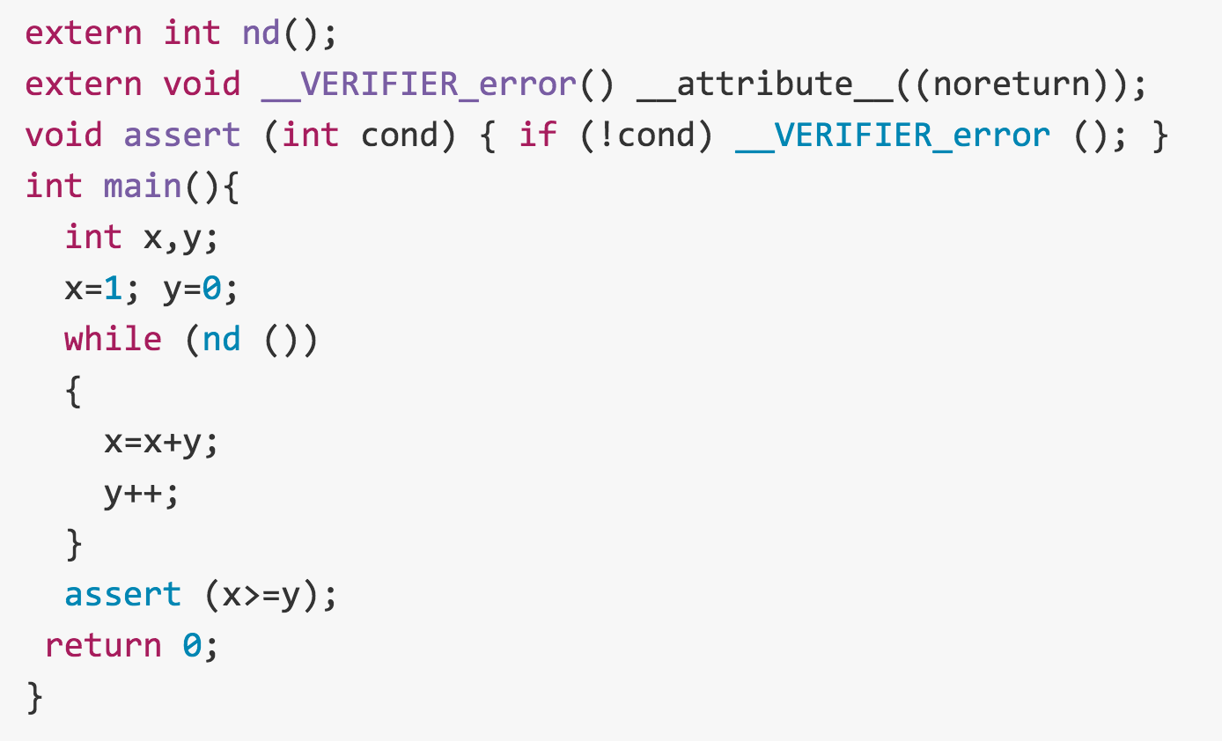

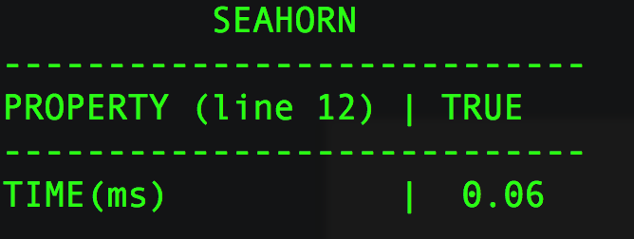


SeaHorn Usage
Example: in test.c, check that x is always greater than or equal to y
test.c
SeaHorn result:
SeaHorn command:

Slide 10
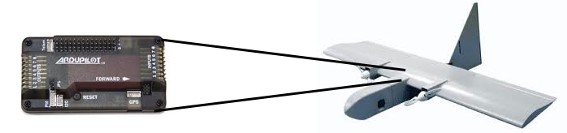
Applications of SeaHorn at NASA
Absence of Buffer Overflows
  Open source auto-pilots
    paparazzi and mnav autopilots
  Automatically instrument buffer accesses with runtime checks
  Use SeaHorn to validate that run-time checks never fail
    slower than pure abstract interpretation
    BUT, much more precise!
Verify Level 5 requirements of the LADEE software stack
  Manually encode requirements in Simulink model
  Verify that the requirements hold in auto-generated C
Memory safety of a C++ controller code
  ongoing…

Slide 11
SV-COMP 2015
http://sv-comp.sosy-lab.org/2015/
4th Competition on Software Verification held at TACAS 2015
Goals
  Provide a snapshot of the state-of-the-art in software verification to the community.
  Increase the visibility and credits that tool developers receive.
  Establish a set of benchmarks for software verification in the community.
Participants:
  Over 22 participants, including most popular Software Model Checkers and Bounded Model Checkers
Benchmarks:
  C programs with error location (programs include pointers, structures, etc.)
  Over 6,000 files, each 2K – 100K LOC
  Linux Device Drivers, Product Lines, Regressions/Tricky examples
  http://sv-comp.sosy-lab.org/2015/benchmarks.php

Slide 12
Results for DeviceDriver category

Slide 13
SeaHorn Architecture
AI
MC

Slide 14
smt-Based Program Verification
Spacer

Slide 15
Logic-based Program Verification
Low-Level Bounded Model Checking (BMC)
  decide whether a low level program/circuit has an execution of a given length that violates a safety property
  effective decision procedure via encoding to propositional SAT
High-Level (Word-Level) Bounded Model Checking
  decide whether a program has an execution of a given length that violates a safety property
  efficient decision procedure via encoding to SMT
What is an SMT-like equivalent for Safety Verification?
  Logic: SMT-Constrained Horn Clauses
  Decision Procedure: Spacer / GPDR
    extend IC3/PDR algorithms from Hardware Model Checking

Slide 16
Symbolic Reachability Problem
P = (V, Init, Tr, Bad)
P is UNSAFE if and only if there exists a number N s.t.
P is SAFE if and only if there exists a safe inductive invariant Inv s.t.
Inductive
Safe

Slide 17
Constrained Horn Clauses (CHC)
A Constrained Horn Clause (CHC) is a FOL formula of the form
8 V . (Á Æ p₁[X₁] Æ…Æ p_{n}[X_{n}] → h[X]),
where
  A is a background theory (e.g., Linear Arithmetic, Arrays, Bit-Vectors, or combinations of the above)
  Á is a constrained in the background theory A
  p₁, …, p_{n}, h are n-ary predicates
  p_{i}[X] is an application of a predicate to first-order terms
A model of a set of clauses is an interpretation of the predicates p_{i} and h that makes all clauses valid
A set of clauses is satisfiable iff it has a model

Slide 18
Horn Clauses for Program Verification
De Angelis et al. Verifying Array Programs by Transforming Verification Conditions. VMCAI'14
Bjørner, Gurfinkel, McMillan, and Rybalchenko:
Horn Clause Solvers for Program Verification

Slide 19
Horn Clauses for Concurrent / Distributed / Parameterized Systems
Hojjat et al. Horn Clauses for Communicating Timed Systems. HCVS'14
Rybalchenko et al. Synthesizing Software Verifiers from Proof Rules. PLDI'12
Gurfinkel et al. SMT-Based Verification of Parameterized Systems. FSE 2016
Hoenicke et al. Thread Modularity at Many Levels. POPL'17
Notes:
Rybalchenko Threader, Podelski POPL’17, Philipp Ruemer Workshop

Slide 20

SMT-based Model Checking
Generalizing from bounded proofs
T, N=0
A counterexample of length N exists?
Yes
No, N:=N+1
SMT
Is a safe inductive invariant?
YES
No + bounded proof
SMT
Generalize proof
candidate Inv
SMT

Slide 21
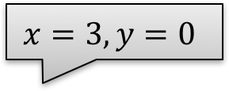
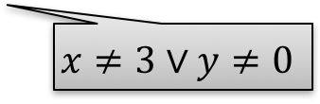
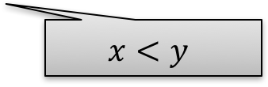

Spacer/IC3/PDR In Pictures: MkSafe
MkSafe
$$x=3,y=0$$
$$x=1,y=0$$
$$x<y$$
$$x≠3∨y≠0$$
F₂
F₃
F₁
F₀

Slide 22
Spacer/IC3/PDR in Pictures: Push
Push
Inductive
Algorithm Invariants
R_{i} → : Bad Init → R_{i}
R_{i} → R_{i+1} R_{i} Æ ½ → R_{i+1}

Slide 23
Spacer: Solving SMT-constrained CHC
Spacer: a solver for SMT-constrained Horn Clauses
  stand-alone implementation in a fork of Z3
  http://bitbucket.org/spacer/code
Support for Non-Linear CHC
  model procedure summaries in inter-procedural verification conditions
  model assume-guarantee reasoning
  uses MBP to under-approximate models for finite unfoldings of predicates
  uses MAX-SAT to decide on an unfolding strategy
Supported SMT-Theories
  Best-effort support for arbitrary SMT-theories
    data-structures, bit-vectors, non-linear arithmetic
  Full support for Linear arithmetic (rational and integer)
  Quantifier-free theory of arrays
    only quantifier free models with limited applications of array equality

Slide 24
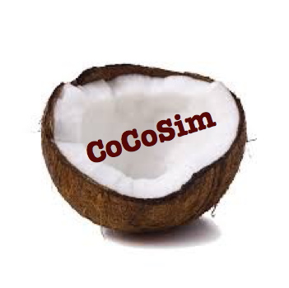


Logic-based Algorithmic Verification
Simulink
C/C++
concurrent /distributed systems
Java
SeaHorn
Lustre
CPR
Termination for C
T2
Spacer

Slide 25
Challenges for the Next 40 Years
Effective combination of Abstract Interpretation and Model Checking
  scalability while maintaining precision
  beyond simple integration
Algorithmic Human-In-The-Loop Verification
  program verification is undecidable
  complex properties always require interaction between human and machine
  e.g., Padon et al. Ivy: Safety Verification by Interactive Generalization. PLDI 2016
Dealing with False Positives
  well known issue in Abstract Interpretation
  often hidden in Model Checking by forcing the User to provide a complete accurate model of the environment!
  need automatic synthesis of environment with user-guidance
  e.g., Lahiri et al. Angelic Verification. CAV 2015.

Slide 26
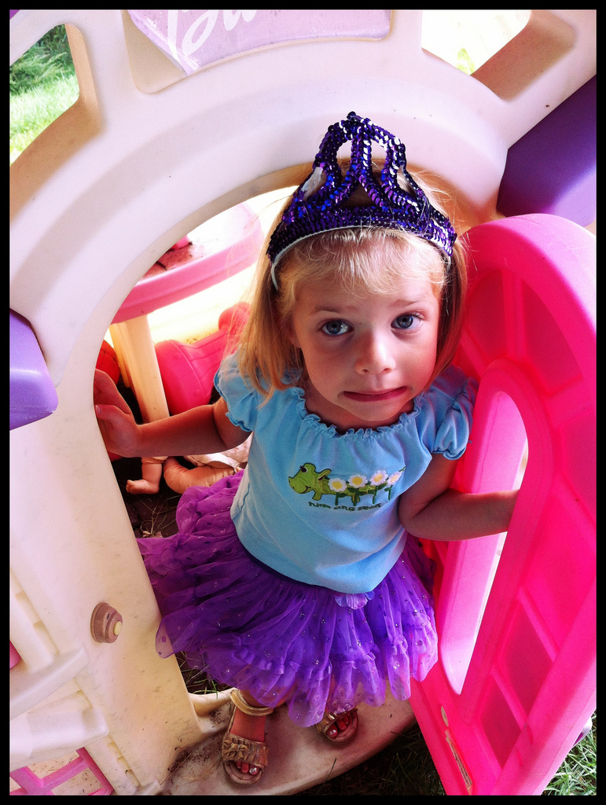
?
?
?
?
?
?

Slide 27
From Programs to Logic
Program
CFG
CHC

Slide 28
IC3/PDR
F = [Init]
MkSafe
CEX
G = [G₀, …, G_{N}]
Push
F = [F₀, …, F_{N}]
F = [F₀, …, F_{N}]
No
9 i, F_{i} = F_{i+1}
Yes
SAFE

Slide 29
Conclusion
SeaHorn (http://seahorn.github.io)
  a state-of-the-art Software Model Checker
  LLVM-based front-end
  CHC-based verification engine
  a framework for research in logic-based verification
The future
  making SeaHorn useful to the consumers of verification technology
    counterexamples, build integration, property specification, proofs,
  Concurrent / distributed / embedded systems
    cyber-physical systems
    very challenging but there are many opportunities
  richer properties
    termination[TACAS’16], liveness, synthesis

Slide 30
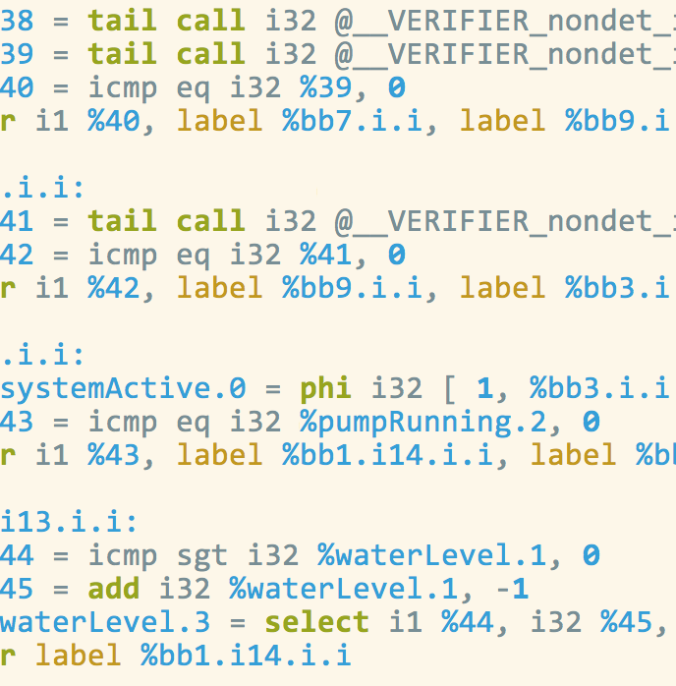
Verification by Successive Under-Approximation
bound 1
bound 2
bound 3
SMT+ Interpolation
SMT+ Interpolation
SMT + Interpolation
Lemma3
Lemma1
Lemma2
bounded proof
Lemma3
Lemma1
Lemma2
bounded proof
Lemma3
Lemma1
Lemma2
bounded proof
Inductive?
No
Inductive?
No
Inductive?
No
SMT
SMT
SMT

Slide 31
Logic-based Program Verification
Low-Level Bounded Model Checking (BMC)
  decide whether a low level program/circuit has an execution of a given length that violates a safety property
  effective decision procedure via encoding to propositional SAT
High-Level (Word-Level) Bounded Model Checking
  decide whether a program has an execution of a given length that violates a safety property
  efficient decision procedure via encoding to SMT
Safety Verification of Propositional Circuits
  decide whether a circuit has an execution (of arbitrary length) that violates a safety property; produce a counterexample or a proof certificate
  efficient decision procedure via reduction to multiple SAT problems

Slide 32
CNF-SAT: Boolean Satisfiability
Decide whether a Boolean formula is satisfiable
  Quintessential NP-complete problem
  Hard, but effectively solvable in practice
DPLL (Davis-Putnam-Logemman-Loveland, ‘60)
  smart enumeration of all possible SAT assignments
  worst-case EXPTIME
  alternate between deciding and propagating variable assignments
CDCL (GRASP ‘96, Chaff ‘01)
  conflict-driven clause learning
  extends DPLL with
    smart data structures, backjumping, clause learning, heuristics, restarts…
  scales to millions of variables

Slide 33
SMT: Satisfiability Modulo Theory
Satisfiability of Boolean formulas over atoms in a theory
  e.g., (x < 0) && (x >= 0)
Extends syntax of Boolean formulas with functions and predicates
  +, -, div, select, store, bvadd, etc.
Existing solvers support many theories useful for program analysis
  Equality and Uninterpreted Functions: f(x)
  Real/Integer Linear Arithmetic: x + 2*y <= 3
  Unbounded Arrays: a[i], a[i := v]
  Bitvectors (a.k.a. machine integers): x >> 3, x/3
  Floating point: 3.0 * x
  …

Slide 34
Horn Clauses for Parameterized Verification
VC₁(T)
Theorem
  If VC₁(T) is QF-SAT then VC(T) is SAT
  If Tr does not contain functions that range over PIDs, then VC₁(T) is QF-SAT only if VC(T) admits a solution definable by a simple single quantifier formula
    simple == quantified id variables do not appear as arguments to functions
VC₁(T) is essentially Owicki-Gries for 2 processes i and j
If there are no global variables then (3) is unnecessary
  VC₁(T) is linear
A. Gurfinkel, S. Shoham, and Yuri Meshman. “SMT-Based Verification of Parameterized Systems”. FSE 2016.

Slide 35
SeaHorn Philosophy
Build a state-of-the-art Software Model Checker
  useful to “average” users
    user-friendly, efficient, trusted, certificate-producing, …
  useful to researchers in verification
    modular design, clean separation between syntax, semantics, and logic, …
Stand on the shoulders of giants
  reuse techniques from compiler community to reduce verification effort
    SSA, loop restructuring, induction variables, alias analysis, …
    static analysis and abstract interpretation
  reduce verification to logic
    verification condition generation
    Constrained Horn Clauses
Build reusable logic-based verification technology
  “SMT-LIB” for program verification

Slide 36
IC3, PDR, and Friends (1)
IC3: A SAT-based Hardware Model Checker
  Incremental Construction of Inductive Clauses for Indubitable Correctness
  A. Bradley: SAT-Based Model Checking without Unrolling. VMCAI 2011
PDR: Explained and extended the implementation
  Property Directed Reachability
  N. Eén, A. Mishchenko, R. K. Brayton: Efficient implementation of property directed reachability. FMCAD 2011
PDR with Predicate Abstraction (easy extension of IC3/PDR to SMT)
  A. Cimatti, A. Griggio, S. Mover, St. Tonetta: IC3 Modulo Theories via Implicit Predicate Abstraction. TACAS 2014
  J. Birgmeier, A. Bradley, G. Weissenbacher: Counterexample to Induction-Guided Abstraction-Refinement (CTIGAR). CAV 2014

Slide 37
IC3, PDR, and Friends (2)
GPDR: Non-Linear CHC with Arithmetic constraints
  Generalized Property Directed Reachability
  K. Hoder and N. Bjørner: Generalized Property Directed Reachability. SAT 2012
SPACER: Non-Linear CHC with Arithmetic
  fixes an incompleteness issue in GPDR and extends it with under-approximate summaries
  A. Komuravelli, A. Gurfinkel, S. Chaki: SMT-Based Model Checking for Recursive Programs. CAV 2014
PolyPDR: Convex models for Linear CHC
  simulating Numeric Abstract Interpretation with PDR
  N. Bjørner and A. Gurfinkel: Property Directed Polyhedral Abstraction. VMCAI 2015
ArrayPDR: CHC with constraints over Airthmetic + Arrays
  Required to model heap manipulating programs
  A. Komuravelli, N. Bjørner, A. Gurfinkel, K. L. McMillan:Compositional Verification of Procedural Programs using Horn Clauses over Integers and Arrays. FMCAD 2015

