Slide 1
Boxes: A Symbolic Abstract Domain of Boxes
Arie Gurfinkel and Sagar Chaki
Software Engineering Institute
Carnegie Mellon University
September 16th, 2010
SAS 2010

Slide 2
Disjunctive Refinement of an Abstract Domain
Bounded disjunctions
  extend base domain with disjunctions of size at most k
  all operations are done by lifting corresponding base domain operations
  easy to implement by modifying program control flow graph
Finite Powerset Domain [Bagnara et al.]
  extend base domain with all finite disjunctions
  most operations are done by lifting corresponding base domain opertions
  finding a good widening is complex (and often tricky)
Predicate Abstraction
  extend finite base domain with all disjunctions
  domain elements are represented by BDDs
  no widening required
OUR
WORK

Slide 3
Outline
Boxes: semantics, representation, operations
Widening
Experiments
Conclusion

Slide 4
Boxes: Semantic View
Boxes are “finite union of box values”
(alternatively)
Boxes are “Boolean formulas over interval constraints”

Slide 5
Boxes: Representation
LDD
Semantics
Represented by (Interval) Linear Decision Diagrams (LDD)
  BDDs + non-terminal nodes are labeled by interval constraints + extra rules
  retain complexity of BDD operations
  canonical for Boxes
  available at http://lindd.sf.net

Slide 6
Domain Operations
order
(semantic)
Basic domain operations are implemented by LDD operations
join
meet
Operation | Complexity
f ⋀ g | O(|f||g|)
ITE(h, f, g) | O(|h||f||g|)
¬ f | O(1)
Operation | Complexity
f ⋁ g | O(|f||g|)
f ⇒ g | O(|f||g|)
∃U. f | O(|f| 2^{|U|})
projection
Additional operations
  set difference f ∖ g implemented by f ⋀¬g
  BoxHull (f) – smallest Box containing f
  BoxJoin (f, g) – smallest Box containing the union of Box f and Box g
used to compare
Box and Boxes
used to compare
Box and Boxes
All operations are polynomial in the size of the representation

Slide 7
Transfer Functions
polynomial
boxes
x := x + 1
expensive
x := x + 1
x := x + 1
box

Slide 8
Outline
Boxes: semantics, representation, operations
Widening
Experiments
Conclusion

Slide 9
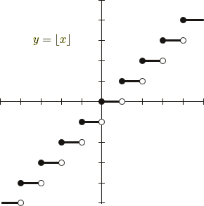
Step Function
A function on the reals ℝ is a step function if it can be written as a finite linear combination of semi-open intervals
  f(x) = α₁ f₁ (x) + ☹ + α_{n} f_{n} (x)
where f_{i} 2 ℝ and α_{i}(x)=1 if x 2 [a_{i}, b_{i}) and 0 otherwise, for i=1,…,n
Weisstein, Eric W. "Step Function." From MathWorld--A Wolfram Web Resource.
http://mathworld.wolfram.com/StepFunction.html

Slide 10
Step Functions as an Abstract Domain
1
2
3
x

Slide 11
Step Functions as an Abstract Domain
interval
[0,3]
[0,0]
[1,10]
x
STEP(D) an abstract domain of step functions over an abstract domain D
  elements are step functions ℝ→D
  order is pointwise: f ⊑ g iff 8 x . f(x) ⊑_{D} g(x)
  join is pointwise: f ⊔ g is ¸ x . f(x) ⊔_{D} g(x)
  meet is pointwise: f ⊓ g is ¸ x . f(x) ⊓_{D} g (x)
  widen is pointwise: f ∇ g is ¸ x . f(x) ∇_{D} g(x) ????

Slide 12
Pointwise Extension of Widen Diverges
1
[0,3]
[0,0]
[1,9]
2
[0,5]
[0,0]
[1,9]
[1,10]
[1,9]
WDN
[0,∞]
[0,0]
[1,9]
[1,∞]
[1,9]
3
[0,∞]
[0,0]
[1,9]
[1,10]
[1,∞]
[1,9]
WDN
[0,∞]
[0,0]
[1,9]
[1,∞]
[1,9]
4
[0,∞]
[0,0]
[1,9]
[1,10]
[1,∞]
[1,9]

Slide 13
Widening for Step Functions
1
[0,3]
[0,0]
[1,9]
2
[0,5]
[0,0]
[1,9]
[1,10]
[1,9]
Step 1
[0,∞]
[0,0]
[1,9]
[1,∞]
[1,9]
Step 2
[0,∞]
[0,0]
[1,∞]
[1,∞]
[1,∞]
Step 3
[0,∞]
[0,0]
[1,∞]

Slide 14
Back to Boxes
Boxes are Step functions!
  1-dim Boxes are STEP({⊥,⊤}) ℝ→{⊥,⊤}
  2-dim Boxes are STEP (STEP ({⊥,⊤}) ℝ→ℝ→{⊥,⊤}
  n-dim Boxes are STEP^{n} ({⊥,⊤}) ℝ^{n}→{⊥,⊤}
Widen for {⊥,⊤} is trivial
Widen for n-dim Boxes is defined recursively on dimensions
In the paper, a polynomial time algorithm that implements this widen operator directly on LDDs.

Slide 15
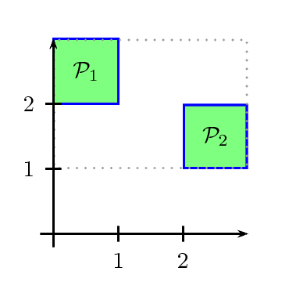
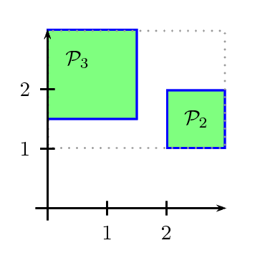
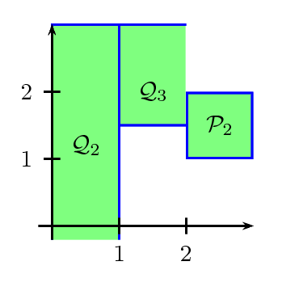
Widen: An Example
widen

Slide 16
Boxes versus Finite Powersets
 | Boxes | Finite Powerset
Base domain | Box | Any
Representation | Decision Diagram | Set / DNF
Domain order | semantic | syntactic
Complexity | polynomial in representation | polynomial in representation
Singleton Widen | Box | base domain
Widen | Step Function | Multiple Choices

Slide 17
Experiments: Invariant Computation
Abstract Domains
  LDD Box – Box domain using LDDs
  LDD Boxes – Our Boxes domain using LDDs
  PPL Box – Rational_Box of Parma Polyhedra Library (PPL)
  PPL Boxes – Pointset_Powerset<Rational_Box> of PPL
Analyzer
  custom analyzer on top of LLVM compiler infrustructure
  computes loop invariants for all loops over all SSA variables in a function
Benchmark
  from open source software: mplayer, CUDD, make, …
  Stats: 5,727 functions
  9 – 9,052 variables (avg. 238, std. 492)
  0 – 241 loops (avg. 7, std. 12)

Slide 18
Results: Time
Domain | %Solved (w/ 60s TO) | Time (m) | % in Basic | % in Image | % in Widen
LDD Box | 99.8% | 4 | 77% | 23% | 0%
PPL Box | 96.1% | 117 | 86% | 14% | 0%
LDD Boxes | 87.9% | 118 | 61% | 38% | 1%
PPL Boxes | 14.2% | 201 | 95% | 1% | 3%

Slide 19
Results: Precision
PPL | LDD
x₁₉=0 x₁₉=1 x₂₃=1 x₁₉=2 x₂₃=2 x₁₉=3 x₂₃=3 x₁₉>3 | x₁₉=0 x₁₉=1 x₂₃=1 x₁₉=2 x₂₃=2 3≤x₁₉<65536 x₂₃=3 3≤x₁₉<65536 x₂₃≥4 x₁₉≥65536 x₂₃=3 x₁₉≥65536 x₂₃≥65536
56%
23%
20%
1%

Slide 20
Widening: PPL vs LDD
PPL
LDD
x = 0;
y = 0
while (1){
x++;
y++;
}
≡
Iteration 1
x=0 y=0
x=0 y=0
x=0 y=0
x=1 y=1
≡
x=0 y=0
x=1 y=1
Iteration 2
x=0 y=0
x=1 y=1
1<x
⊇
x=0 y=0
1≤x y=1
Widen 1
x=0 y=0
1≤x y=1
2≤x y=2
Iteration 3
Widen 2
x=0 y=0
1≤x y=1
1≤x 2≤y

Slide 21
Results: Precision w/ Tuned Widening
56%
44%
32%
23%
20%
1%

Slide 22
Conclusion
Boxes: A new disjunctive abstract domain of sets of boxes
  efficient representation based on Linear Decision Diagrams
  semantic order relation
  efficient operations and widening
  more precise and efficient than finite powersets of box
A new widening scheme
  lifting widening from a base domain to the domain of step functions
Future Work
  applications
  extending the technique to richer base domains, i.e., octagons, TVPI
    representation and base operations are easy (already exist in LDD)
    widening?
http://lindd.sf.net

Slide 23
THE END

Slide 24
Transfer Functions: PPL vs LDD
x=1
x=2
y := x
x=1 y=1
x=2 y=2
PPL
≡
⊇
y := x
LDD
1 ≤ x ≤ 2
1 ≤ x ≤ 2, 1 ≤ y ≤ 2

Slide 25
Contact Information
Presenter Arie Gurfinkel RTSS Telephone: +1 412-268-5800 Email: arie@cmu.edu | U.S. mail: Software Engineering Institute Customer Relations 4500 Fifth Avenue Pittsburgh, PA 15213-2612 USA
Web: www.sei.cmu.edu http://www.sei.cmu.edu/contact.cfm | Customer Relations Email: info@sei.cmu.edu Telephone: +1 412-268-5800 SEI Phone: +1 412-268-5800 SEI Fax: +1 412-268-6257

Slide 26
NO WARRANTY
THIS CARNEGIE MELLON UNIVERSITY AND SOFTWARE ENGINEERING INSTITUTE MATERIAL IS FURNISHED ON AN “AS-IS" BASIS. CARNEGIE MELLON UNIVERSITY MAKES NO WARRANTIES OF ANY KIND, EITHER EXPRESSED OR IMPLIED, AS TO ANY MATTER INCLUDING, BUT NOT LIMITED TO, WARRANTY OF FITNESS FOR PURPOSE OR MERCHANTABILITY, EXCLUSIVITY, OR RESULTS OBTAINED FROM USE OF THE MATERIAL. CARNEGIE MELLON UNIVERSITY DOES NOT MAKE ANY WARRANTY OF ANY KIND WITH RESPECT TO FREEDOM FROM PATENT, TRADEMARK, OR COPYRIGHT INFRINGEMENT.
Use of any trademarks in this presentation is not intended in any way to infringe on the rights of the trademark holder.
This Presentation may be reproduced in its entirety, without modification, and freely distributed in written or electronic form without requesting formal permission. Permission is required for any other use. Requests for permission should be directed to the Software Engineering Institute at permission@sei.cmu.edu.
This work was created in the performance of Federal Government Contract Number FA8721-05-C-0003 with Carnegie Mellon University for the operation of the Software Engineering Institute, a federally funded research and development center. The Government of the United States has a royalty-free government-purpose license to use, duplicate, or disclose the work, in whole or in part and in any manner, and to have or permit others to do so, for government purposes pursuant to the copyright license under the clause at 252.227-7013.

Slide 27
Boxes: Representation
x ≤1
x < 2
y < 1
y ≤ 3
0
1
Represented by (Interval) Linear Decision Diagrams (LDD)
  BDDs + non-terminal nodes are labeled by interval constraints + extra rules
  retain complexity of BDD operations
  canonical for Boxes
  available at http://lindd.sf.net

