Slide 1
Building Program Verifiers from Compilers and Theorem Provers
Software Engineering Institute
Carnegie Mellon University
Pittsburgh, PA 15213
Arie Gurfinkel
based on joint work with Teme Kahsai, Jorge A. Navas, Anvesh Komuravelli, and Nikolaj Bjorner
Notes:
Title Slide
Title and Subtitle text blocks should not be moved from their position if at all possible.

Slide 2
Copyright 2015 Carnegie Mellon University
This material is based upon work funded and supported by the Department of Defense under Contract No. FA8721-05-C-0003 with Carnegie Mellon University for the operation of the Software Engineering Institute, a federally funded research and development center.
Any opinions, findings and conclusions or recommendations expressed in this material are those of the author(s) and do not necessarily reflect the views of the United States Department of Defense.
NO WARRANTY. THIS CARNEGIE MELLON UNIVERSITY AND SOFTWARE ENGINEERING INSTITUTE MATERIAL IS FURNISHED ON AN “AS-IS” BASIS. CARNEGIE MELLON UNIVERSITY MAKES NO WARRANTIES OF ANY KIND, EITHER EXPRESSED OR IMPLIED, AS TO ANY MATTER INCLUDING, BUT NOT LIMITED TO, WARRANTY OF FITNESS FOR PURPOSE OR MERCHANTABILITY, EXCLUSIVITY, OR RESULTS OBTAINED FROM USE OF THE MATERIAL. CARNEGIE MELLON UNIVERSITY DOES NOT MAKE ANY WARRANTY OF ANY KIND WITH RESPECT TO FREEDOM FROM PATENT, TRADEMARK, OR COPYRIGHT INFRINGEMENT.
This material has been approved for public release and unlimited distribution.
This material may be reproduced in its entirety, without modification, and freely distributed in written or electronic form without requesting formal permission. Permission is required for any other use. Requests for permission should be directed to the Software Engineering Institute at permission@sei.cmu.edu.
DM-0002433

Slide 3
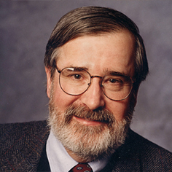
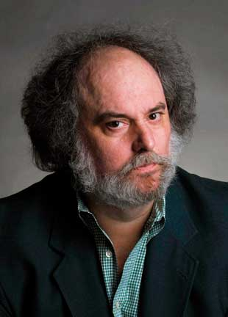

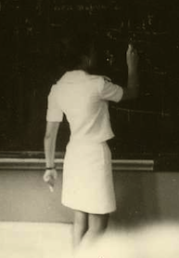
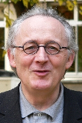
Automated Software Analysis
Automated
Analysis
Correct
Program
Incorrect
Software Model Checking with Predicate Abstraction
e.g., Microsoft’s SDV
Abstract Interpretation with Numeric Abstraction
e.g., ASTREE, Polyspace

Slide 4
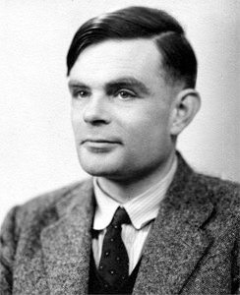
Turing, 1936: “undecidable”

Slide 5
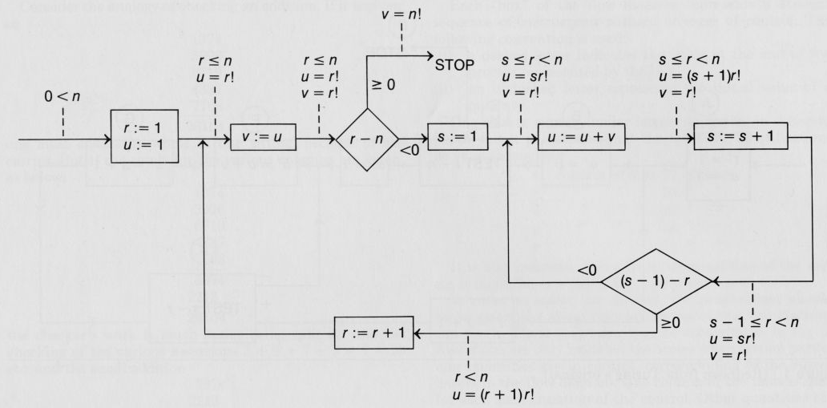
Turing, 1949
Alan M. Turing. “Checking a large routine”, 1949
5

Slide 6
Three-Layers of a Program Verifier
Compiler
  compiles surface syntax to some machine
  embodies syntax with semantics
Verification Condition Generator
  transforms a program and a property to verification condition in logic
  employs different abstractions, refinements, proof-search strategies, etc.
Automated Theorem Prover / Reasoning Engine
  discharges verification conditions
  general purpose constraint solver
  SAT, SMT, Abstract Interpreter, Temporal Logic Model Checker,…

Slide 7

http://seahorn.github.io

Slide 8
The Plan
This Lecture
  front-end: verification conditions, constrained horn clauses
  from verification problems to decision problems in logic
Next Lecture
  back-end: solving verification conditions
  IC3/PDR algorithms and extensions for software verification
  http://arieg.bitbucket.org/pdf/gurfinkel_ssft15.pdf
Labs
  we will play with tools
  get binary distribution from github.com/seahorn
  get seahorn-tutorial repo from github.com/seahorn-tutorial
  pre-requisites: recent Linux or OSX + clang-3.6
  can use provided VM to satisfy the pre-requisites

Slide 9
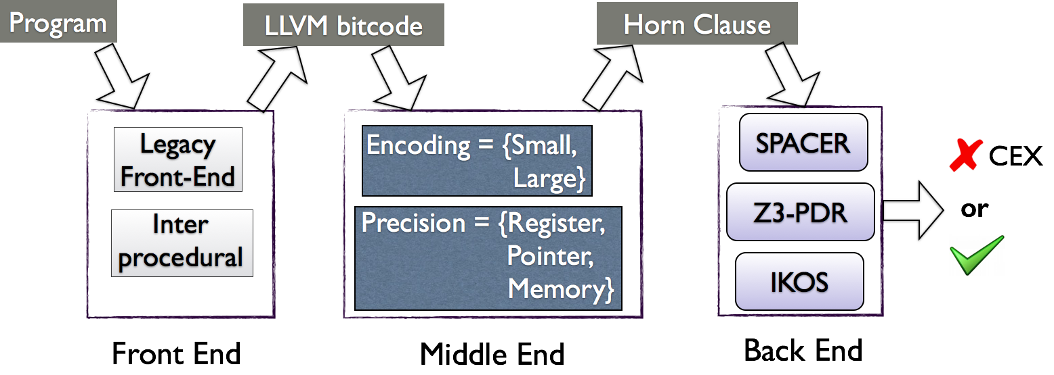
SeaHorn Verification Framework
Distinguishing Features
  LLVM front-end(s)
  Constrained Horn Clauses to represent Verification Conditions
  Comparable to state-of-the-art tools at SV-COMP’15
Goals
  be a state-of-the-art Software Model Checker
  be a framework for experimenting and developing CHC-based verification

Slide 10
Related Tools
CPAChecker
  Custom front-end for C
  Abstract Interpretation-inspired verification engine
  Predicate abstraction, invariant generation, BMC, k-induction
SMACK / Corral
  LLVM-based front-end
  Reduces C verification to Boogie
  Corral / Q verification back-end based on Bounded Model Checking with SMT
UFO
  LLVM-based front-end (partially reused in SeaHorn)
  Combines Abstract Interpretation with Interpolation-Based Model Checking
  (no longer actively developed)

Slide 11
SeaHorn Philosophy
Build a state-of-the-art Software Model Checker
  useful to “average” users
    user-friendly, efficient, trusted, certificate-producing, …
  useful to researchers in verification
    modular design, clean separation between syntax, semantics, and logic, …
Stand on the shoulders of giants
  reuse techniques from compiler community to reduce verification effort
    SSA, loop restructuring, induction variables, alias analysis, …
    static analysis and abstract interpretation
  reduce verification to logic
    verification condition generation
    Constrained Horn Clauses
Build reusable logic-based verification technology
  “SMT-LIB” for program verification

Slide 12
SeaHorn Usage
> sea pf FILE.c
Outputs sat for unsafe (has counterexample); unsat for safe
Additional options
  --cex=trace.xml outputs a counter-example in SV-COMP’15 format
  --show-invars displays computed invariants
  --track={reg,ptr,mem} track registers, pointers, memory content
  --step={large,small} verification condition step-semantics
    small == basic block, large == loop-free control flow block
  --inline inline all functions in the front-end passes
Additional commands
  sea smt – generates CHC in extension of SMT-LIB2 format
  sea clp -- generates CHC in CLP format (under development)
  sea lfe-smt – generates CHC in SMT-LIB2 format using legacy front-end

Slide 13
Verification Pipeline
front-end
clang | pp | ms |opt | horn
compile
pre-process
optimize
mixed semantics
VC gen & solve

Slide 14
Intermediate representation
Constrained Horn Clauses

Slide 15
Constrained Horn Clauses (CHC)
A Constrained Horn Clause (CHC) is a FOL formula of the form
8 V . (Á Æ p₁[X₁] Æ…Æ p_{n}[X_{n}] → h[X]),
where
  A is a background theory (e.g., Linear Arithmetic, Arrays, Bit-Vectors, or combinations of the above)
  Á is a constrained in the background theory A
  p₁, …, p_{n}, h are n-ary predicates
  p_{i}[X] is an application of a predicate to first-order terms

Slide 16
Example Horn Encoding

Slide 17
CHC Terminology
head
body
constraint
Rule
h[X] Ã p₁[X₁],…, p_{n}[X_{n}], Á.
Query
false Ã p₁[X₁],…, p_{n}[X_{n}], Á.
Fact
h[X] Ã Á.
Linear CHC
h[X] Ã p[X₁], Á.
Non-Linear CHC
h[X] Ã p₁[X₁],…, p_{n}[X_{n}], Á.
for n > 1

Slide 18
CHC Satisfiability
A model of a set of clauses ¦ is an interpretation of each predicate p_{i} that makes all clauses in ¦ valid
A set of clauses is satisfiable if it has a model, and is unsatisfiable otherwise
A model is A-definable, it each p_{i} is definable by a formula Ã_{i} in A

Slide 19
Relationship between CHC and Verification
A program satisfies a property iff corresponding CHCs are satisfiable
  satisfiability-preserving transformations == safety preserving
Models for CHC correspond to verification certificates
  inductive invariants and procedure summaries
Unsatisfiability (or derivation of FALSE) corresponds to counterexample
  the resolution derivation (a path or a tree) is the counterexample
CAVEAT: In SeaHorn the terminology is reversed
  SAT means there exists a counterexample – a BMC at some depth is SAT
  UNSAT means the program is safe – BMC at all depths are UNSAT

Slide 20
From Programs to Clauses

Slide 21
Hoare Triples
A Hoare triple {Pre} P {Post} is valid iff every terminating execution of P that starts in a state that satisfies Pre ends in a state that satisfies Post
Inductive Loop Invariant
Function Application
Recursion
Pre ) Inv {InvÆC} Body {Inv} InvÆ:C ) Post
{Pre} while C do Body {Post}
(PreÆp=a) ) P {P} Body_{F} {Q} (QÆp,r=a,b) ) Post
{Pre} b = F(a) {Post}
{Pre} b = F(a) {Post} ` {Pre} Body_{F} {Post}
{Pre} b = F(a) {Post}

Slide 22
Weakest Liberal Pre-Condition
Validity of Hoare triples is reduced to FOL validity by applying a predicate transformer
Dijkstra’s weakest liberal pre-condition calculus [Dijkstra’75]
wlp (P, Post)
weakest pre-condition ensuring that executing P ends in Post
{Pre} P {Post} is valid , Pre ) wlp (P, Post)

Slide 23
A Simple Programming Language
Prog ::= def Main(x) { body_{M} }, …, def P (x) { body_{P} }
body ::= stmt (; stmt)*
stmt ::= x = E | assert (E) | assume (E) |
while E do S | y = P(E) |
L:stmt | goto L (optional)
E := expression over program variables

Slide 24
Horn Clauses by Weakest Liberal Precondition
Prog ::= def Main(x) { body_{M} }, …, def P (x) { body_{P} }
wlp (x=E, Q) = let x=E in Q
wlp (assert(E) , Q) = E Æ Q
wlp (assume(E), Q) = E → Q
wlp (while E do S, Q) = I(w) Æ
8w . ((I(w) Æ E) → wlp (S, I(w))) Æ ((I(w) Æ :E) → Q))
wlp (y = P(E), Q) = p_{pre}(E) Æ (8 r. p(E, r) → Q[r/y])
ToHorn (def P(x) {S}) = wlp (x0=x;assume(p_{pre}(x)); S, p(x0, ret))
ToHorn (Prog) = wlp (Main(), true) Æ 8{P 2 Prog} . ToHorn (P)

Slide 25
Example of a WLP Horn Encoding
{Pre: y¸ 0}
x_{o} = x;
y_{o} = y;
while y > 0 do
x = x+1;
y = y−1;
{Post: x=x_{o}+y_{o}}
ToHorn
C1: I(x,y,x,y) Ã y>=0.
C2: I(x+1,y-1,x_{o},y_{o}) Ã I(x,y,x_{o},y_{o}), y>0.
C3: false Ã I(x,y,x_{o},y_{o}), y·0, x≠x_{o}+y_{o}
{y ¸ 0} P {x = x_{old}+y_{old}} is true iff the query C₃ is satisfiable

Slide 26
Dual WLP
Dual weakest liberal pre-condition
dual-wlp (P, Post) = :wlp (P, :Post)
s ² dual-wlp (P, Post) iff there exists an execution of P that starts in s and ends in Post
dual-wlp (P, Post) is the weakest condition ensuring that an execution of P can reach a state in Post

Slide 27
Control Flow Graph
basic block
A CFG is a graph of basic blocks
  edges represent different control flow
A CFG corresponds to a program syntax
  where statements are restricted to the form
  L_{i}:S ; goto L_{j}
  and S is control-free (i.e., assignments and procedure calls)

Slide 28
Horn Clauses by Dual WLP
Assumptions
  each procedure is represent by a control flow graph
    i.e., statements of the form l_{i}:S ; goto l_{j} , where S is loop-free
  program is unsafe iff the last statement of Main() is reachable
    i.e., no explicit assertions. All assertions are top-level.
For each procedure P(x), create predicates
  l(w) for each label, p_{en}(x₀,x,w) for entry, p_{ex} (x₀,r) for exit
The verification condition is a conjunction of clauses:
p_{en}(x₀,x) Ã x₀=x
l_{i}(x₀,w’) Ã l_{j}(x₀,w) Æ :wlp (S, :(w=w’)), for each statement l_{i}: S; goto l_{j}
p (x₀,r) Ã p_{ex}(x₀,r)
false Ã Main_{ex}(x, ret)

Slide 29
Example Horn Encoding

Slide 30
From CFG to Cut Point Graph
A Cut Point Graph hides (summarizes) fragments of a control flow graph by (summary) edges
Vertices (called, cut points) correspond to some basic blocks
An edge between cut-points c and d summarizes all finite (loop-free) executions from c to d that do not pass through any other cut-points

Slide 31
Cut Point Graph Example
CFG
CPG
1
1
2
3
4
6
5
6

Slide 32
From CFG to Cut Point Graph
A Cut Point Graph hides (summarizes) fragments of a control flow graph by (summary) edges
Cut Point Graph preserves reachability of (not-summarized) control location.
Summarizing loops is undecidable! (Halting program)
A cutset summary summarizes all location except for a cycle cutset of a CFG. Computing minimal cutset summary is NP-hard (minimal feedback vertex set).
A reasonable compromise is to summarize everything but heads of loops. (Polynomial-time computable).

Slide 33
Single Static Assignment
SSA == every value has a unique assignment (a definition)
A procedure is in SSA form if every variable has exactly one definition
SSA form is used by many compilers
  explicit def-use chains
  simplifies optimizations and improves analyses
PHI-function are necessary to maintain unique definitions in branching control flow
x = PHI ( v₀:bb₀, …, v_{n}:bb_{n}) ) (phi-assignment)
“x gets v_{i} if previously executed block was bb_{i}”

Slide 34
Single Static Assignment: An Example
val:bb
0: goto 1
1: x_0 = PHI(0:0, x_3:5);
y_0 = PHI(y:0, y_1:5);
if (x_0 < N) goto 2 else goto 6
2: if (y_0 > 0) goto 3 else goto 4
3: x_1 = x_0 + y_0; goto 5
4: x_2 = x_0 – y_0; goto 5
5: x_3 = PHI(x_1:3, x_2:4);
y_1 = -1 * y_0;
goto 1
6:
int x, y, n;
x = 0;
while (x < N) {
if (y > 0)
x = x + y;
else
x = x – y;
y = -1 * y;
}

Slide 35
Large Step Encoding
0: goto 1
1: x_0 = PHI(0:0, x_3:5);
y_0 = PHI(y:0, y_1:5);
if (x_0 < N) goto 2 else goto 6
2: if (y_0 > 0) goto 3 else goto 4
3: x_1 = x_0 + y_0; goto 5
4: x_2 = x_0 – y_0; goto 5
5: x_3 = PHI(x_1:3, x_2:4);
y_1 = -1 * y_0;
goto 1
6:
Problem: Generate a compact verification condition for a loop-free block of code

Slide 36
Large Step Encoding: Extract all Actions
x₁ = x₀ + y₀
x₂ = x₀ – y₀
y₁ = -1 * y₀
1: x_0 = PHI(0:0, x_3:5);
y_0 = PHI(y:0, y_1:5);
if (x_0 < N) goto 2 else goto 6
2: if (y_0 > 0) goto 3 else goto 4
3: x_1 = x_0 + y_0; goto 5
4: x_2 = x_0 – y_0; goto 5
5: x_3 = PHI(x_1:3, x_2:4);
y_1 = -1 * y_0;
goto 1

Slide 37
Example: Encode Control Flow
x₁ = x₀ + y₀
x₂ = x₀ – y₀
y₁ = -1 * y₀
1: x_0 = PHI(0:0, x_3:5);
y_0 = PHI(y:0, y_1:5);
if (x_0 < N) goto 2 else goto 6
2: if (y_0 > 0) goto 3 else goto 4
3: x_1 = x_0 + y_0; goto 5
4: x_2 = x_0 – y_0; goto 5
5: x_3 = PHI(x_1:3, x_2:4);
y_1 = -1 * y_0;
goto 1
B₂ → x₀ < N
B₃ → B₂ ∧ y₀ > 0
B₄ → B₂ ∧ y₀ ≤ 0
B₅ → (B₃ ∧ x₃=x₁)∨
(B₄ ∧ x₃=x₂)
B₅ ∧ x’₀=x₃ ∧ y’₀=y₁
p₁(x’₀,y’₀) Ã p₁ (x₀, y₀), Á.

Slide 38
Program transformation
Mixed Semantics

Slide 39
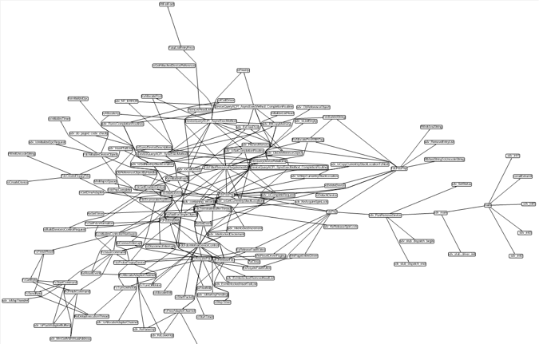
Deeply nested assertions
Assertion
Main

Slide 40
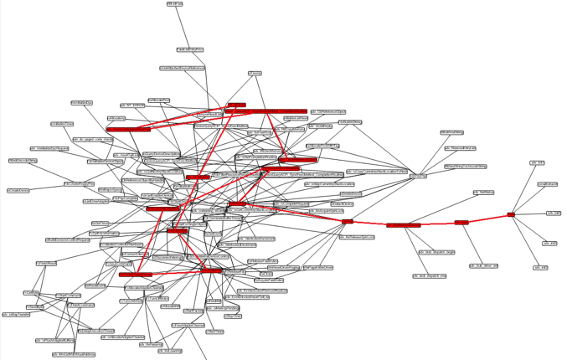
Deeply nested assertions
Assertion
Main
Counter-examples are long
Hard to determine (from main) what is relevant

Slide 41
Mixed Semantics
[GWC’08,LQ’14]
Stack-free program semantics combining:
  operational (or small-step) semantics
    i.e., usual execution semantics
  natural (or big-step) semantics: function summary [Sharir-Pnueli 81]
    (¾, ¾`) 2 ||f|| iff the execution of f on input state ¾ terminates and results in state ¾’
  some execution steps are big, some are small
Non-deterministic executions of function calls
  update top activation record using function summary, or
  enter function body, forgetting history records (i.e., no return!)
Preserves reachability and non-termination
  Theorem: Let K be the operational semantics, K^{m} the stack-free semantics, and L a program location. Then,
  K ² EF (pc=L) , K^{m} ² EF (pc=L) and K ² EG (pc≠L) , K^{m} ² EG (pc≠L)

Slide 42
def main()
1: int x = nd();
2: x = x+1;
3: while(x>=0)
4: x=f(x);
5: if(x<0)
6: Error;
7:
8: END;
def f(int y): ret y
9: if(y¸10){
10: y=y+1;
11: y=f(y);
12: else if(y>0)
13: y=y+1;
14: y=y-1
15:
1
y=4
y’=y
x’=nd()
9
x=3
2
y ¸ 10
10
x’=x+1
y’=x
y · 9
x=4
y’ = y+1
3
11
x ¸ 0
y=4
y’ = f(y)
(1·x·9 Æ x’=x) Ç (x·0 Æ x’=x-1)
4
x=4
12
y > 0
y=4
x’ = f(x)
x < 0
x=4
y · 0
13
5
x < 0
x ¸ 0
y’= y+1
6:Error
14
y=5
Summary of f(y)
(1·y·9 Æ y’=y) Ç (y·0 Æ y’=y-1)
y’= y-1
8:END
7
15
y=4

Slide 43
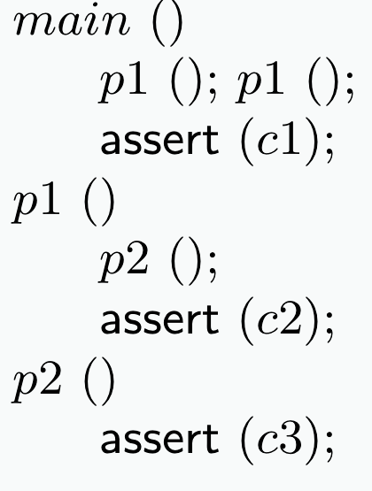
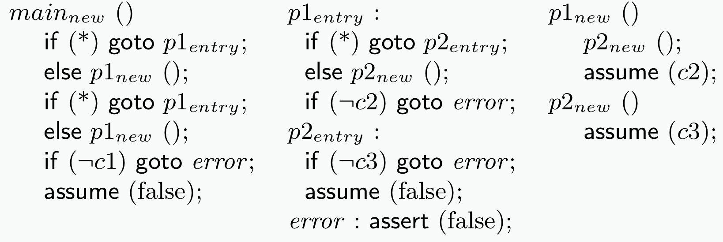
Mixed Semantics as Program Transformation
Mixed Semantics

Slide 44
Mixed Semantics: Summary
Every procedure is inlined at most once
  in the worst case, doubles the size of the program
  can be restricted to only inline functions that directly or indirectly call errror() function
Easy to implement at compiler level
  create “failing” and “passing” versions of each function
  reduce “passing” functions to returning paths
  in main(), introduce new basic block bb.F for every failing function F(), and call failing.F in bb.F
  inline all failing calls
  replace every call to F to non-deterministic jump to bb.F or call to passing F
Increases context-sensitivity of context-insensitive analyses
  context of failing paths is explicit in main (because of inlining)
  enables / improves many traditional analyses

Slide 45
Solving chc with smt

Slide 46
Programs, Cexs, Invariants
A program P = (V, Init, ½, Bad)
  Notation: F(X) = 9 u . (X Æ ½) Ç Init
P is UNSAFE if and only if there exists a number N s.t.
P is SAFE if and only if there exists a safe inductive invariant Inv s.t.
Inductive
Safe

Slide 47
IC3/PDR Algorithm Overview
bounded safety
strengthen result

Slide 48
IC3/PDR in Pictures
PdrMkSafe

Slide 49
IC3/PDR in Pictures
PdrMkSafe
cex
Cex Queue
Trace
lemma
Frame R₀
Frame R₁

Slide 50
IC3/PDR in Pictures
PdrPush
Inductive

Slide 51
IC3/PDR in Pictures
PdrPush
Inductive
PDR Invariants
R_{i} → : Bad Init → R_{i}
R_{i} → R_{i+1} R_{i} Æ ½ → R_{i+1}

Slide 52

Spacer: Solving CHC in Z3
Spacer: solver for SMT-constrained Horn Clauses
  stand-alone implementation in a fork of Z3
  http://bitbucket.org/spacer/code
Support for Non-Linear CHC
  model procedure summaries in inter-procedural verification conditions
  model assume-guarantee reasoning
  uses MBP to under-approximate models for finite unfoldings of predicates
  uses MAX-SAT to decide on an unfolding strategy
Supported SMT-Theories
  Best-effort support for arbitrary SMT-theories
    data-structures, bit-vectors, non-linear arithmetic
  Full support for Linear arithmetic (rational and integer)
  Quantifier-free theory of arrays
    only quantifier free models with limited applications of array equality

Slide 53
REsults

Slide 54
SV-COMP 2015
http://sv-comp.sosy-lab.org/2015/
4th Competition on Software Verification held (here!) at TACAS 2015
Goals
  Provide a snapshot of the state-of-the-art in software verification to the community.
  Increase the visibility and credits that tool developers receive.
  Establish a set of benchmarks for software verification in the community.
Participants:
  Over 22 participants, including most popular Software Model Checkers and Bounded Model Checkers
Benchmarks:
  C programs with error location (programs include pointers, structures, etc.)
  Over 6,000 files, each 2K – 100K LOC
  Linux Device Drivers, Product Lines, Regressions/Tricky examples
  http://sv-comp.sosy-lab.org/2015/benchmarks.php

Slide 55
Results for DeviceDriver category

Slide 56
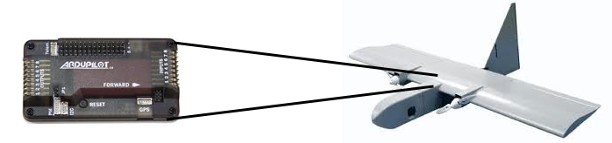
Detecting Buffer Overflow in Auto-pilot software
Show absence of Buffer Overflows in
  paparazzi and mnav autopilots
Automatically instrument buffer accesses with runtime checks
Use SeaHorn to validate that run-time checks never fail
  somewhat slower than pure abstract interpretation
  much more precise!
LLVM Pass to insert BO checks

Slide 57

Conclusion
SeaHorn (http://seahorn.github.io)
  a state-of-the-art Software Model Checker
  LLVM-based front-end
  CHC-based verification engine
  a framework for research in logic-based verification
The future
  making SeaHorn useful to users of verification technology
    counterexamples, build integration, property specification, proofs, etc.
  targeting many existing CHC engines
    specialize encoding and transformations to specific engines
    communicate results between engines
  richer properties
    termination, liveness, synthesis

Slide 58
Contact Information
Arie Gurfinkel, Ph. D. Sr. Researcher CSC/SSD Telephone: +1 412-268-5800 Email: info@sei.cmu.edu | U.S. Mail Software Engineering Institute Customer Relations 4500 Fifth Avenue Pittsburgh, PA 15213-2612 USA
Web www.sei.cmu.edu www.sei.cmu.edu/contact.cfm | Customer Relations Email: info@sei.cmu.edu Telephone: +1 412-268-5800 SEI Phone: +1 412-268-5800 SEI Fax: +1 412-268-6257

