Slide 1

The Science, Art and Magic of Constrained Horn Clauses
Arie Gurfinkel and Nikolaj Bjørner
SYNASC 2019
21st International Symposium on Symbolic and Numeric Algorithms for Scientific Computing
https://notebooks.azure.com/arie-gurfinkel/projects/spacerexamples
Notes:
Title Slide
Title and Subtitle text blocks should not be moved from their position if at all possible.

Slide 2

Software Model Checking of Programs / Transitions Systems / Push-down Systems
=
Satisfiability of Constrained Horn Logic (CHC) fragment of First Order Logic
Reduce Model Checking to FOL Satisfiability
https://notebooks.azure.com/arie-gurfinkel/projects/spacerexamples

Slide 3
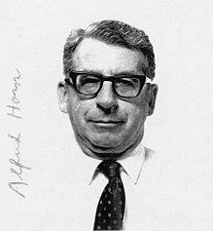
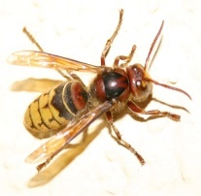
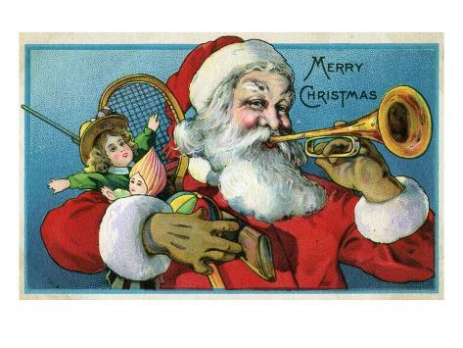
Constrained Horn Clauses (CHC)
_{Is it short for Horner?}
_{Is it related to hornets?}
Is it Santa Clause blowing a Horn?
Alfred Horn
https://notebooks.azure.com/arie-gurfinkel/projects/spacerexamples

Slide 4
Example CHC: Is this SAT?
This set of clauses is satisfiable
The model is an extension of the standard model of arithmetic with:
https://notebooks.azure.com/arie-gurfinkel/projects/spacerexamples

Slide 5
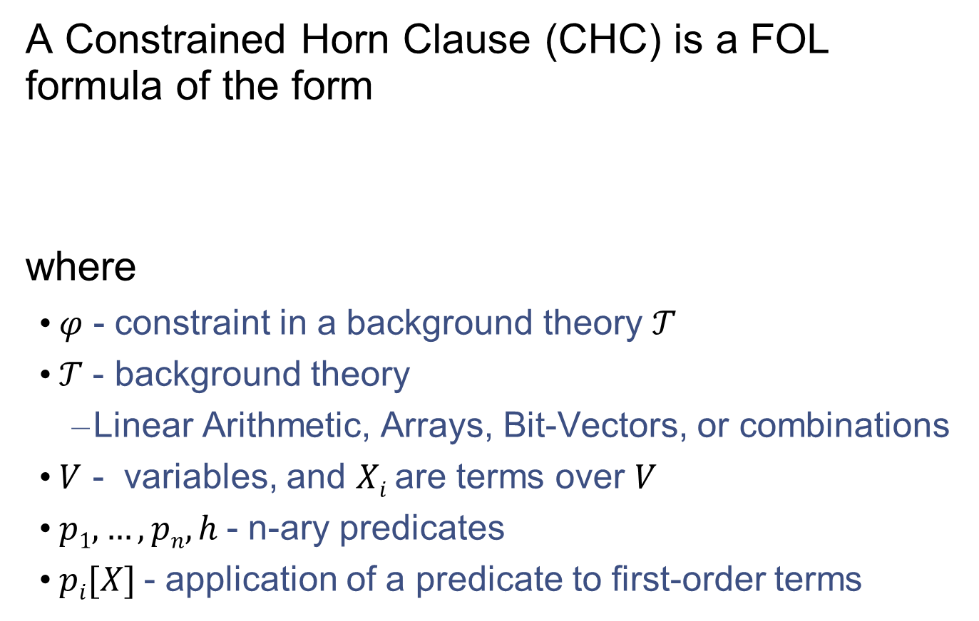
Constrained Horn Clauses (CHC)
A Constrained Horn Clause (CHC) is a FOL formula of the form
where
  𝜑 - constraint in a background theory 𝒯
  𝒯 - background theory
    Linear Arithmetic, Arrays, Bit-Vectors, or combinations
  $V$ - variables, and $Xi$ are terms over $V$
  $p1, …, pn, h$- n-ary predicates
  $pi[X]$- application of a predicate to first-order terms

Slide 6
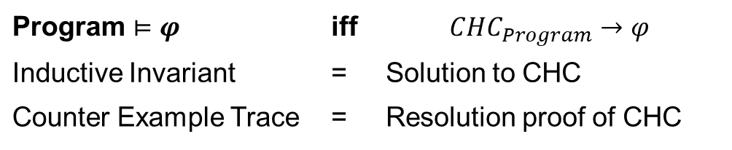
CHC Satisfiability
𝛱 - set of CHCs
M - 𝒯-model of a set of 𝛱
M satisfies 𝒯
M satisfies 𝛱 – through first-order interpretation of each predicate p_{i}
A set of clauses is satisfiable if and only if it has a model
  This is the usual FOL satisfiability
𝒯-solution of a set of CHCs 𝛱 is a substitution 𝜎 from predicates p_{i} to 𝒯-formulas such that 𝛱𝜎 is 𝒯-valid
In the context of program verification
Program $⊨φ$ | iff | $$CHC_{Program}→φ$$
Inductive Invariant | = | Solution to CHC
Counter Example Trace | = | Resolution proof of CHC

Slide 7
Example CHC: Is this SAT?
This set of clauses is satisfiable
The model is an extension of the standard model of arithmetic with:
https://notebooks.azure.com/arie-gurfinkel/projects/spacerexamples

Slide 8
Validating the solution
Original CHC
Validation of P(x) = {x | x <= 5}
https://notebooks.azure.com/arie-gurfinkel/projects/spacerexamples

Slide 9
Example CHC: is this SAT?
This set of clauses is unsatisfiable
Justification is a refutation by resolution and instantiation
https://notebooks.azure.com/arie-gurfinkel/projects/spacerexamples

Slide 10
Example CHC: is this SAT?
Refutation
https://notebooks.azure.com/arie-gurfinkel/projects/spacerexamples

Slide 11
Horn Clauses for Program Verification
De Angelis et al. Verifying Array Programs by Transforming Verification Conditions. VMCAI'14
Bjørner, Gurfinkel, McMillan, and Rybalchenko:
Horn Clause Solvers for Program Verification

Slide 12
Horn Clauses for Concurrent / Distributed / Parameterized Systems
Hojjat et al. Horn Clauses for Communicating Timed Systems. HCVS'14
Rybalchenko et al. Synthesizing Software Verifiers from Proof Rules. PLDI'12
Gurfinkel et al. SMT-Based Verification of Parameterized Systems. FSE 2016
Hoenicke et al. Thread Modularity at Many Levels. POPL'17
Notes:
Rybalchenko Threader, Podelski POPL’17, Philipp Ruemer Workshop

Slide 13
Program Verification with HORN(LIA)
z = x; i = 0;
assume (y > 0);
while (i < y) {
z = z + 1;
i = i + 1;
}
assert(z == x + y);
IS SAT?
z = x & i = 0 & y > 0 ➔ Inv(x, y, z, i)
Inv(x, y, z, i) & i < y & z1=z+1 & i1=i+1 ➔ Inv(x, y, z1, i1)
Inv(x, y, z, i) & i >= y & z != x+y ➔ false

Slide 14
In SMT-LIB
(set-logic HORN)
;; Inv(x, y, z, i)
(declare-fun Inv ( Int Int Int Int) Bool)
(assert
(forall ( (A Int) (B Int) (C Int) (D Int))
(=> (and (> B 0) (= C A) (= D 0))
(Inv A B C D)))
)
(assert
(forall ( (A Int) (B Int) (C Int) (D Int) (C1 Int) (D1 Int) )
(=>
(and (Inv A B C D) (< D B) (= C1 (+ C 1)) (= D1 (+ D 1)))
(Inv A B C1 D1)
)
)
)
(assert
(forall ( (A Int) (B Int) (C Int) (D Int))
(=> (and (Inv A B C D) (>= D B) (not (= C (+ A B))))
false
)
)
)
(check-sat)
(get-model)
$ z3 add-by-one.smt2
sat
(model
(define-fun Inv ((x!0 Int) (x!1 Int) (x!2 Int) (x!3 Int)) Bool
(and (<= (+ x!2 (* (- 1) x!0) (* (- 1) x!3)) 0)
(<= (+ x!2 (* (- 1) x!0) (* (- 1) x!1)) 0)
(<= (+ x!0 x!3 (* (- 1) x!2)) 0)))
)
Inv(x, y, z, i)
z = x + i
z <= x + y

Slide 15




Logic-based Algorithmic Verification
Simulink
C/C++
concurrent /distributed systems
Java
SeaHorn
Lustre
CPR
Termination for C
Smart Contracts
T2
Spacer
https://notebooks.azure.com/arie-gurfinkel/projects/spacerexamples

Slide 16
Interactive tutorial
https://notebooks.azure.com/arie-gurfinkel/projects/spacerexamples

Slide 17
Procedures for Solving CHC(T)
Predicate abstraction by lifting Model Checking to HORN
  QARMC, Eldarica, …
Maximal Inductive Subset from a finite Candidate space (Houdini)
  TACAS’18: hoice, FreqHorn
Machine Learning
  PLDI’18: sample, ML to guess predicates, DT to guess combinations
Abstract Interpretation (Poly, intervals, boxes, arrays…)
  Approximate least model by an abstract domain (SeaHorn, …)
Interpolation-based Model Checking
  Duality, QARMC, …
SMT-based Unbounded Model Checking (IC3/PDR)
  Spacer, Implicit Predicate Abstraction

Slide 18
Spacer: Solving SMT-constrained CHC
Spacer: SAT procedure for SMT-constrained Horn Clauses
  now the default CHC solver in Z3
    https://github.com/Z3Prover/z3
    dev branch at https://github.com/agurfinkel/z3
Supported SMT-Theories
  Linear Real and Integer Arithmetic
  Quantifier-free theory of arrays
  Universally quantified theory of arrays + arithmetic
  Best-effort support for many other SMT-theories
    data-structures, bit-vectors, non-linear arithmetic
Support for Non-Linear CHC
  for procedure summaries in inter-procedural verification conditions
  for compositional reasoning: abstraction, assume-guarantee, thread modular, etc.

Slide 19
A little bit of complexity
Satisfiability of CHC over most interesting theories is undecidable
  e.g., CHC(Linear Real Arithmetic), CHC(Linear Integer Arithmetic)
  proof: many easy reductions, for example, counter automata
Satisfiability of Linear CHC over Propositional logic is decidable
  Finite state model checking of transition systems
  Complexity: linear in the size of the graph induced by the transition system
Satisfiability of Non-Linear CHC over Propositional logic is decidable
  Finite state model checking of pushdown systems
  Complexity: cubic in the size of the pushdown system
  Decidability of some classes of CHC: Difference arithmetic (= timed automata)

Slide 20
Solving Constrained Horn Clauses

Slide 21
A Magician’s Guide to Solving Undecidable Problems
Develop a procedure P for a decidable problem
Show that P is a decision procedure for the problem
  e.g., model checking of finite-state systems
Choose one of
  Always terminate with some answer (over-approximation)
  Always make useful progress (under-approximation)
Extend procedure P to procedure Q that “solves” the undecidable problem
  Ensure that Q is still a decision procedure whenever P is
  Ensure that Q either always terminates or makes progress

Slide 22
Linear CHC Satisfiability
Satisfiability of a set of linear CHCs is reducible to satisfiability of THREE clauses of the form
where, X’ = {x’ | x 2 X}, P a fresh predicate, and Init, Bad, and Tr are constraints
Proof:
  add extra arguments to distinguish between predicates
  Q(y) ∧ Á → W(y, z)
    P(id=‘Q’, y) ∧ Á → P(id=‘W’, y, z)

Slide 23








IC3, PDR and friends
$$Init$$
$$Tr$$
$$Tr$$
$$¬Bad$$
Finite State Machines
(HW model checking)
[Bradley, VMCAI 2011]
$$Init$$
$$Tr$$
$$Tr$$
$$¬Bad$$
Push Down Machines
(SW model checking)
[Hoder&B, SAT 2012]

Slide 24
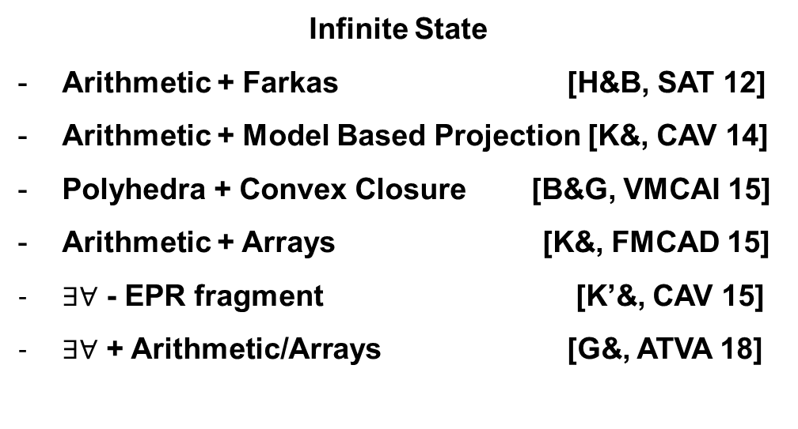






IC3, PDR and friends
$$Init$$
$$Tr$$
$$Tr$$
$$¬Bad$$
Finite State
Incremental SAT solving [Bradley, VMCAI 11]
Fast prime implicants [Een& FMCAD 11]
Basis for predicate abstraction
[Cimatti& TACAS 14, Birgmeier& CAV 14]
Finite State Machines
(HW model checking)
[Bradley, VMCAI 2011]
$$Init$$
$$Tr$$
$$Tr$$
$$¬Bad$$
Infinite State
Arithmetic + Farkas [H&B, SAT 12]
Arithmetic + Model Based Projection [K&, CAV 14]
Polyhedra + Convex Closure [B&G, VMCAI 15]
Arithmetic + Arrays [K&, FMCAD 15]
$∃∀$ - EPR fragment [K’&, CAV 15]
$∃∀$ + Arithmetic/Arrays [G&, ATVA 18]
Push Down Machines
(SW model checking)
[Hoder, B, SAT 2012]

Slide 25
IC3, PDR and friends
$$Init$$
$$Tr$$
$$Tr$$
$$¬Bad$$
Finite State
SAT
Infinite State
SMT
Arithmetic
Arrays
Quantifiers
Search Strategies
[Bradley, VMCAI 11]
CTI – Counter Examples To Induction
[G&Ivrii, FMCAD 15]
Under and over-approximations
[Vizel&G, CAV 14]
Use SAT for blocking
IC3 for pushing
Finite State Machines
(HW model checking)
[Bradley, VMCAI 2011]
$$Init$$
$$Tr$$
$$Tr$$
$$¬Bad$$
Push Down Machines
(SW model checking)
[Hoder, B, SAT 2012]

Slide 26
IC3, PDR, and Friends (1)
IC3: A SAT-based Hardware Model Checker
  Incremental Construction of Inductive Clauses for Indubitable Correctness
  A. Bradley: SAT-Based Model Checking without Unrolling. VMCAI 2011
PDR: Explained and extended the implementation
  Property Directed Reachability
  N. Eén, A. Mishchenko, R. K. Brayton: Efficient implementation of property directed reachability. FMCAD 2011
PDR with Predicate Abstraction (easy extension of IC3/PDR to SMT)
  A. Cimatti, A. Griggio, S. Mover, St. Tonetta: IC3 Modulo Theories via Implicit Predicate Abstraction. TACAS 2014
  J. Birgmeier, A. Bradley, G. Weissenbacher: Counterexample to Induction-Guided Abstraction-Refinement (CTIGAR). CAV 2014

Slide 27
IC3, PDR, and Friends (2)
GPDR: Non-Linear CHC with Arithmetic constraints
  Generalized Property Directed Reachability
  K. Hoder and N. Bjørner: Generalized Property Directed Reachability. SAT 2012
SPACER: Non-Linear CHC with Arithmetic
  fixes an incompleteness issue in GPDR and extends it with under-approximate summaries
  A. Komuravelli, A. Gurfinkel, S. Chaki: SMT-Based Model Checking for Recursive Programs. CAV 2014
PolyPDR: Convex models for Linear CHC
  simulating Numeric Abstract Interpretation with PDR
  N. Bjørner and A. Gurfinkel: Property Directed Polyhedral Abstraction. VMCAI 2015
ArrayPDR: CHC with constraints over Arithmetic + Arrays
  Required to model heap manipulating programs
  A. Komuravelli, N. Bjørner, A. Gurfinkel, K. L. McMillan:Compositional Verification of Procedural Programs using Horn Clauses over Integers and Arrays. FMCAD 2015

Slide 28
IC3, PDR, and Friends (3)
Quip: Forward Reachable States + Conjectures
  Use both forward and backward reachability information
  A. Gurfinkel and A. Ivrii: Pushing to the Top. FMCAD 2015
Avy: Interpolation with IC3
  Use SAT-solver for blocking, IC3 for pushing
  Y. Vizel, A. Gurfinkel: Interpolating Property Directed Reachability. CAV 2014
uPDR: Constraints in EPR fragment of FOL
  Universally quantified inductive invariants (or their absence)
  A. Karbyshev, N. Bjørner, S. Itzhaky, N. Rinetzky, S. Shoham: Property-Directed Inference of Universal Invariants or Proving Their Absence. CAV 2015
Quic3: Universally quantified invariants for LIA + Arrays
  Extending Spacer with quantified reasoning
  A. Gurfinkel, S. Shoham, Y. Vizel: Quantifiers on Demand. ATVA 2018

Slide 29

Verification by Incremental Generalization
T, N=0
A counterexample of length N exists?
Yes
No, N:=N+1
SMT
Is a safe inductive invariant?
YES
No + bounded proof
SMT
Generalize proof
candidate Inv
SMT

Slide 30

IC3/PDR In Pictures: MkSafe
MkSafe
$$x=3,y=0$$
$$x=1,y=0$$
$$x<y$$
Predecessor
NewLemma

Slide 31
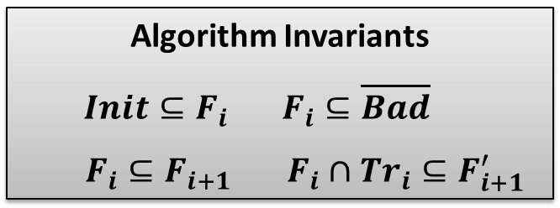
IC3/PDR in Pictures: Push
Push
Inductive
Algorithm Invariants
$Init⊆F_{i} F_{i}⊆\overline{Bad}$
$F_{i}⊆F_{i+1}$ $F_{i}∩Tr_{i}⊆F_{i+1}^{′}$

Slide 32

IC3/PDR: Solving Linear (Propositional) CHC
Unreachable and Reachable
  terminate the algorithm when a solution is found
Unfold
  increase search bound by 1
Candidate
  choose a bad state in the last frame
Decide
  extend a cex (backward) consistent with the current frame
  choose an assignment s s.t. $(s ⋀ Fi ⋀ Tr ⋀ cex’)$is SAT
Conflict
  construct a lemma to explain why cex cannot be extended
  Find a clause L s.t. $L⇒¬cex$, $Init ⇒ L$, and $Fi ⋀ Tr ⇒ L’$
Induction
  propagate a lemma as far into the future as possible
  (optionally) strengthen by dropping literals

Slide 33
From Propositional PDR to Solving CHC
Theories with infinitely many models
  infinitely many satisfying assignments
  can’t simply enumerate (when computing predecessor)
  can’t block one assignment at a time (when blocking)
Non-Linear Horn Clauses
  multiple predecessors (when computing predecessors)
The problem is undecidable in general, but we want an algorithm that makes progress
  doesn’t get stuck in a decidable sub-problem
  guaranteed to find a counterexample (if it exists)

Slide 34
IC3/PDR: Solving Linear (Propositional) CHC
Unreachable and Reachable
  terminate the algorithm when a solution is found
Unfold
  increase search bound by 1
Candidate
  choose a bad state in the last frame
Decide
  extend a cex (backward) consistent with the current frame
  choose an assignment s s.t. $(s ⋀ Fi ⋀ Tr ⋀ cex’)$is SAT
Conflict
  construct a lemma to explain why cex cannot be extended
  Find a clause L s.t. $L⇒¬cex$, $Init ⇒ L$, and $Fi ⋀ Tr ⇒ L’$
Induction
  propagate a lemma as far into the future as possible
  (optionally) strengthen by dropping literals
Theory dependent

Slide 35

Conflict (Arithmetic)
$$\left(\left(F_{i}∧Tr\right)∨Init^{′}\right)⇒φ^{′}, φ^{′}⇒¬cex′$$
Looking for $φ’$

Slide 36
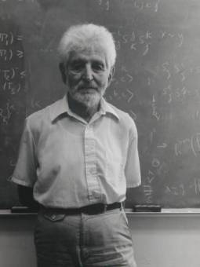
Craig Interpolation Theorem
Theorem (Craig 1957)
Let A and B be two First Order (FO) formulae such that A ) :B, then there exists a FO formula I, denoted ITP(A, B), such that
A ) I I ) :B Σ(I) 2 Σ(A) ∩ Σ(B)
A Craig interpolant ITP(A, B) can be effectively constructed from a resolution proof of unsatisfiability of A∧ B
In Model Checking, Craig Interpolation Theorem is used to safely over-approximate the set of (finitely) reachable states

Slide 37
Examples of Craig Interpolation for Theories
Boolean logic
Equality with Uniterpreted Functions (EUF)
Linear Real Arithmetic (LRA)

Slide 38
Craig Interpolation for Linear Arithmetic
Proof obligation
A = F(R_{i})
B = P
I = interpolant
Reachable states
Useful properties of existing interpolation algorithms [CGS10] [HB12]
  I 2 ITP (A, B) then :I 2 ITP (B, A)
  if A is syntactically convex (a monomial), then I is convex
  if B is syntactically convex, then I is co-convex (a clause)
  if A and B are syntactically convex, then I is a half-space
Notes:
[CGS10] Alessandro Cimatti, Alberto Griggio, Roberto Sebastiani: Efficient generation of craig interpolants in satisfiability modulo theories. ACM Trans. Comput. Log. 12(1): 7 (2010)
[HB12] Krystof Hoder, Nikolaj Bjørner: Generalized Property Directed Reachability. SAT 2012: 157-171

Slide 39
Arithmetic Conflict
Counterexample is blocked using Craig Interpolation
  summarizes the reason why the counterexample cannot be extended
Generalization is not inductive
  weaker than IC3/PDR
  inductive generalization for arithmetic is still an open problem

Slide 40
Computing Interpolants for IC3/PDR
Much simpler than general interpolation problem for A ∧ B
  B is always a conjunction of literals
  A is dynamically split into DNF by the SMT solver
  DPLL(T) proofs do not introduce new literals
Interpolation algorithm is reduced to analyzing all theory lemmas in a DPLL(T) proof produced by the solver
  every theory-lemma that mixes B-pure literals with other literals is interpolated to produce a single literal in the final solution
  interpolation is restricted to clauses of the form (∧ B_{i} ⇒ ⋁ A_{j})
Interpolating (UNSAT) Cores
  improve interpolation algorithms and definitions to the specific case of PDR
  classical interpolation focuses on eliminating non-shared literals
  in PDR, the focus is on finding good generalizations

Slide 41
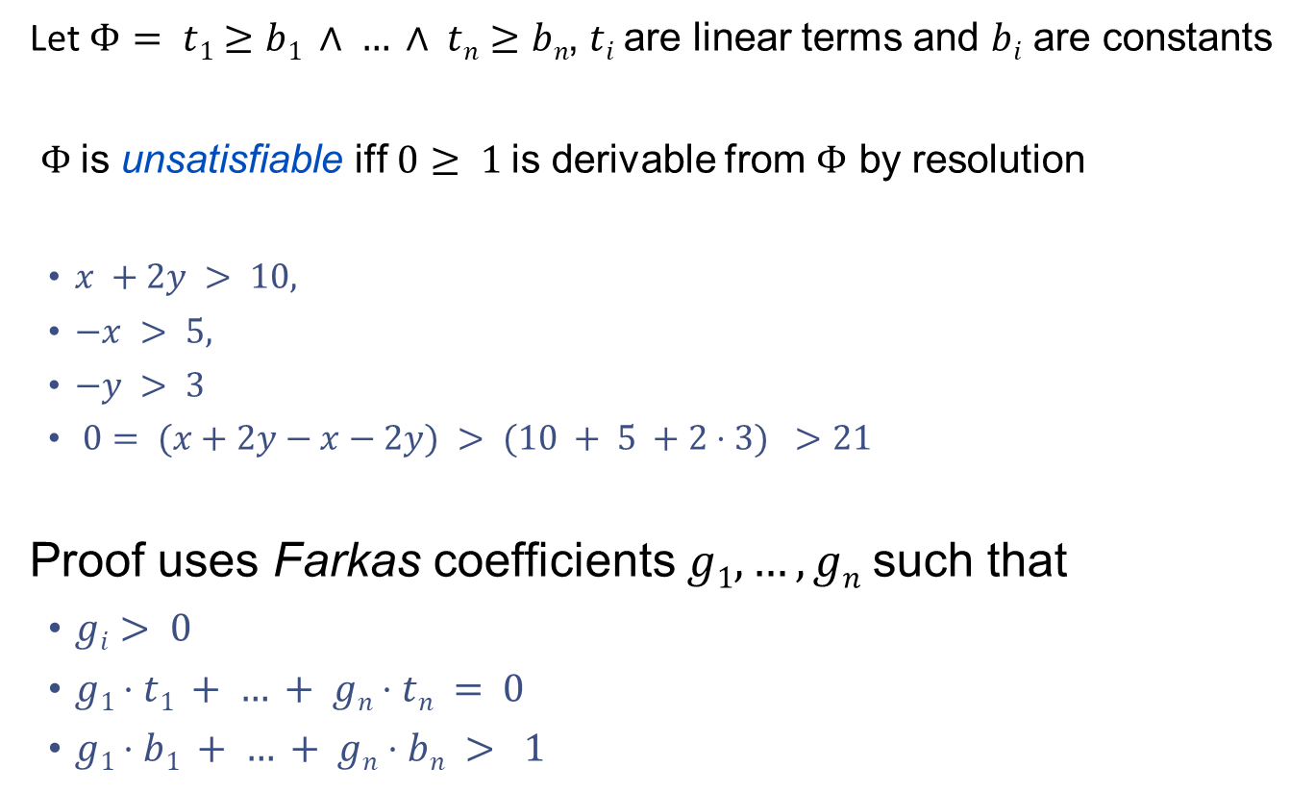
Farkas Lemma
Let$Φ= t1≥b1 ∧ … ∧ tn≥bn$, $ti$are linear terms and $bi$ are constants
$Φ$is unsatisfiable iff $0≥ 1$is derivable from $Φ$ by resolution
  $x +2y > 10,$
  $−x > 5,$
  $−y > 3$
  $0= (x+2y−x−2y) > (10 + 5 +2⋅3) >21$
Proof uses Farkas coefficients $g1, …, gn$such that
  $gi> 0$
  $g1⋅t1 + … + gn⋅tn = 0$
  $g1⋅b1 + … + gn⋅bn > 1$

Slide 42
Frakas Lemma Example
Interpolants

Slide 43
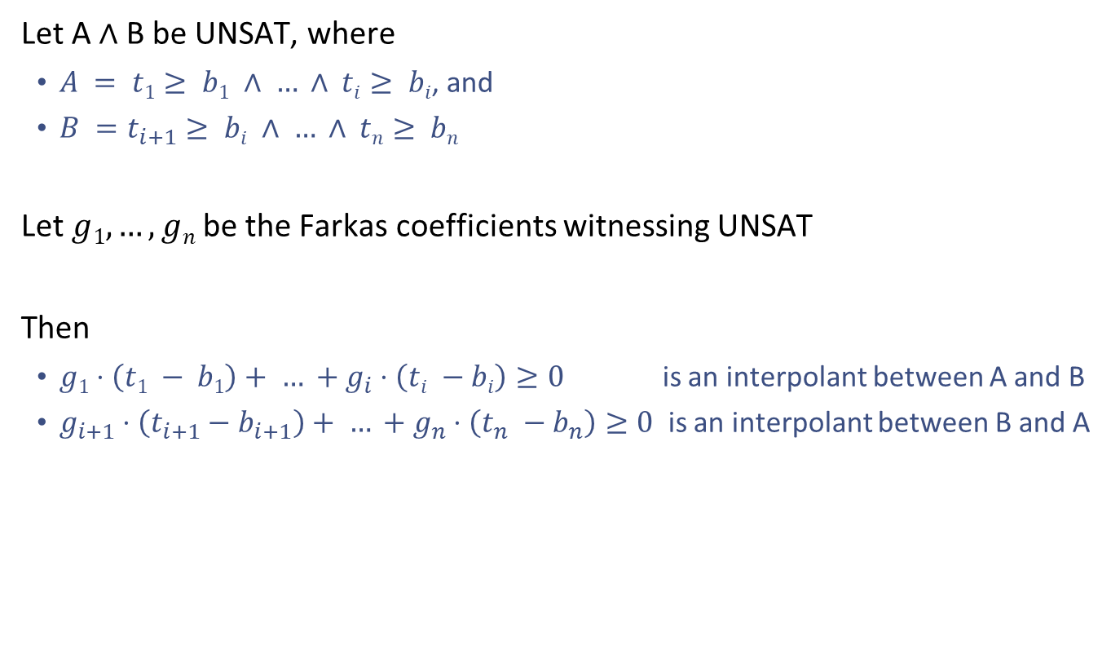
Interpolation for Linear Real Arithmetic
Let A ∧ B be UNSAT, where
  $A = t1≥ b1 ∧ … ∧ ti≥ bi$, and
  $B =t_{i+1}≥ bi ∧ … ∧ tn≥ bn$
Let $g1, …, gn$be the Farkas coefficients witnessing UNSAT
Then
  $g1⋅\left(t1 − b1\right)+ … +g_{i}⋅\left(ti −bi\right)≥0$ is an interpolant between A and B
  $g_{i+1}⋅\left(t_{i+1}−b_{i+1}\right)+ … +g_{n}⋅\left(t_{n} −b_{n}\right)≥0$ is an interpolant between B and A

Slide 44
Program Verification with HORN(LIA)
z = x; i = 0;
assume (y > 0);
while (i < y) {
z = z + 1;
i = i + 1;
}
assert(z == x + y);
IS SAT?
z = x & i = 0 & y > 0 ➔ Inv(x, y, z, i)
Inv(x, y, z, i) & i < y & z1=z+1 & i1=i+1 ➔ Inv(x, y, z1, i1)
Inv(x, y, z, i) & i >= y & z != x+y ➔ false

Slide 45

Lemma Generation Example
MkSafe
$$error$$
Transition Relation
Pob
x = x₀ ∧ z = z₀+1 ∧ i=i₀+1 ∧ y > i₀
i >= y ∧ x + y > z
Farkas explanation for unsat
x₀ + y₀ <= z₀, x <= x₀, z₀ < z, i <= i₀ + 1
x + i <= z
i >= y, x+y > z
x + i > z
false
Learn lemma:
x + i <= z

Slide 46
Interpolation Problem in Spacer
Given an arbitrary LRA formula A and a conjunction of literals s such that A ∧ s are UNSAT, compute an interpolant I such that
  s ⇒ I I ∧ A ⇒ FALSE I is over symbols common to s and A
Use an SMT solver to decide that s ∧ A are UNSAT
  SMT solver uses LRA theory lemmas (called Farkas Theory Lemmas) of the form:
    ¬ ((s₁ ∧ … ∧ s_{k}) ∧ (a₁ ∧ … ∧ a_{m}))
    where s_{i} are literals from s and a_{i} are literals from A
  For each such lemma L_{j}, ((s₁ ∧ … ∧ s_{k}) ∧ (a₁ ∧ … ∧ a_{m}) is UNSAT
  Let t_{j} be an interpolant corresponding to L_{j}
Then, an interpolant between s and A is a clause of the form
(¬t₁ ∨ … ∨ ¬t_{k}) with one literal per each theory lemma
  in practice, interpolation is optimized by examining and restructuring SMT resolution proof, dealing with Boolean reasoning, and global optimization

Slide 47
Computing Interpolants in Spacer
Much simpler than general interpolation problem for A ∧ B
  B is always a conjunction of literals
  A is dynamically split into DNF by the SMT solver
  DPLL(T) proofs do not introduce new literals
Interpolation algorithm is reduced to analyzing all theory lemmas in a DPLL(T) proof produced by the solver
  every theory-lemma that mixes B-pure literals with other literals is interpolated to produce a single literal in the final solution
  interpolation is restricted to clauses of the form (∧ B_{i} ⇒ ⋁ A_{j})
Interpolating (UNSAT) Cores
  improve interpolation algorithms and definitions to the specific case of PDR
  classical interpolation focuses on eliminating non-shared literals
  in PDR, the focus is on finding good generalizations

Slide 48
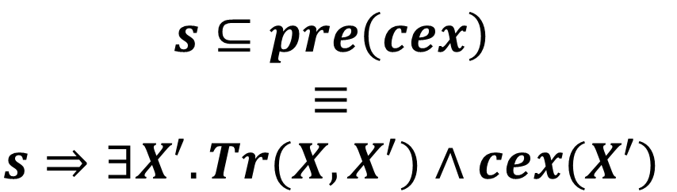
DECIDE (Arithmetic)
$$s⊆pre\left(cex\right)$$
$$≡$$
$$s⇒∃X^{′}. Tr(X, X^{′})∧cex(X^{′})$$
Computing a predecessor s of a counterexample cex

Slide 49
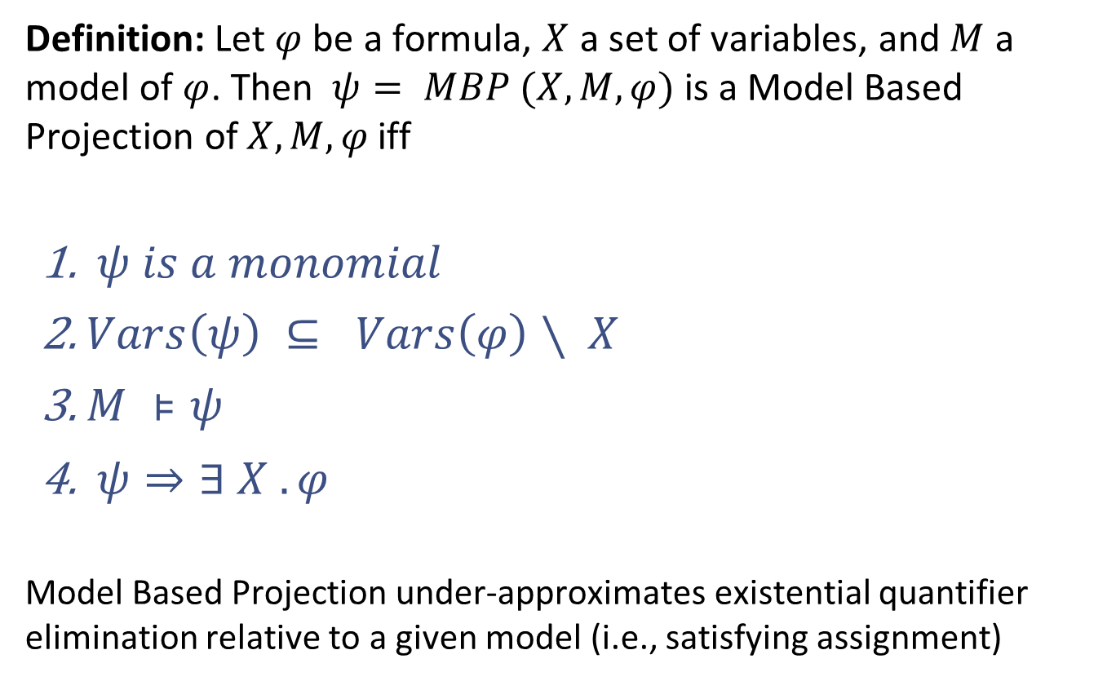
Model Based Projection
Definition: Let $φ$ be a formula, $X$ a set of variables, and $M$ a model of $φ$. Then $ψ= MBP (X, M, φ)$is a Model Based Projection of $X, M, φ$iff
  $ψ is a monomial$
  $Vars\left(ψ\right) ⊆ Vars\left(φ\right)∖ X$
  $M ⊧ψ$
  $ψ⇒∃ X . φ$
Model Based Projection under-approximates existential quantifier elimination relative to a given model (i.e., satisfying assignment)

Slide 50
Model Based Projection
Expensive to find a quantifier-free
Find model M of φ (x,y)
M
Models of
2. Compute a partition containing M

Slide 51
Quantifier Elimination
Quantifier elimination procedure:
Input: formula ∃ x ψ(x)
Output: equivalent 𝜑 without existential quantifier. x is eliminated.
QELIM(∃ x ψ(x) ) = 𝜑 and ∃ x ψ(x) ⟺ 𝜑
Quantifier elimination in propositional logic
  QELIM(∃ x ψ(x) ) = ψ(TRUE) ∨ ψ(FALSE)
Many theories support quantifier elimination (e.g., linear arithmetic)
  but not all. No quantifier elimination for EUF,
    e.g., (∃x f(x) ≠ g(x)) cannot be expressed without the existential quantifier
Quantifier elimination is usually expensive
  e.g., propositional QELIM is exponential in the number of variables quantified

Slide 52
Loos-Weispfenning Quantifier Elimination for LRA
φ is LRA formula in Negation Normal Form
E is set of x=t atoms, U set of x < t atoms, and L set of s < x atoms
There are no other occurrences of x in φ[x]
where
The case of lower bounds is dual
  using –∞ and t+𝜖

Slide 53
Fourier–Motzkin Quantifier Elimination for LRA
Quadratic increase in the formula size per each eliminated variable

Slide 54
Quantifier Elimination with Assumptions
Quantifier elimination is simplified by a choice of a minimal upper bound
  For each choice of minimal upper bound, no increase in term size
  Dually, can use largest lower bound
How to chose an the assumptions?!
  MBP == use the order chosen by the model

Slide 55
MBP for Linear Rational Arithmetic
Compute a single disjunct from LW-QE that includes the model
  Use the Model to uniquely pick a substitution term for x
MBP techniques have been developed for
  Linear Rational Arithmetic, Linear Integer Arithmetic
  Theories of Arrays, and Recursive Data Types

Slide 56
Arithmetic Decide
Compute a predecessor using Model Based Projection
To ensure progress, Decide must be finite
  finitely many possible predecessors when all other arguments are fixed
Alternatively
  Completeness can follow from an interaction of Decide and Conflict
    but requires more rules to propagate implicants backward (as in PDR) and forward (as in Spacer and Quip)

Slide 57
PolyPDR: Solving CHC(LRA)
Unreachable and Reachable
  terminate the algorithm when a solution is found
Unfold
  increase search bound by 1
Candidate
  choose a bad state in the last frame
Decide
  extend a cex (backward) consistent with the current frame
  find a model M of s s.t. (F_{i} ⋀ Tr ⋀ cex’), and let s = MBP(X’, F_{i} ⋀ Tr ⋀ cex’)
Conflict
  construct a lemma to explain why cex cannot be extended
  Find an interpolant L s.t. L⇒¬cex , Init ⇒ L , and F_{i} ⋀ Tr ⇒ L’
Induction
  propagate a lemma as far into the future as possible
  (optionally) strengthen by dropping literals

Slide 58
Non-Linear CHC Satisfiability
Satisfiability of a set of arbitrary (i.e., linear or non-linear) CHCs is reducible to satisfiability of THREE (3) clauses of the form
where, X’ = {x’ | x 2 X}, Xº = {xº | x 2 X}, P a fresh predicate, and Init, Bad, and Tr are constraints

Slide 59
Generalized GPDR
counterexample is a tree
two predecessors
theory-aware Conflict

Slide 60
Counterexamples to non-linear CHC
A set S of CHC is unsatisfiable iff S can derive FALSE
  we call such a derivation a counterexample
For linear CHC, the counterexample is a path
For non-linear CHC, the counterexample is a tree
s’₄ 2 s₂ ∧ sº₃ ∧ Tr
s₂ 2 Init
s₃ 2 Init
s’₅ 2 s₀ ∧ sº₁ ∧ Tr
s₀ 2 Init
FALSE
s₁ 2 Init

Slide 61
GPDR Search Space
queue element
Bad
Level
In Decide, one POB in the frontier is chosen and its two children are expanded

Slide 62
GPDR: Splitting predecessors
Consider a clause
How to compute a predecessor for a proof obligation z > 0
Predecessor over the constraint is:
Need to create two separate proof obligation
  one for P(x) and one for P(y)
  gpdr solution: split by substituting values from the model (incomplete)

Slide 63
GPDR: Deciding predecessors
Compute two predecessors at each application of GPDR/Decide
Can explore both predecessors in parallel
  e.g., BFS or DFS exploration order
Number of predecessors is unbounded
  incomplete even for finite problem (i.e., non-recursive CHC)
No caching/summarization of previous decisions
  worst-case exponential for Boolean Push-Down Systems

Slide 64
Spacer
Same queue as in IC3/PDR
Cache Reachable states
Three variants of Decide
Same Conflict as in APDR/GPDR

Slide 65
SPACER Search Space
Bad
Level
In Decide, unfold the derivation tree in a fixed depth-first order
  use MBP to decide on counterexamples
Successor: Learn new facts (reachable states) on the way up
  use MBP to propagate facts bottom up

Slide 66
Successor Rule: Computing Reachable States
Computing new reachable states by under-approximating forward image using MBP
  since MBP is finite, guarantee to exhaust all reachable states
Second use of MBP
  orthogonal to the use of MBP in Decide
  can allow REACH to contain auxiliary variables, but this might explode
For Boolean CHC, the number of reachable states is bounded
  complexity is polynomial in the number of states
  same as reachability in Push Down Systems

Slide 67
Decide Rule: Must and May refinement
DecideMust
  use computed summary (REACH) to skip over a call site
DecideMay
  use over-approximation of a calling context to guess an approximation of the call-site
  the call-site either refutes the approximation (Conflict) or refines it with a witness (Successor)

Slide 68
Art, Science, and Magic
Verification of Safety Properties is FOL satisfiability
  Logic: Constrained Horn Clauses (CHC)
  “Decision” procedure: Spacer
  Now with (universal) quantifiers!
Art: finding the right encoding from the problem domain to logic
  the difference between easy to impossible
  encodings can “simulate” specialized algorithms
Science: Progress, termination (when decidable)
  while the underlying problem is undecidable, many fragment or sub-problems are decidable
Magic: actually solving useful problems
  interpolation, heuristics, generalizations, …
  the list is endless

Slide 69
THE END

