Slide 1
Vinta: Verification with INTerpolation and Abstract iterpretation
Arie Gurfinkel
Software Engineering Institute
Carnegie Mellon University
joint work with
Aws Albarghouthi, Yi Li, and Marsha Chechik University of Toronto
Sagar Chaki, SEI
TexPoint fonts used in EMF.
Read the TexPoint manual before you delete this box.: AAAA

Slide 2
NO WARRANTY
THIS CARNEGIE MELLON UNIVERSITY AND SOFTWARE ENGINEERING INSTITUTE MATERIAL IS FURNISHED ON AN “AS-IS" BASIS. CARNEGIE MELLON UNIVERSITY MAKES NO WARRANTIES OF ANY KIND, EITHER EXPRESSED OR IMPLIED, AS TO ANY MATTER INCLUDING, BUT NOT LIMITED TO, WARRANTY OF FITNESS FOR PURPOSE OR MERCHANTABILITY, EXCLUSIVITY, OR RESULTS OBTAINED FROM USE OF THE MATERIAL. CARNEGIE MELLON UNIVERSITY DOES NOT MAKE ANY WARRANTY OF ANY KIND WITH RESPECT TO FREEDOM FROM PATENT, TRADEMARK, OR COPYRIGHT INFRINGEMENT.
Use of any trademarks in this presentation is not intended in any way to infringe on the rights of the trademark holder.
This Presentation may be reproduced in its entirety, without modification, and freely distributed in written or electronic form without requesting formal permission. Permission is required for any other use. Requests for permission should be directed to the Software Engineering Institute at permission@sei.cmu.edu.
This work was created in the performance of Federal Government Contract Number FA8721-05-C-0003 with Carnegie Mellon University for the operation of the Software Engineering Institute, a federally funded research and development center. The Government of the United States has a royalty-free government-purpose license to use, duplicate, or disclose the work, in whole or in part and in any manner, and to have or permit others to do so, for government purposes pursuant to the copyright license under the clause at 252.227-7013.

Slide 3

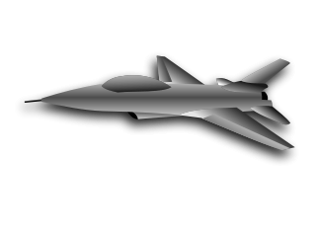


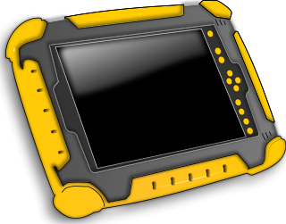


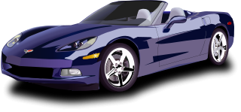
Software is Everywhere

Slide 4


Software is Everywhere
“Software easily rates as the most poorly constructed, unreliable, and least maintainable technological artifacts invented by man”
Paul Strassman, former CIO of Xerox

Slide 5
Recent Software Disasters
In July 2010, The Food and Drug Administration ordered Baxter International to recall all of its Colleague infusion pumps in use and provide a refund or no-cost replacement to United States customers. It has been working with Baxter since 1999 to correct numerous device flaws. Some of the issues were caused by simple buffer overflow.
In January 2011, two German researchers have shown that most “feature” mobile phones can be “killed” by sending a simple SMS message (SMS of Death). The attack exploits many bugs in the implementation of SMS protocol in the phones. It can potentially bring down all mobile communication…
On August 1, 2012, Knight Capital's bugs in high-frequency trading algorithm caused a pre-tax loss of $440m. The nature of the bug was described as a "technology breakdown".

Slide 6
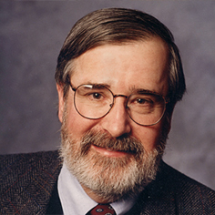
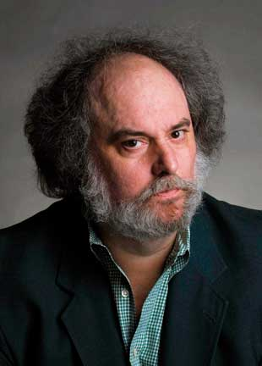
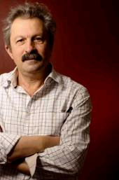
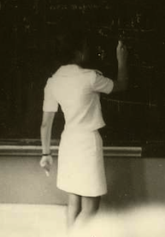
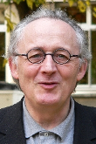
Automated Software Analysis
Automated
Analysis
Correct
Program
Incorrect
Software Model Checking with Predicate Abstraction
e.g., Microsoft’s SDV
Abstract Interpretation with Numeric Abstraction
e.g., ASTREE, Polyspace

Slide 7
Motivation
Abstract Interpretation is one of the most scalable approaches for program verification
But, in practice, AI suffers from many false positives due to
  imprecise operations: join, widen
  imprecise semantics of operations: abstract post
  in-expressivity of abstract domains: weakly relational facts, …
No CounterExamples and No Refinement
Goal: Enhance Abstract Interpretation with Interpolation-based refinement strategy

Slide 8
Outline (of the rest of the talk)
Numeric Abstract Interpretation
Vinta illustrated
  Abstract Interpretation with Unfoldings
  Abstract-Interpretation guided DAG-Interpolation Refinement
Implementation
Results of Software Verification Competition
Secret Sauce
Conclusions and Future Directions

Slide 9
Numeric Abstract Interpretation
Analysis is restricted to a fixed Abstract Domain
Abstract Domain ≡ “a (possibly infinite) set of predicates from a fixed theory” + efficient (abstract) operations
Common Numeric Abstract Domains
Abstract Domain | Abstract Elements
Sign | 0 < x, x = 0, x > 0
Box (or Interval) | c₁ ≤ x ≤ c₂
Octagon | ± x ± y ≤ c
Polyhedra | a₁x₁ + a₂x₂ + a₃x₃ + a₄ ≤ 0
Legend
x,y | program variables
c,c_{i},a_{i} | numeric constants

Slide 10

Abstract Interpretation w/ Box Domain (1)
Program
if (3 <= y1 <= 4) {
x1 := y1-2;
x2 := y1+2;
}
else if (3 <= y2 <= 4) {
x1 := y2-2;
x2 := y2+2;
}
else return;
assert (5 <= x1 + x2 <= 10);
3 <= y1 <= 4
3 <= y1 <= 4
1 <= x1 <= 2
5 <= x2 <= 6
3 <= y2 <= 4
1 <= x1 <= 2
5 <= x2 <= 6
1<=x1<=2
5<=x2<=6
3 <= y2 <= 4
Steps:
1
2
3
4
5

Slide 11
Abstract Interpretation w/ Box Domain (2)
Program
0<= x <=2
x := 0
while (x < 1000) {
x := x + 1;
}
assert (x == 1000);
0<= x <=1000
0<= x <=1
x = 0
0<= x <=2
x = 0
0<= x < 1000
0<= x <=1
widening
1<= x <=3
x = 1
1<= x <= 1000
1<= x <=2
x = 1000
Steps:
1
2
3
4
5
6
7
8
9
10
11
12
13
14

Slide 12
Abstract Domain as an Interface
interface AbstractDomain(V) :
  V – set of variables
  A – abstract elements
  E – expressions
  S – statements
α : E → A γ : A → E meet : A × A → A
isTop : A → bool isBot : A → bool join : A × A → A
leq : A × A → bool αPost : S → (A → A) widen : A × A → A
All operations are over-approximations, e.g.,
γ (a) || γ (b) ⇒ γ ( join (a, b) )
γ (a) && γ (b) ⇒ γ (meet (a,b) )
abstract
concretize
order
abstract transformer

Slide 13
Example: Box Abstract Domain
abstract
concretize
α
γ
1 ≤ x ≤ 10
(1, 10)
1 ≤ x ≤ 10
Definition of Operations
Examples
(a, b) meet (c, d) = (max(a,c), min(b,d))
(1, 10) meet (2, 12) = (2,10)
(a, b) join (c, d) = (min(a,c),max(b,d))
(1, 3) join (7, 12) = (1,12)
αPost (x := x + 1) ((a, b)) = (a+1, b+1)
(1, 10) + 1 = (2, 11)
over-approximation

Slide 14
Abstract Interpretation w/ Box Domain (3)
Program
assume (i=1 || i=2)
if (i = 1)
x1 := i;
else if (i = 2)
x2 := -4;
if (i = 1)
assert (x1 > 0);
else if (i = 2)
assert (x2 < 0);
1 <= i <= 2
i=1
1 <= i <= 2
i=1 && x1=1
Loss of precision due to join
i=2
i=2 && x2=-4
i=1
i=2
False
Positive
Steps:
1
2
3
4
5
6
7
8

Slide 15

Vinta: Verification with INTERP and AI
SAFE
(+Invariant)
UNSAFE
(+CEX)
Unsafe Invariant
Abstract
Interpretation
Refinement
Program
Interpolation
Strengthening
  uses Cutpoint Graph (CPG)
  maintains an unrolling of CPG
  computes disjunctive invariants
  uses novel powerset widening
  uses SMT to check for CEX
  DAG Interpolation for Refinement
  Guided by AI-computed Invs
  Fills in “gaps” in AI

Slide 16
Example: AI phase
Exploration: WTO
Abstract Domain: Intervals
Side effect: Labelled CFG unrolling
1: x = 10;
2: while (*)
x = x - 2;
if (x == 9)
3: error();
1
2
Alarm!
2’
3
2’’

Slide 17



Verification Conditions
1
1: x = 10;
2: while (*)
x = x - 2;
if (x == 9)
3: error();
2
2’
3
2’’
Instruction encoding
Control-flow encoding

Slide 18
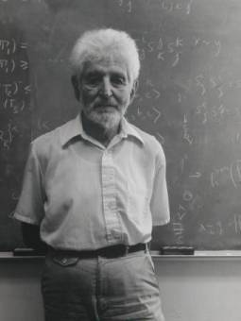
Craig Interpolation Theorem
Theorem (Craig 1957)
Let A and B be two First Order (FO) formulae such that A ) :B, then there exists a FO formula I, denoted ITP(A, B), such that
A ) I I ) :B atoms(I) 2 atoms(A) Å atoms(B)
Theorem (McMillan 2003)
A Craig interpolant ITP(A, B) can be effectively constructed from a resolution proof of unsatisfiability of A Æ B
In Model Cheching, Craig Interpolation Theorem is used to safely over-approximate the set of (finitely) reachable states

Slide 19
DAG Interpolants [TACAS’12]
Given a DAG G = (V, E) and a labeling of edges ¼:E→Expr. A DAG Interpolant (if it exists) is a labeling I:V→Expr such that
  for any path v₀, …, v_{n}, and 0 < k < n, I(v_{k}) = ITP (¼(v₀) Æ … Æ ¼ (v_{k-1}), ¼(v_{k}) Æ … Æ ¼(v_{n}))
  8 (u, v) 2 E . (I(u) Æ ¼ (u, v)) ) I(v)
1
I₁
¼₁
2
I₂
I₂ = ITP (¼₁, ¼₈)
I₂ = ITP (¼₁, ¼₂ Æ ¼₃ Æ ¼₆ Æ ¼₇)
…
(I₁ Æ ¼₁) ) I₂
(I₂ Æ ¼₈) ) I₇
(I₂ Æ ¼₂) ) I₃
…
¼₂
I₃
¼₃
3
¼₄
¼₈
4
I₄
5
I₅
I₇
7
¼₆
¼₅
¼₇
6
I₆

Slide 20
DAG Interpolation Algorithm [TACAS’12]
Reduce DAG Interpolation to Sequence Interpolation!
Encode input DAG by a set of constraints. One constraint per vertex.
DagItp ((V, E), ¼)
{
(A₀, …, A_{n}) = Encode(V, E, ¼)
(I₁, …, I_{n-1}) = SeqItp(A₀, …, A_{n})
for i in [1, n-1] do J_{i} = Clean(I_{i})
return (J₁, …, J_{n-1})
}
Compute interpolant sequence. One interpolant per vertex.
Remove out-of-scope variables

Slide 21




In our running example…
1
2
2’
3
2’’
How to use the results of AI here?

Slide 22






Restricted DAG Interpolants
1
2
2’
3
2’’

Slide 23

Refinement: Strengthening
1
1: x = 10;
2: while (*)
x = x - 2;
if (x == 9)
3: error();
Program is safe!
2
2’
3
3
2’’
2’’’
2’’’

Slide 24
VINTA from 30,000 ft
Abstract Interpretation
Refinement w/ DAG Interpolants
Refinement
Alarm!

Slide 25
VINTA from 30,000 ft
Abstract Interpretation
Refinement w/ DAG Interpolants
Refinement
Strengthening
Refinement recovers imprecision in:
  Join, Widening
  Abstract Transformer
  Inexpressive Abstract Domain

Slide 26

Vinta is part of UFO
A framework and a tool for software verification
Tightly integrates interpolation- and abstraction-based techniques
Check it out at:
http://bitbucket.org/arieg/ufo
References:
[SAS12] Craig Interpretation
[CAV12] UFO: A Framework for Abstraction- and Interpolation-based Software Verification
[TACAS12] From Under-approximations to Over-approximations and Back
[VMCAI12] Whale: An Interpolation-based Algorithm for Interprocedural Verification

Slide 27
Implementation in UFO Framework
C Program
with assertions
C to LLVM
Optimizer
Cutpoint Graph
Mathsat
SMT interface
ARG Constructor
Z3
Refinement Strategy
Abstract Post
Expansion Strategy

Slide 28
Software Verification Competition (SV-COMP 2013)

Slide 29
SV-COMP 2013
http://sv-comp.sosy-lab.org/2013/
2nd Software Verification Competition held at TACAS 2013
Goals
  Provide a snapshot of the state-of-the-art in software verification to the community.
  Increase the visibility and credits that tool developers receive.
  Establish a set of benchmarks for software verification in the community.
Participants:
  BLAST, CPAChecker-Explicit, CPAChecker-SeqCom, CSeq, ESBMC, LLBMC, Predator, Symbiotic, Threader, UFO, Ultimate
Benchmarks:
  C programs with ERROR label (programs include pointers, structures, etc.)
  Over 2,000 files, each 2K – 100K LOC
  Linux Device Drivers, SystemC, “Old” BLAST, Product Lines
  http://sv-comp.sosy-lab.org/2013/benchmarks.php

Slide 30
SV-COMP 2013: Scoring Scheme
Points | Reported Result | Description
0 | UNKNOWN | Failure to compute verification result, out of resources, program crash.
+1 | FALSE/UNSAFE correct | The error in the program was found and an error path was reported.
-4 | FALSE/UNSAFE wrong | An error is reported for a program that fulfills the property (false alarm, incomplete analysis).
+2 | TRUE/SAFE correct | The program was analyzed to be free of errors.
-8 | TRUE/SAFE wrong | The program had an error but the competition candidate did not find it (missed bug, unsound analysis).
Ties are broken by run-time

Slide 31
UFO/VINTA Results
VINTA was the main reasoning engine used by UFO at SV-COMP
UFO won in 4 categories
  Control Flow Integers (perfect score)
  Product Lines (perfect score)
  Device Drivers
  SystemC
VINTA with Box domain was most competitive for bug-discovery
VINTA with Boxes domain was most competitive for proving safety
http://sv-comp.sosy-lab.org/2013/results/index.php

Slide 32
The Secret Sauce
UFO Front-End
Boxes Abstract Domain
Parallel Verification Strategy

Slide 33
UFO Front End
In principle simple, but in practice very messy
  CIL passes to normalize the code (library functions, uninitialized vars, etc.)
  llvm-gcc (without optimization) to compile C to LLVM bitcode
  llvm opt with many standard, custom, and modified optimizations
    lower pointers, structures, unions, arrays, etc. to registers
    constant propagation + many local optimizations
    difficult to preserve indented semantics of the benchmarks
    based on very old LLVM 2.6 (newer version of LLVM are “too smart”)
Many benchmarks discharged by front-end alone
  1,321 SAFE (out of 1,592) and 19 UNSAFE (out of 380)
C Program
with assertions
C to LLVM
Optimizer
Cutpoint Graph

Slide 34
Boxes Abstract Domain: Semantic View
Boxes are “finite union of box values”
(alternatively)
Boxes are “Boolean formulas over interval constraints”

Slide 35
Linear Decision Diagrams in a Nutshell*
Linear Decision Diagram
Linear Arithmetic Formula
(x + 2y < 10) OR
(x + 2y ≥ 10 AND z < 10)
false
edge
x + 2y < 10
Compact Representation
decision
node
z < 10
Sharing sub-expressions
Local numeric reductions
Dynamic node reordering
true
edge
Operations
0
1
Propositional (AND, OR, NOT)
Existential Quantification
false
terminal
true
terminal
*joint work w/ Ofer Strichman

Slide 36
Boxes: Representation
LDD
Syntax
Semantics
3
(x ≤ 1 || x ≥ 2)
&&
1 ≤ y ≤ 3
1
1
2
Represented by (Interval) Linear Decision Diagrams (LDD)
  BDDs + non-terminal nodes are labeled by interval constraints + extra rules
  retain complexity of BDD operations
  canonical representation for Boxes Abstract Domain
  available at http://lindd.sf.net

Slide 37
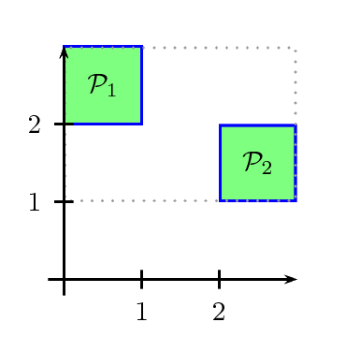
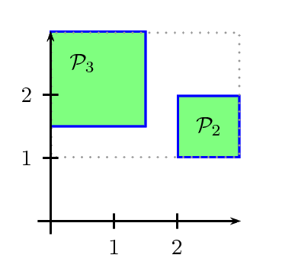
Widening: The Problem
( x ≤ 1 ∧ 2 ≤ y ≤ 3) ∨
(2 ≤ x ≤ 3 ∧ 1 ≤ y ≤ 2)
( x ≤ 1.5 ∧ 1.5 ≤ y ≤ 3) ∨
(2 ≤ x ≤ 3 ∧ 1 ≤ y ≤ 2)
widen

Slide 38
Parallel Verification Strategy
Run 7 verification strategies in parallel until a solution is found
  cpredO3
    all LLVM optimizations + Cartesian Predicate Abstraction
  bpredO3
    all LLVM optimizations + Boolean PA + 20s TO
  bigwO3
    all LLVM optimizations + BOXES + non-aggressive widening + 10s TO
  boxesO3
    all LLVM optimizations + BOXES + aggressive widening
  boxO3
    all LLVM optimizations + BOX + aggressive widening + 20s TO
  boxesO0
    minimal LLVM optimizations + BOXES + aggressive widening
  boxbpredO3
    all LLVM opts + BOX + Boolean PA + aggressive widening + 60s TO

Slide 39


Vinta Family
Interpolation-based interprocedural analysis
Interpolants as procedure summaries
State/transition interpolation
  a.k.a. Tree Interpolants
Whale [VMCAI12]
Refinement with DAG interpolants
Tight integration of interpolation-based verification with predicate abstraction
UFO [TACAS12]
Refinement of Abstract Interpretation (AI)
AI-guided DAG Interpolation
Vinta [SAS12]

Slide 40
Future Work
Symbolic Abstraction
  An abstract domain based on SMT-formulae
DAG Interpolation via (Non-Recursive) Horn Clause Solving
  DAG Interpolation is an instance of Horn Clause Satisfiability Problem
  Need to better understand how to combine Interpolation and Inductive Generalization-based solutions
Tighter integration of existing engines and passes
  our current solution is “embarrassingly parallel”
  there are many other strategies with better defined communication between components and “failed” attempts
Concurrency

Slide 41
Contact Information
Presenter Arie Gurfinkel RTSS Telephone: +1 412-268-7788 Email: arie@cmu.edu | U.S. mail: Software Engineering Institute Customer Relations 4500 Fifth Avenue Pittsburgh, PA 15213-2612 USA
Web: www.sei.cmu.edu http://www.sei.cmu.edu/contact.cfm | Customer Relations Email: info@sei.cmu.edu Telephone: +1 412-268-5800 SEI Phone: +1 412-268-5800 SEI Fax: +1 412-268-6257

Slide 42
THE END

