Slide 1


Algorithmic Logic-Based Verification with SeaHorn
Arie Gurfinkel
Department of Electrical and Computer Engineering
University of Waterloo
Waterloo, Ontario, Canada
http://ece.uwaterloo.ca/~agurfink
Notes:
Title Slide
Title and Subtitle text blocks should not be moved from their position if at all possible.

Slide 2
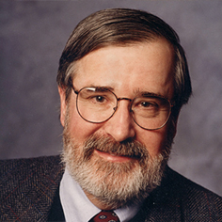
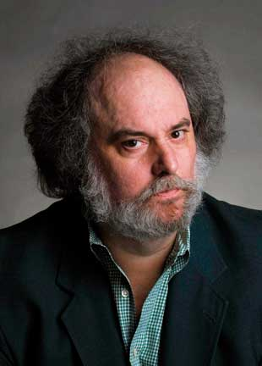

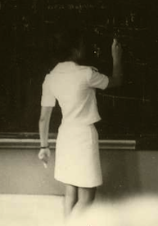
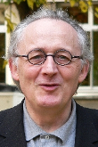
Automated Software Analysis
Automated
Analysis
Correct
Program
Incorrect
Software Model Checking with Predicate Abstraction
e.g., Microsoft’s SDV
Abstract Interpretation with Numeric Abstraction
e.g., ASTREE, Polyspace

Slide 3
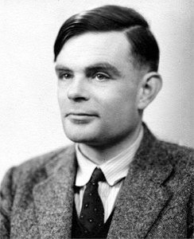
Turing, 1936: “undecidable”

Slide 4
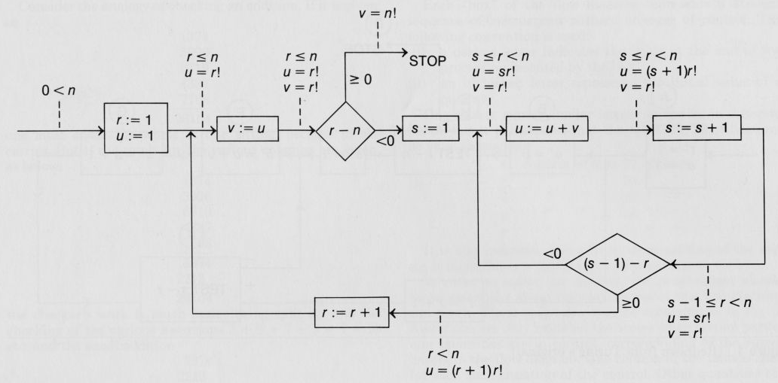
Turing, 1949
Alan M. Turing. “Checking a large routine”, 1949
4

Slide 5
Automated Software Analysis
J. McCarthy, “A basis for mathematical theory of computation”, 1963.
P. Naur, “Proof of algorithms by general snapshots”, 1966.
R. W. Floyd, “Assigning meaning to programs”, 1967.
C.A.R Hoare, “An axiomatic basis for computer programming”, 1969.
E. W. Dijkstra: “Guarded Commands, Nondeterminacy and Formal derivation ”, 1975.
Notes:
Dijkstra presented the first semi-algorithmic view of the Floyd-Hoare logic based on the ideas of predicate transformers.

Slide 6
Automated Verification
Deductive Verification
  A user provides a program and a verification certificate
    e.g., inductive invariant, pre- and post-conditions, function summaries, etc.
  A tool automatically checks validity of the certificate
    this is not easy! (might even be undecidable)
  Verification is manual but machine certified
Algorithmic Verification (My research area)
  A user provides a program and a desired specification
    e.g., program never writes outside of allocated memory
  A tool automatically checks validity of the specification
    and generates a verification certificate if the program is correct
    and generates a counterexample if the program is not correct
  Verification is completely automatic – “push-button”

Slide 7

Algorithmic Logic-Based Verification
Safety Properties
Program + Spec
Verification Condition (in Logic)
Decision Procedure
Constrained Horn Clauses
Spacer
Yes
No

Slide 8
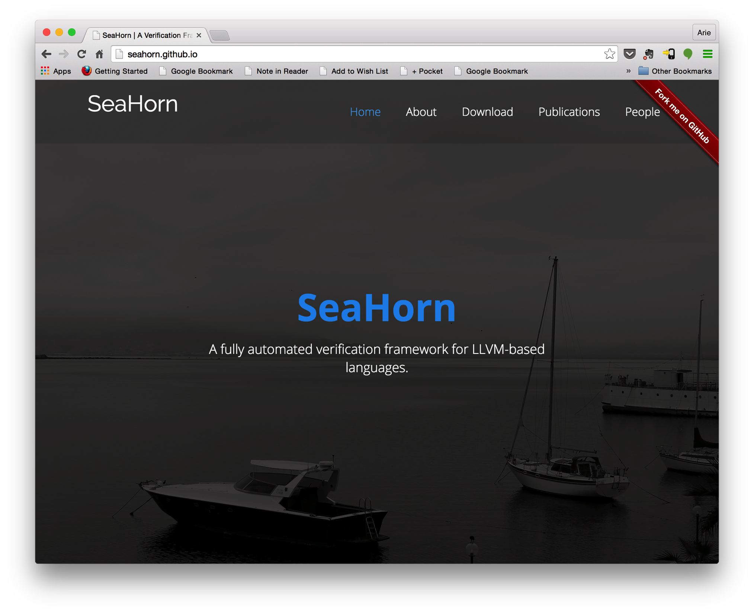
http://seahorn.github.io

Slide 9
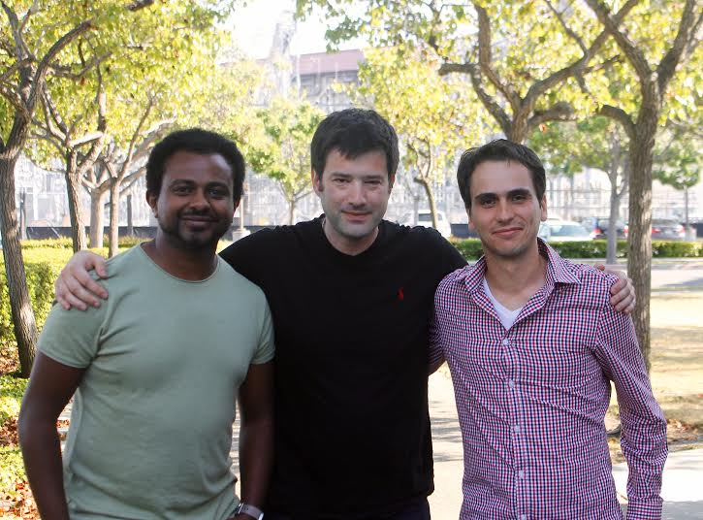
Temesghen Kahsai (NASA/CMU)
Jorge Navas (SRI)
http://seahorn.github.io

Slide 10
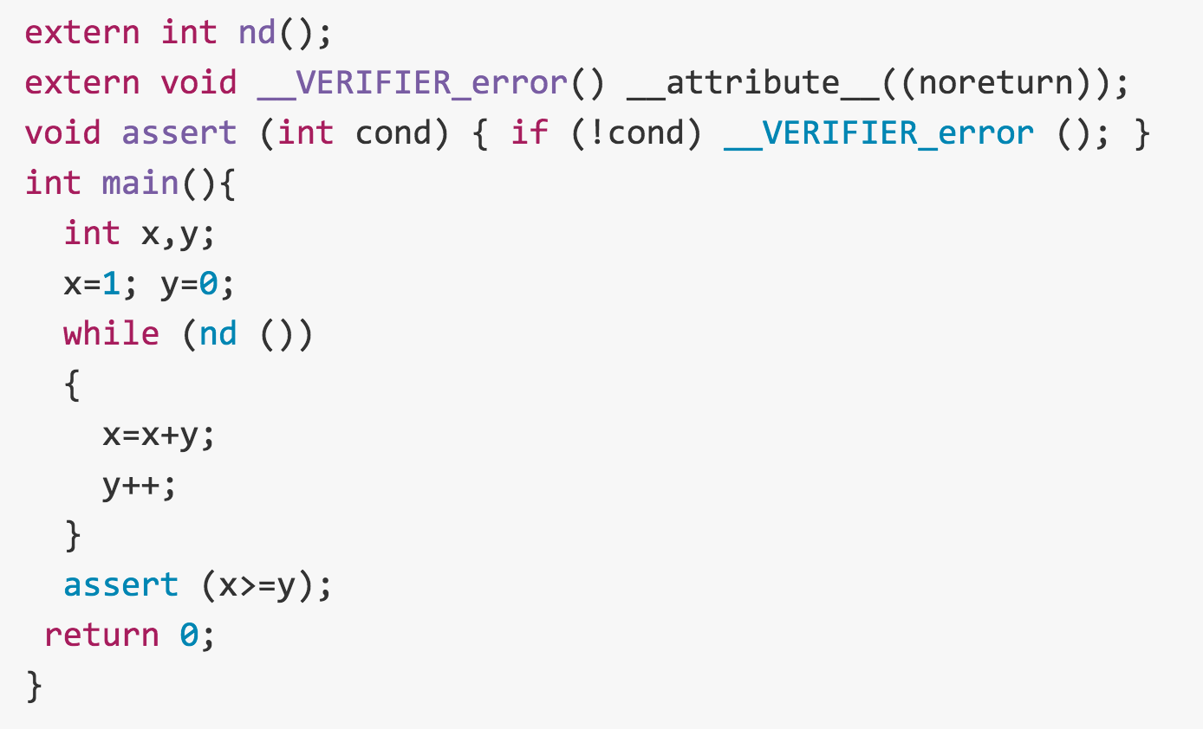

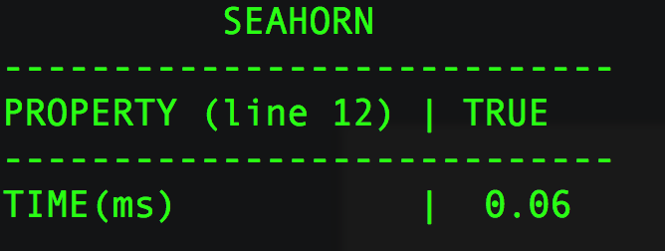


SeaHorn Usage
Example: in test.c, check that x is always greater than or equal to y
test.c
SeaHorn result:
SeaHorn command:

Slide 11
SeaHorn Philosophy
Build a state-of-the-art Software Model Checker
  useful to “average” users
    user-friendly, efficient, trusted, certificate-producing, …
  useful to researchers in verification
    modular design, clean separation between syntax, semantics, and logic, …
Stand on the shoulders of giants
  reuse techniques from compiler community to reduce verification effort
    SSA, loop restructuring, induction variables, alias analysis, …
    static analysis and abstract interpretation
  reduce verification to logic
    verification condition generation
    Constrained Horn Clauses
Build reusable logic-based verification technology
  “SMT-LIB” for program verification

Slide 12
Three-Layers of a Program Verifier
Compiler
  compiles surface syntax a target machine
  embodies syntax with semantics
Verification Condition Generator
  transforms a program and a property to a verification condition in logic
  employs different abstractions, refinements, proof-search strategies, etc.
Automated Theorem Prover / Reasoning Engine
  discharges verification conditions
  general purpose constraint solver
  SAT, SMT, Abstract Interpreter, Temporal Logic Model Checker,…

Slide 13
SeaHorn Architecture

Slide 14
DEMO

Slide 15
Solving chc with smt
Spacer

Slide 16
Boolean Satisfiability
Let V be a set of variables
A literal is either a variable v in V or its negation ~v
A clause is a disjunction of literals
  e.g., (v1 || ~v2 || v3)
A Boolean formula in Conjunctive Normal Form (CNF) is a conjunction of clauses
  e.g., (v1 || ~v2) && (v3 || v2)
An assignment s of Boolean values to variables satisfies a clause c if it evaluates at least one literal in c to true
An assignment s satisfies a formula C in CNF if it satisfies every clause in C
Boolean Satisfiability Problem (SAT):
  determine whether a given CNF C is satisfiable

Slide 17
CNF-SAT: Boolean Satisfiability
Decide whether a Boolean formula is satisfiable
  Quintessential NP-complete problem
  Hard, but effectively solvable in practice
DPLL (Davis-Putnam-Logemman-Loveland, ‘60)
  smart enumeration of all possible SAT assignments
  worst-case EXPTIME
  alternate between deciding and propagating variable assignments
CDCL (GRASP ‘96, Chaff ‘01)
  conflict-driven clause learning
  extends DPLL with
    smart data structures, backjumping, clause learning, heuristics, restarts…
  scales to millions of variables

Slide 18
from M. Vardi, https://www.cs.rice.edu/~vardi/papers/highlights15.pdf

Slide 19
SMT: Satisfiability Modulo Theory
Satisfiability of Boolean formulas over atoms in a theory
  e.g., (x < 0) && (x >= 0)
Extends syntax of Boolean formulas with functions and predicates
  +, -, div, select, store, bvadd, etc.
Existing solvers support many theories useful for program analysis
  Equality and Uninterpreted Functions: f(x)
  Real/Integer Linear Arithmetic: x + 2*y <= 3
  Unbounded Arrays: a[i], a[i := v]
  Bitvectors (a.k.a. machine integers): x >> 3, x/3
  Floating point: 3.0 * x
  …

Slide 20
Safety Verification Problem
Is Bad reachable?
INIT
Bad

Slide 21
Safety Verification Problem
Is Bad reachable?
……
INIT
Bad
Yes. There is a counterexample!

Slide 22
Safety Verification Problem
Is Bad reachable?
Inv
Bad
INIT
No. There is an inductive invariant

Slide 23
Symbolic Reachability Problem
P = (V, Init, Tr, Bad)
P is UNSAFE if and only if there exists a number N s.t.
P is SAFE if and only if there exists a safe inductive invariant Inv s.t.
Inductive
Safe

Slide 24
Constrained Horn Clauses (CHC)
A Constrained Horn Clause (CHC) is a FOL formula of the form
8 V . (Á Æ p₁[X₁] Æ…Æ p_{n}[X_{n}] → h[X]),
where
  A is a background theory (e.g., Linear Arithmetic, Arrays, Bit-Vectors, or combinations of the above)
  Á is a constrained in the background theory A
  p₁, …, p_{n}, h are n-ary predicates
  p_{i}[X] is an application of a predicate to first-order terms
A model of a set of clauses is an interpretation of the predicates p_{i} and h that makes all clauses valid
A set of clauses is satisfiable iff it has a model

Slide 25
From Programs to Logic
Program
CFG
CHC

Slide 26
Spacer: Solving SMT-constrained CHC
Spacer: a solver for SMT-constrained Horn Clauses
  stand-alone implementation in a fork of Z3
  http://bitbucket.org/spacer/code
Support for Non-Linear CHC
  model procedure summaries in inter-procedural verification conditions
  model assume-guarantee reasoning
  uses MBP to under-approximate models for finite unfoldings of predicates
  uses MAX-SAT to decide on an unfolding strategy
Supported SMT-Theories
  Best-effort support for arbitrary SMT-theories
    data-structures, bit-vectors, non-linear arithmetic
  Full support for Linear arithmetic (rational and integer)
  Quantifier-free theory of arrays
    only quantifier free models with limited applications of array equality

Slide 27
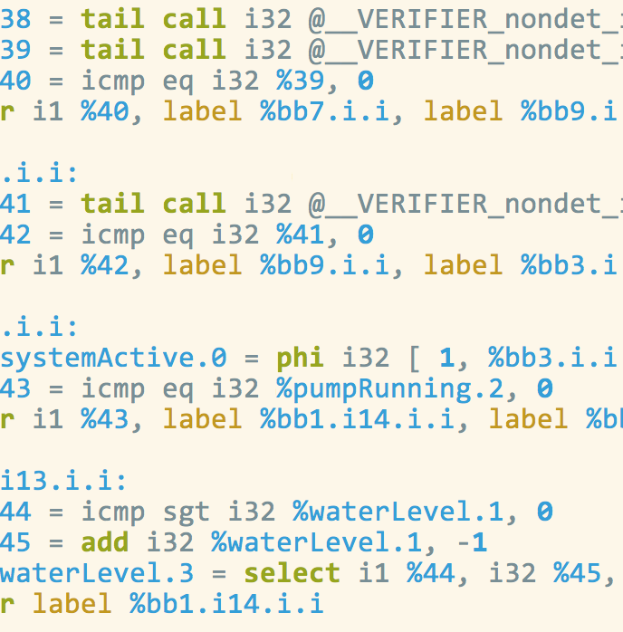
Verification by Evolving Approximations
approx. 1
approx. 2
approx. 3
solver
solver
solver
Lemma3
Lemma1
Lemma2
Inductive Invariant
Lemma3
Lemma1
Lemma2
Inductive Invariant
Lemma3
Lemma1
Lemma2
Inductive Invariant
Safe?
No
Safe?
No
Safe?
No

Slide 28
IC3, PDR, and Friends (1)
IC3: A SAT-based Hardware Model Checker
  Incremental Construction of Inductive Clauses for Indubitable Correctness
  A. Bradley: SAT-Based Model Checking without Unrolling. VMCAI 2011
PDR: Explained and extended the implementation
  Property Directed Reachability
  N. Eén, A. Mishchenko, R. K. Brayton: Efficient implementation of property directed reachability. FMCAD 2011
PDR with Predicate Abstraction (easy extension of IC3/PDR to SMT)
  A. Cimatti, A. Griggio, S. Mover, St. Tonetta: IC3 Modulo Theories via Implicit Predicate Abstraction. TACAS 2014
  J. Birgmeier, A. Bradley, G. Weissenbacher: Counterexample to Induction-Guided Abstraction-Refinement (CTIGAR). CAV 2014

Slide 29
IC3, PDR, and Friends (2)
GPDR: Non-Linear CHC with Arithmetic constraints
  Generalized Property Directed Reachability
  K. Hoder and N. Bjørner: Generalized Property Directed Reachability. SAT 2012
SPACER: Non-Linear CHC with Arithmetic
  fixes an incompleteness issue in GPDR and extends it with under-approximate summaries
  A. Komuravelli, A. Gurfinkel, S. Chaki: SMT-Based Model Checking for Recursive Programs. CAV 2014
PolyPDR: Convex models for Linear CHC
  simulating Numeric Abstract Interpretation with PDR
  N. Bjørner and A. Gurfinkel: Property Directed Polyhedral Abstraction. VMCAI 2015
ArrayPDR: CHC with constraints over Airthmetic + Arrays
  Required to model heap manipulating programs
  A. Komuravelli, N. Bjørner, A. Gurfinkel, K. L. McMillan:Compositional Verification of Procedural Programs using Horn Clauses over Integers and Arrays. FMCAD 2015

Slide 30
Algorithm Overview
bounded safety
strengthen result

Slide 31
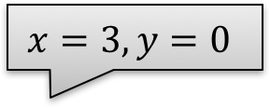
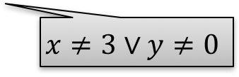
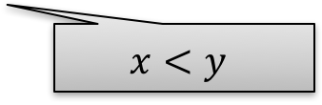

IC3/PDR In Pictures: MkSafe
MkSafe
$$x=3,y=0$$
$$x=1,y=0$$
$$x<y$$
$$x≠3∨y≠0$$

Slide 32
IC3/PDR in Pictures: Push
Push
Inductive
Algorithm Invariants
R_{i} → : Bad Init → R_{i}
R_{i} → R_{i+1} R_{i} Æ ½ → R_{i+1}

Slide 33
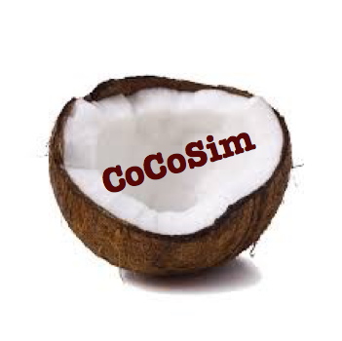



Logic-based Algorithmic Verification
Simulink
C/C++
concurrent /distributed systems
Java
SeaHorn
Lustre
CPR
Termination for C
T2
Spacer

Slide 34
SV-COMP 2015
http://sv-comp.sosy-lab.org/2015/
4th Competition on Software Verification held at TACAS 2015
Goals
  Provide a snapshot of the state-of-the-art in software verification to the community.
  Increase the visibility and credits that tool developers receive.
  Establish a set of benchmarks for software verification in the community.
Participants:
  Over 22 participants, including most popular Software Model Checkers and Bounded Model Checkers
Benchmarks:
  C programs with error location (programs include pointers, structures, etc.)
  Over 6,000 files, each 2K – 100K LOC
  Linux Device Drivers, Product Lines, Regressions/Tricky examples
  http://sv-comp.sosy-lab.org/2015/benchmarks.php

Slide 35
Results for DeviceDriver category

Slide 36
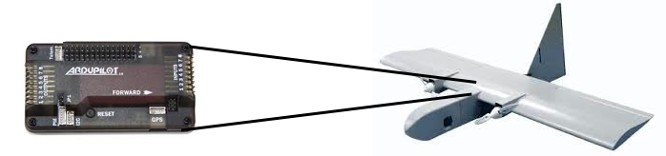
Applications of SeaHorn at NASA
Absence of Buffer Overflows
  Open source auto-pilots
    paparazzi and mnav autopilots
  Automatically instrument buffer accesses with runtime checks
  Use SeaHorn to validate that run-time checks never fail
    slower than pure abstract interpretation
    BUT, much more precise!
Verify Level 5 requirements of the LADEE software stack
  Manually encode requirements in Simulink model
  Verify that the requirements hold in auto-generated C
Memory safety of C++ controller code
  ongoing…

Slide 37
Conclusion
SeaHorn (http://seahorn.github.io)
  a state-of-the-art Software Model Checker
  LLVM-based front-end
  CHC-based verification engine
  a framework for research in logic-based verification
The future
  making SeaHorn useful to the consumers of verification technology
    counterexamples, build integration, property specification, proofs,
  Concurrent / distributed / embedded systems
    cyber-physical systems
    very challenging but there are many opportunities
  richer properties
    termination[TACAS’16], liveness, synthesis

Slide 38

?
?
?
?
?
?

Slide 39
IC3/PDR
Notes:
Invariant of PDR

Slide 40
IC3/PDR: Solving Linear (Propositional) CHC
Unreachable and Reachable
  terminate the algorithm when a solution is found
Unfold
  increase search bound by 1
Candidate
  choose a bad state in the last frame
Decide
  extend a cex (backward) consistent with the current frame
  choose s s.t. (s ⋀ R_{i} ⋀ Tr ⋀ cex’) is SAT
Conflict
  Find a lemma that explains why cex cannot be extended
  Find L s.t. L⇒¬cex and L ⋀ R_{i} ⋀ Tr ⇒ L’
Induction
  Propositional generalization (drop literals from the lemma)
Theory dependent

Slide 41
ARITHMETIC Conflict
Looking for φ’

Slide 42
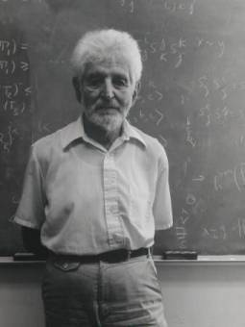
Craig Interpolation Theorem
Theorem (Craig 1957)
Let A and B be two First Order (FO) formulae such that A ) :B, then there exists a FO formula I, denoted ITP(A, B), such that
A ) I I ) :B
atoms(I) 2 atoms(A) Å atoms(B)
A Craig interpolant ITP(A, B) can be effectively constructed from a resolution proof of unsatisfiability of A Æ B
In Model Cheching, Craig Interpolation Theorem is used to safely over-approximate the set of (finitely) reachable states

Slide 43
Craig Interpolant
I
B
A

Slide 44
Examples of Craig Interpolation for Theories
Boolean logic
Equality with Uniterpreted Functions (EUF)
Linear Real Arithmetic (LRA)

Slide 45
Alternative Definition of an Interpolant
Let F = A(x, z) Æ B(z, y) be UNSAT, where x and y are distinct
  Note that for any assignment v to z either
    A(x, v) is UNSAT, or
    B(v, y) is UNSAT
An interpolant is a circuit I(z) such that for every assignment v to z
  I(v) = A only if A(x, v) is UNSAT
  I(v) = B only if B(v, y) is UNSAT
A proof system S has a feasible interpolation if for every refutation ¼ of F in S, F has an interpolant polynomial in the size of ¼
  propositional resolution has feasible interpolation
  extended resolution does not have feasible interpolation

Slide 46
Farkas Lemma
Let M = t₁ ¸ b₁ Æ … Æ t_{n} ¸ b_{n}, where t_{i} are linear terms and b_{i} are constants M is unsatisfiable iff 0 ¸ 1 is derivable from M by resolution
M is unsatisfiable iff M ` 0 ¸ 1
  e.g., x + y > 10, -x > 5, -y > 3 ` (x+y-x-y) > (10 + 5 + 3) ` 0 > 18
M is unsatisfiable iff there exist Farkas coefficients g₁, …, g_{n} such that
  g_{i} ¸ 0
  g₁£t₁ + … + g_{n}£t_{n} = 0
  g₁£b₁ + … + g_{n}£b_{n} ¸ 1

Slide 47
Interpolation for Linear Real Arithmetic
Let M = A Æ B be UNSAT, where
  A = t₁ ¸ b₁ Æ … Æ t_{i} ¸ b_{i}, and
  B = t_{i+1} ¸ b_{i} Æ … Æ t_{n} ¸ b_{n}
Let g₁, …, g_{n} be the Farkas coefficients witnessing UNSAT
Then
  g₁£(t₁ ¸ b₁) + … + g_{i}£(t_{i} ¸ b_{i}) is an interpolant between A and B
  g_{i+1}£(t_{i+1} ¸ b_{i}) + … + g_{n}£ (t_{n} ¸ b_{n}) is an interpolant between B and A
  g₁£t₁ +…+g_{i}£t_{i} = - (g_{i+1}£t_{i+1} + … + g_{n}£t_{n})
  :(g_{i+1}£(t_{i+1} ¸ b_{i}) + … + g_{n}£ (t_{n} ¸ b_{n})) is an interpolant between A and B

Slide 48
Craig Interpolation for Linear Arithmetic
A = F(R_{i})
B = P
I = lemma
Useful properties of existing interpolation algorithms [CGS10] [HB12]
  I 2 ITP (A, B) then :I 2 ITP (B, A)
  if A is syntactically convex (a monomial), then I is convex
  if B is syntactically convex, then I is co-convex (a clause)
  if A and B are syntactically convex, then I is a half-space
Notes:
[CGS10] Alessandro Cimatti, Alberto Griggio, Roberto Sebastiani: Efficient generation of craig interpolants in satisfiability modulo theories. ACM Trans. Comput. Log. 12(1): 7 (2010)
[HB12] Krystof Hoder, Nikolaj Bjørner: Generalized Property Directed Reachability. SAT 2012: 157-171

Slide 49
Arithmetic Conflict
Counterexample is blocked using Craig Interpolation
  summarizes the reason why the counterexample cannot be extended
Generalization is not inductive
  weaker than IC3/PDR
  inductive generalization for arithmetic is still an open problem

Slide 50
Arithmetic DECIDE
Computing a predecessor s of a counterexample c

Slide 51
Model Based Projection
Definition: Let φ be a formula, U a set of variables, and M a model of φ. Then Ã = MBP (U, M, φ) is a Model Based Projection of U, M and φ iff
  Ã is a monomial (optional)
  Vars(Ã) µ Vars(φ) n U
  M ² Ã
  Ã ) 9 U . φ
For a fixed set of variables U and a formula φ, MBP is a function from models to formulas
MBP is finite if its range (as a function defined above) is finite

Slide 52
Model Based Projection
Expensive to find a quantifier-free
Find model M of φ (x,y)
M
Models of
2. Compute a partition containing M

Slide 53
Loos Weispfenning Quantifier Elimination
φ is LRA formula in Negation Normal Form
E is set of x=t atoms, U set of x < t atoms, and L set of s < x atoms
There are no other occurrences of x in φ[x]
where
The case of lower bounds is dual
  using –∞ and t+𝜖

Slide 54
LW-Quantifier Elimination Example

Slide 55
MBP for Linear Rational Arithmetic
Compute a single disjunct from LW-QE that includes the model
  Use the Model to uniquely pick a substitution term for x
MBP techniques have been developed for
  Linear Rational Arithmetic, Linear Integer Arithmetic
  Theories of Arrays, and Recursive Data Types

Slide 56
Arithmetic Decide
Compute a predecessor using an under-approximation of quantifier elimination – called Model Based Projection
To ensure progress, Decide must be finite
  finitely many possible predecessors when all other arguments are fixed
Alternatives
  Completeness can follow from the Conflict rule only
    for Linear Arithmetic this means using Fourier-Motzkin implicants
  Completeness can follow from an interaction of Decide and Conflict

